Slide 1
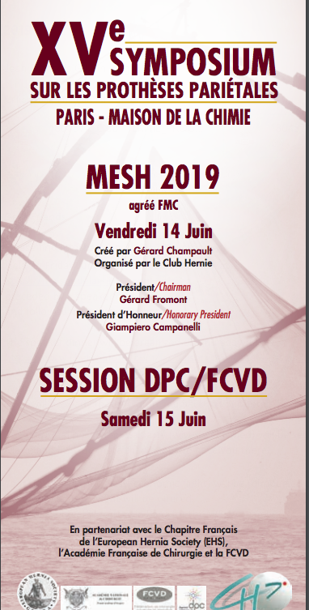



Abdominal wall reconstruction utilizing the combination of absorbable and permanent mesh in a retromuscular position with PCS + TAR
Diego Cuccurullo
AORN Ospedali dei Colli – Monaldi Hospital – Naples
General, Laparoscopic and Robotic Surgery Unit
President Italian Society of Hernia and Abdominal Wall Surgery

Slide 2
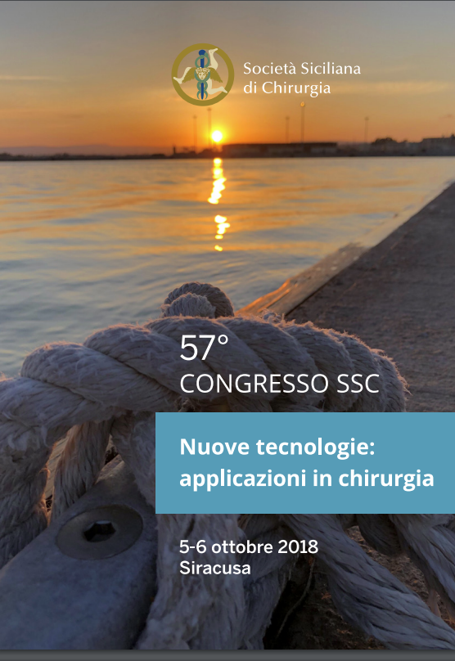
Posterior Component Separation plus TAR: indicazioni, tecniche e risultati
Diego Cuccurullo
AORN Ospedali dei Colli – Monaldi Hospital – Naples
Board Member EHS-Secretary Advisory Board Congress
National Delegate ISHAWS-Italian Chapter EHS
Chief Week Surgery Unit
General Surgery Unit
Laparoscopic and Robotic Surgery Department
Chief: Francesco Corcione

Slide 3

Outcome of abdominal wall reconstruction using bioA tissue reinforcement and 3D configuration of permanent meshes; a single center experience projected in a multi-center prospective study
CHIRURGIA DEI LAPAROCELI:
DALLA LAPAROSCOPIA ALLA COMPONENT SEPARATION
Baggiovara Modena 17/18 Aprile 2018
Diego Cuccurullo
AORN Ospedali dei Colli – Monaldi Hospital – Naples
Board Member EHS-Secretary Advisory Board Congress
National Delegate ISHAWS-Italian Chapter EHS
Chief Week Surgery Unit
General Surgery Unit
Laparoscopic and Robotic Surgery Department
Chief: Francesco Corcione

Slide 4
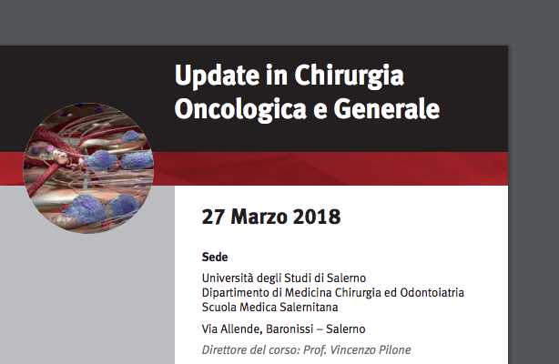
Posterior Component Separation plus TAR: indicazioni, tecniche e risultati
Diego Cuccurullo
AORN Ospedali dei Colli – Monaldi Hospital – Naples
Board Member EHS-Secretary Advisory Board Congress
National Delegate ISHAWS-Italian Chapter EHS
Chief Week Surgery Unit
General Surgery Unit
Laparoscopic and Robotic Surgery Department
Chief: Francesco Corcione

Slide 5
Outcome of abdominal wall reconstruction using bioA tissue reinforcement and 3D configuration of permanent meshes; a single center experience projected in a multi-center prospective study
Diego Cuccurullo
AORN Ospedali dei Colli – Monaldi Hospital – Naples
Board Member EHS-Secretary Advisory Board Congress
National Delegate ISHAWS-Italian Chapter EHS
Chief Week Surgery Unit
General Surgery Unit
Laparoscopic and Robotic Surgery Department
Chief: Francesco Corcione

Slide 6

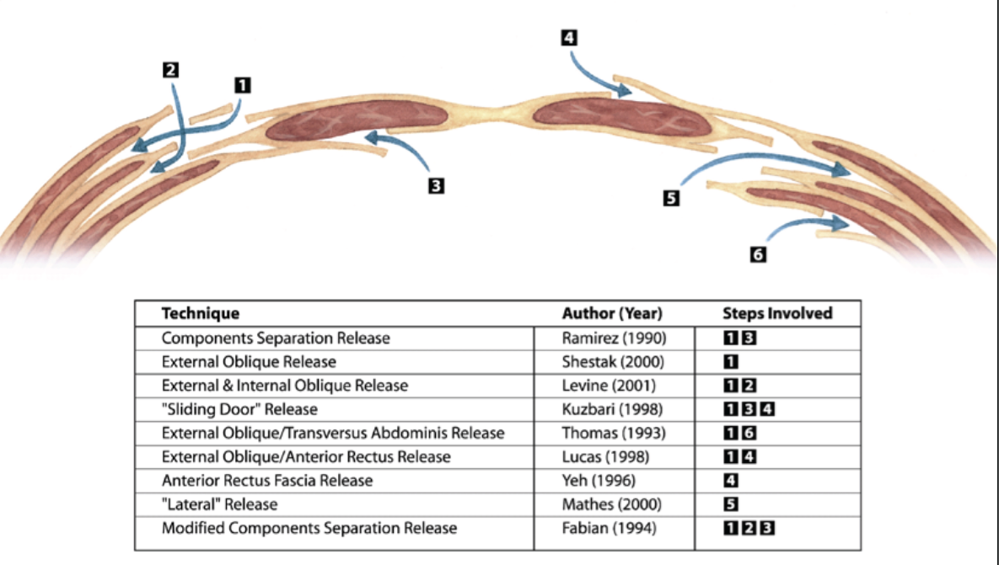

COMPONENT SEPARATION
TECHNIQUES

Slide 7
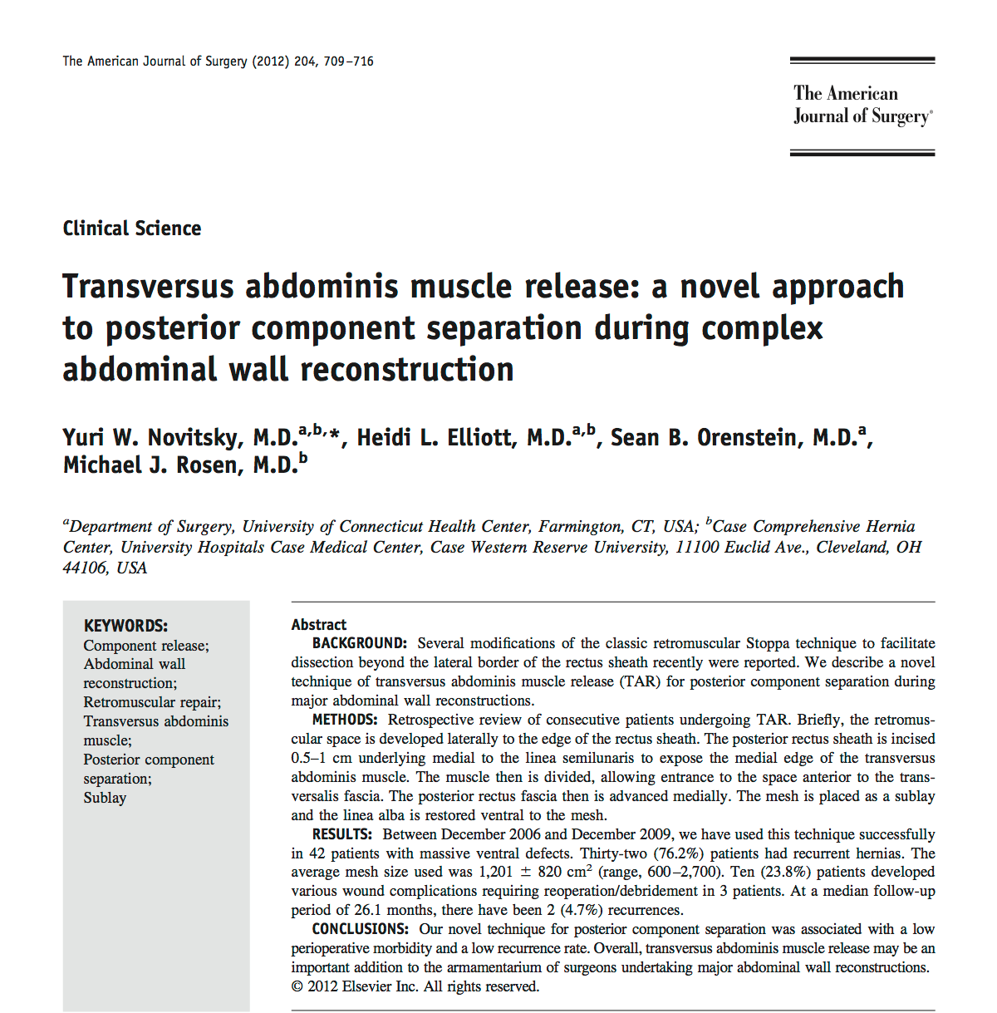
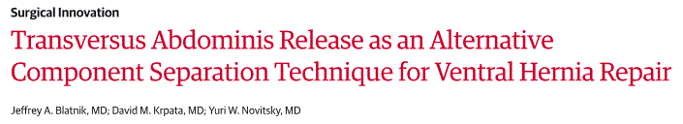


Slide 11
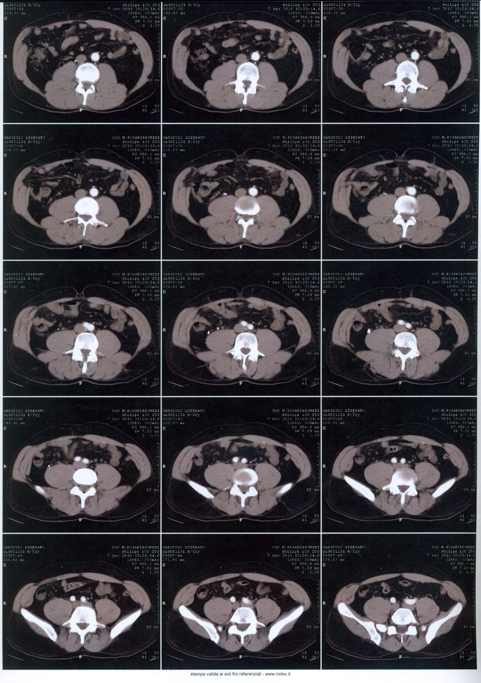
PRE-OP

Slide 12
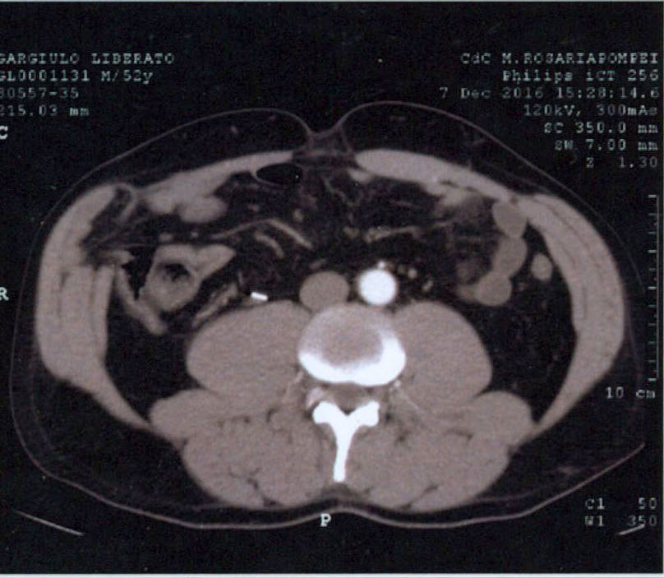
PRE-OP

Slide 13
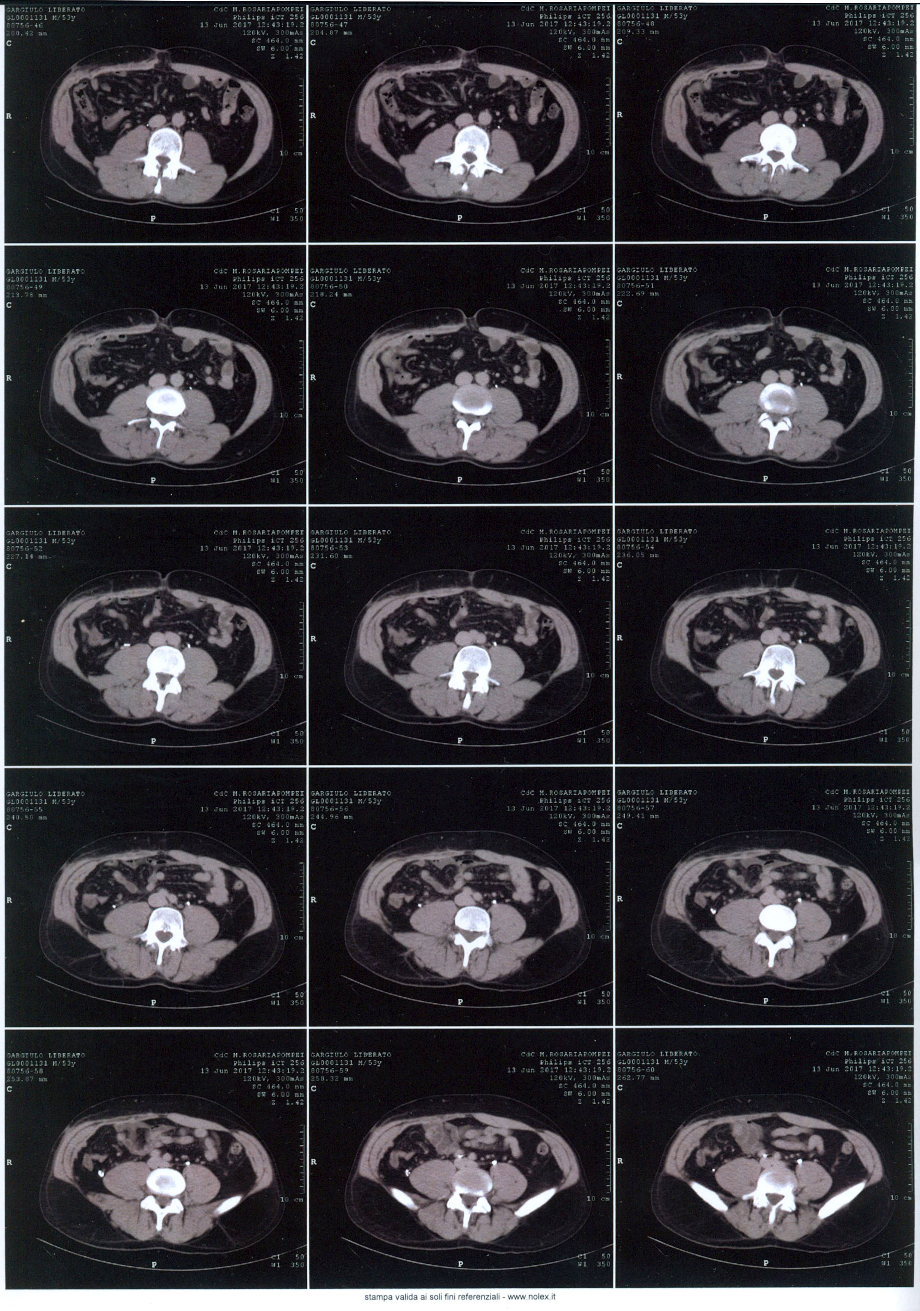
1 Year

Slide 14
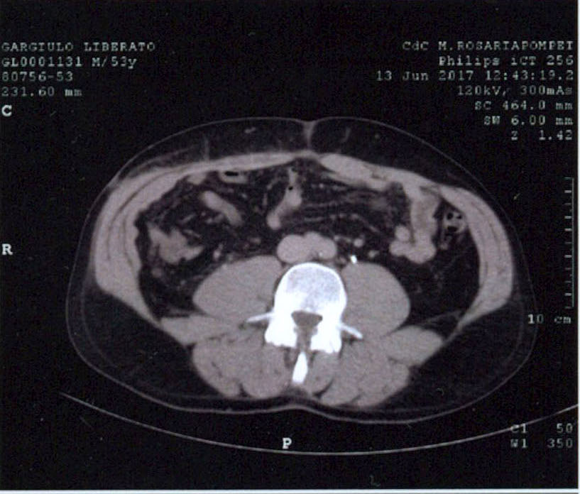
1 YEAR

Slide 15
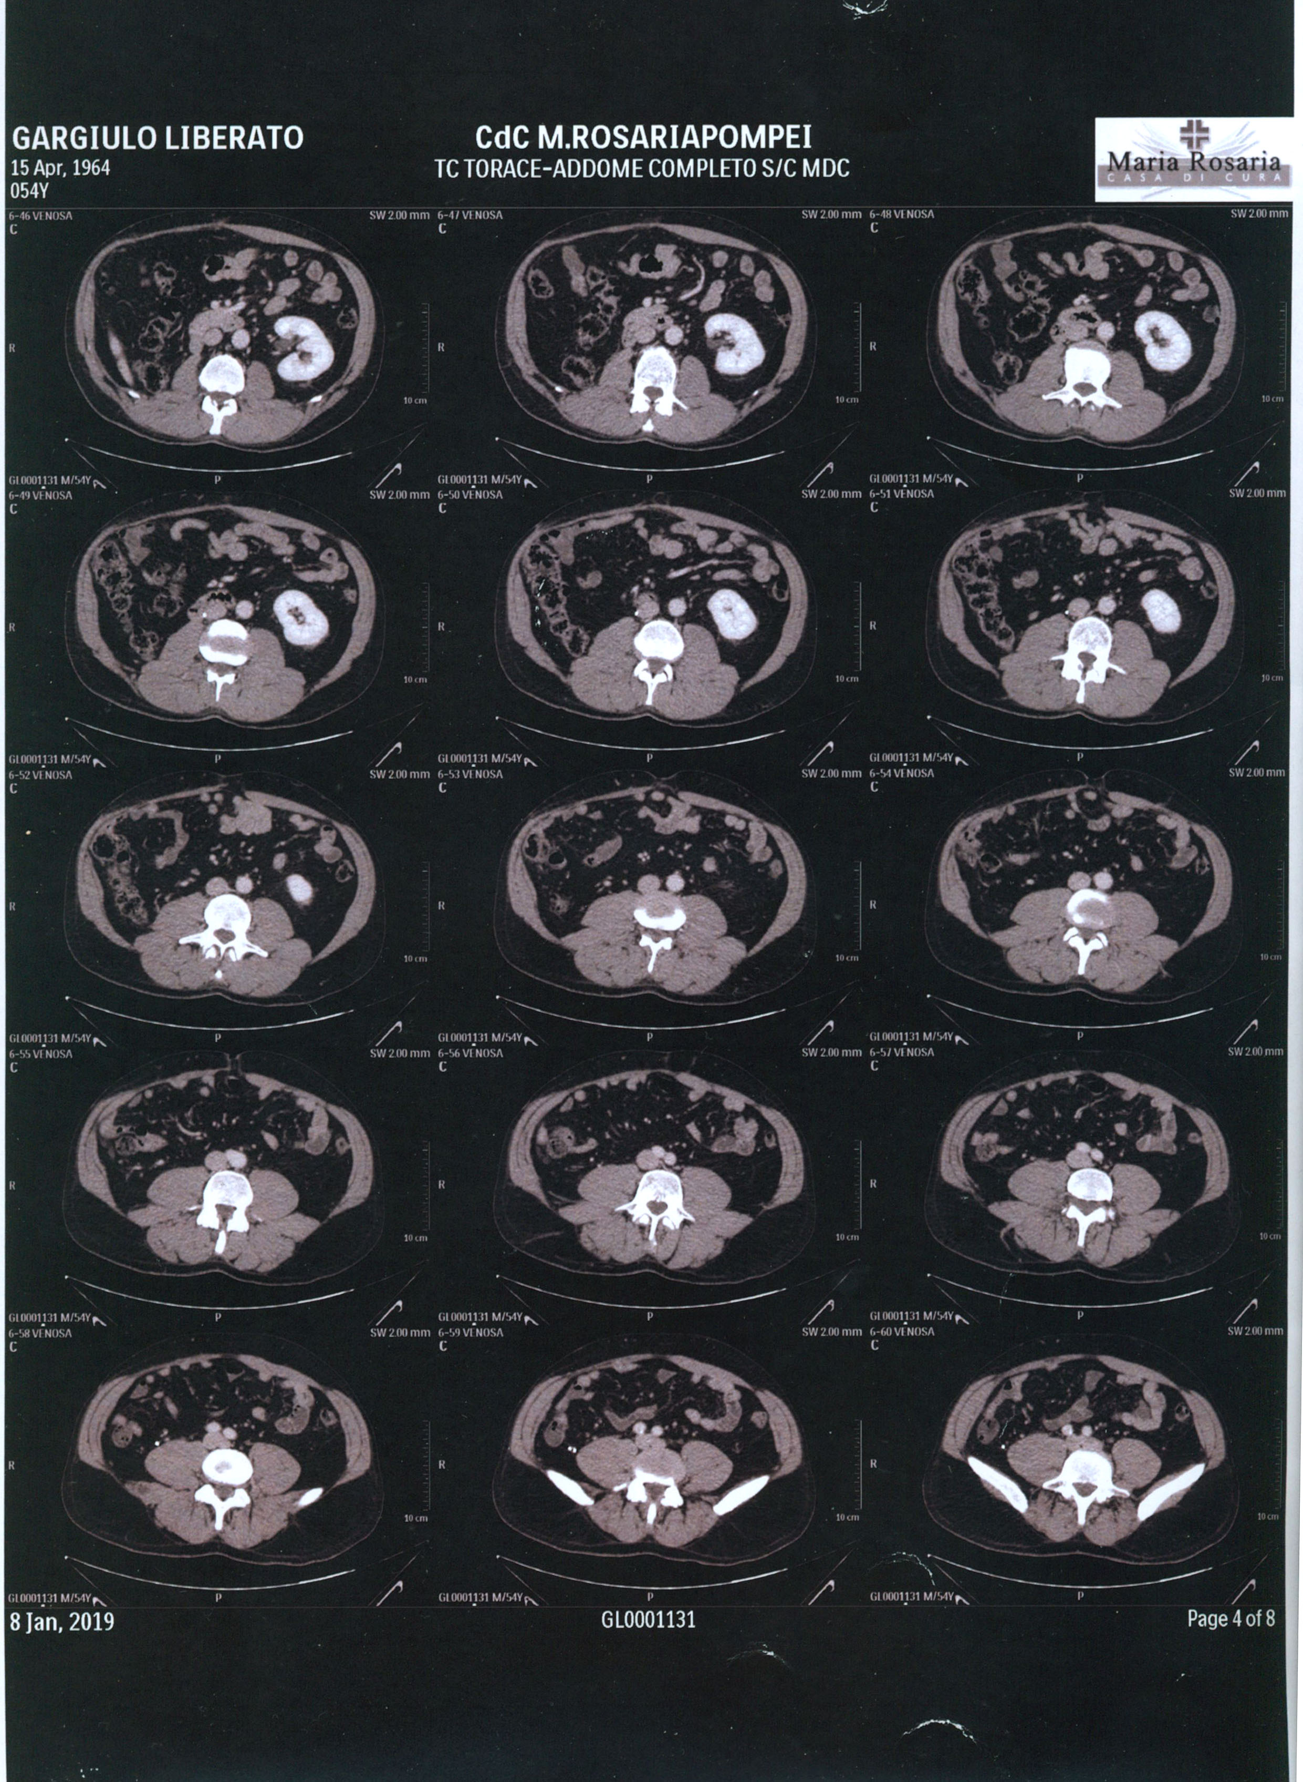
3 Years

Slide 16
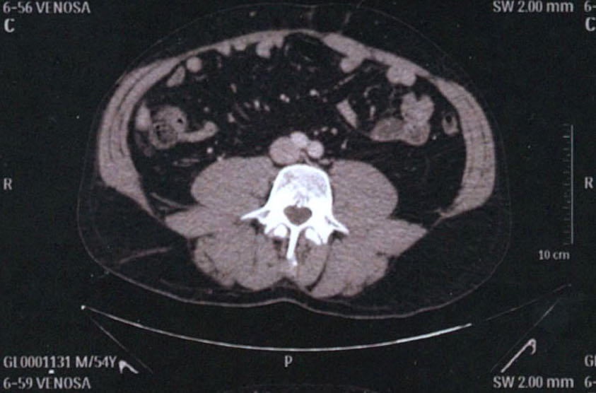
3 YEARS

Slide 17
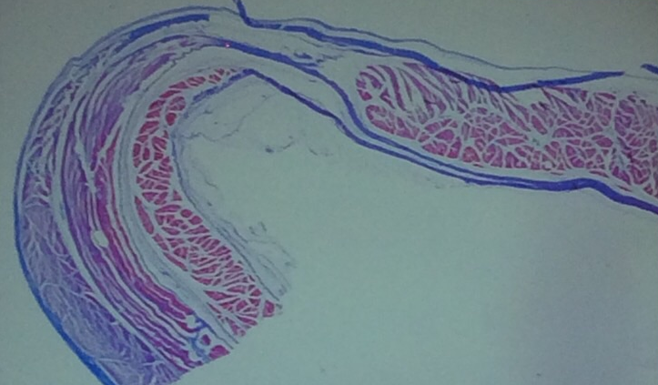
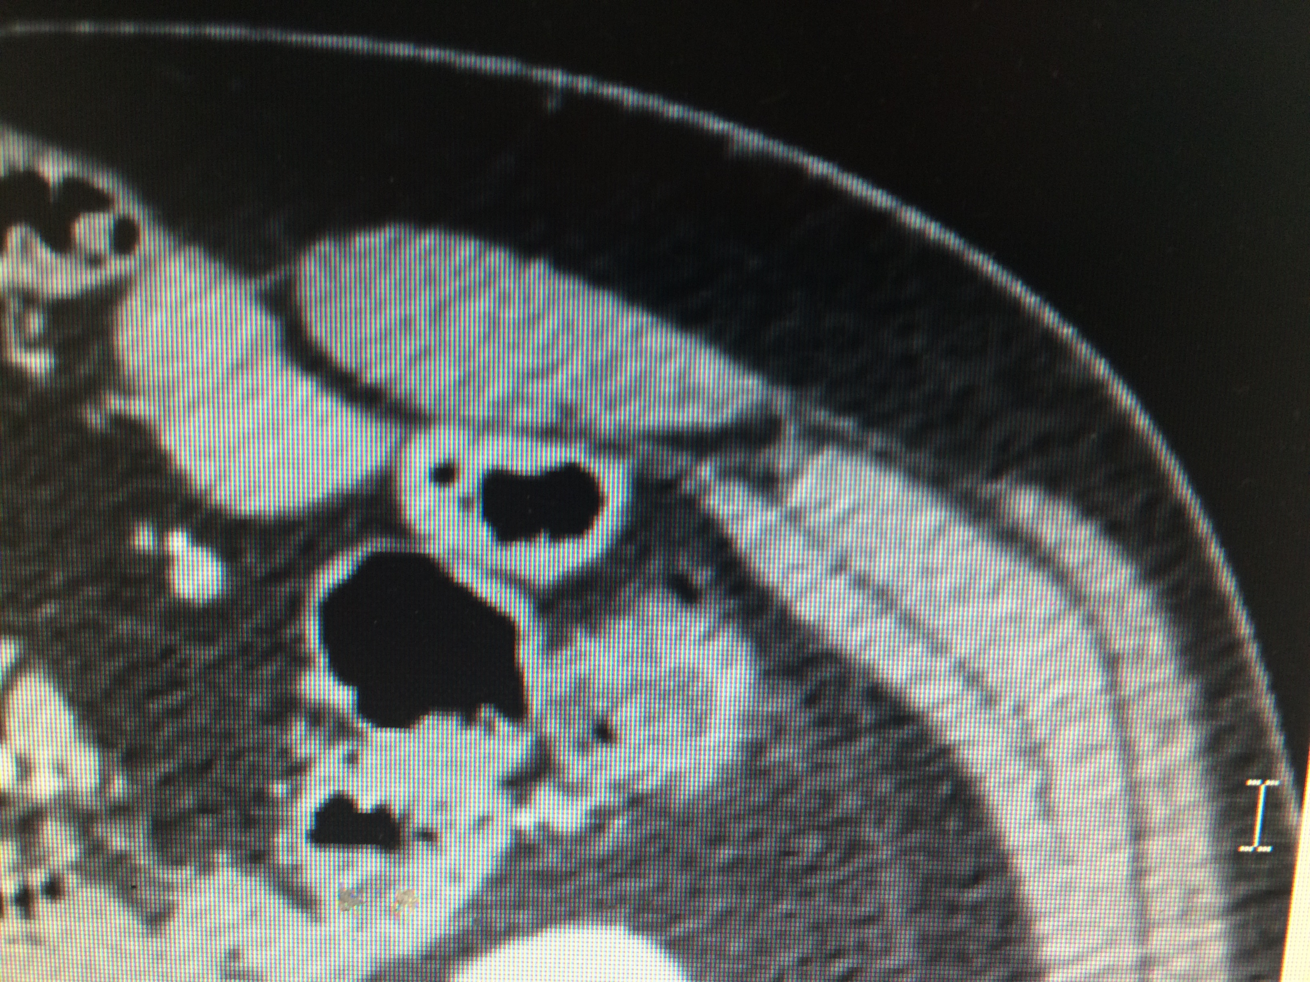

Slide 18
Personal Experience CST+TAR
From March 2014 to MARCH 2019
  96 patients (55 M, 41 F)

Slide 19
Personal Experience CST+TAR
From March 2014 to March 2019
M/F | 55/41
AGE | 53,2
BMI | 29,3
ASA II III | 59 13
SURGICAL TIME | 183 MINUTES
POST OP ICU | 1 DAY
DAYS OF DRAINS | 7
HOSPITAL STAY | 9
FOLLOW UP* | 422 DAYS
POST-OPERATIVE COMPLICATIONS
PAIN | 4.4%
SEROMA | 10.3%
HEMATOMA | 13.3%
URINARY TRACT INFECTIONS | 11.3%
MORTALITY | 1,3%
NO EVISCERATIONS OR INTRA-ABDOMINAL HYPERTENSION OCCURRED
ONLY ONE CASE OF CUTANEOUS DEISHENCE WITH MESH EXPOSITION (CHILD 2-3 PATIENT), TREATED BY VAC THERAPY
All data expressed by median
*mean

Slide 20
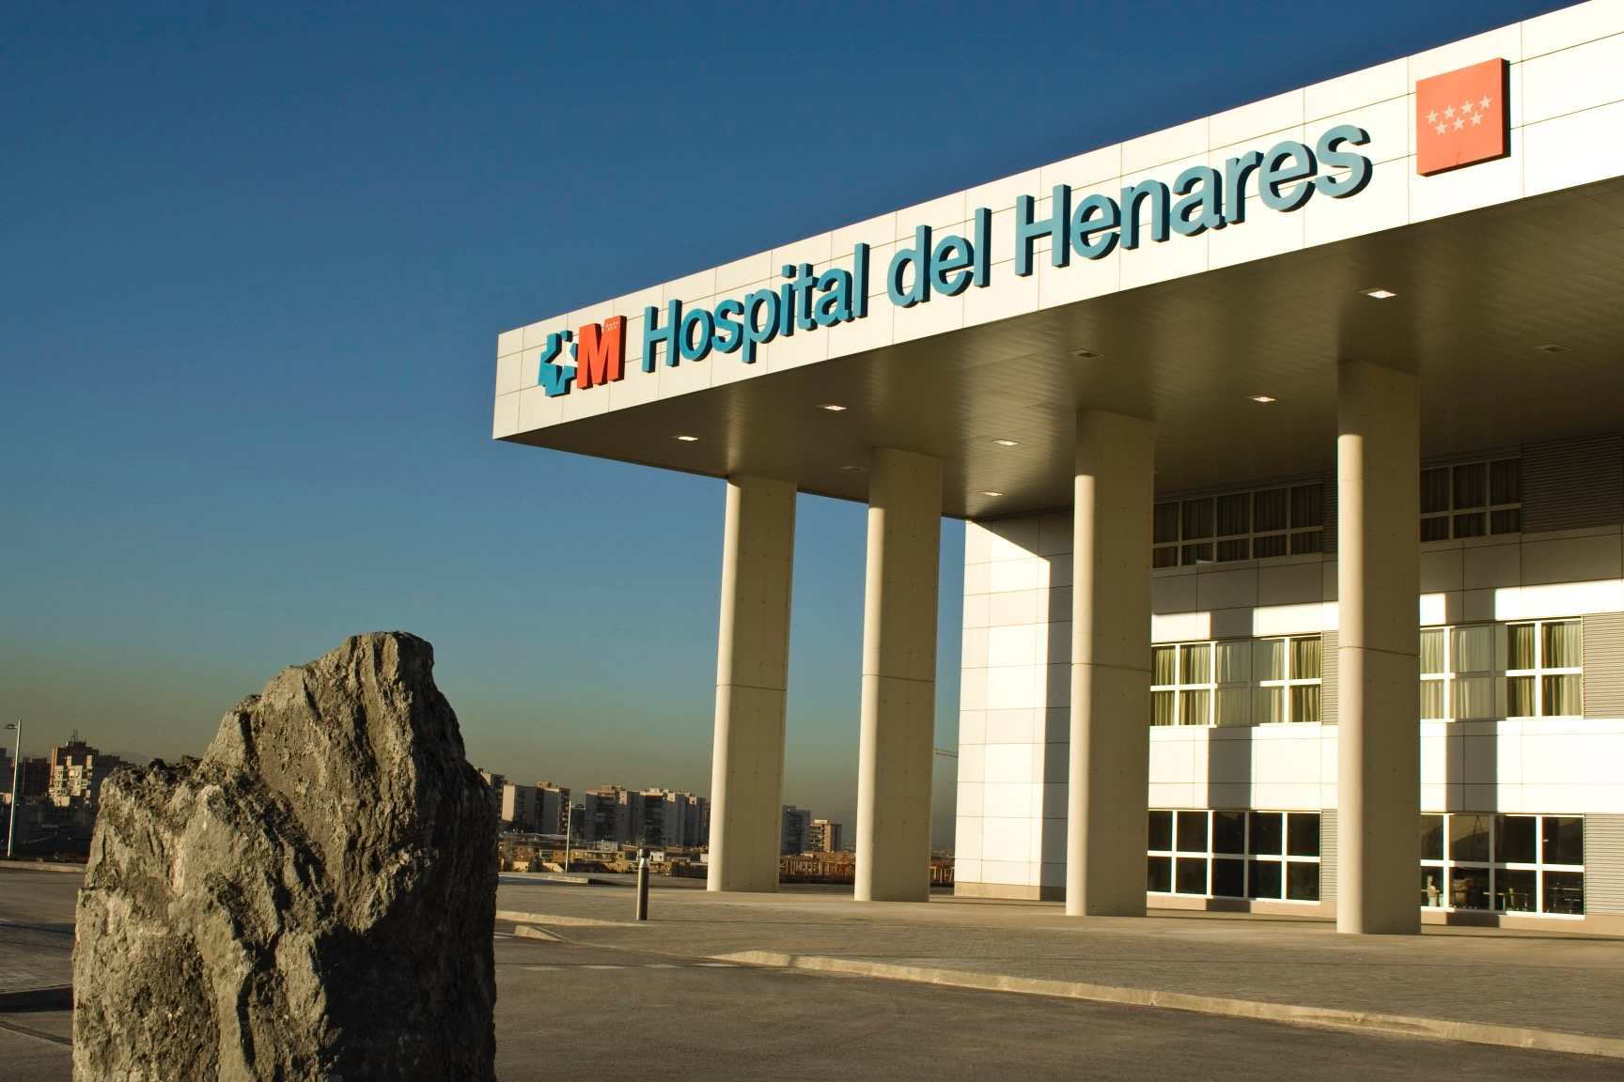
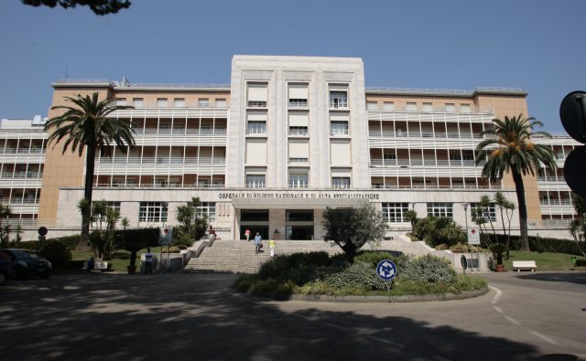
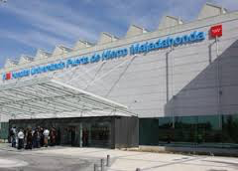
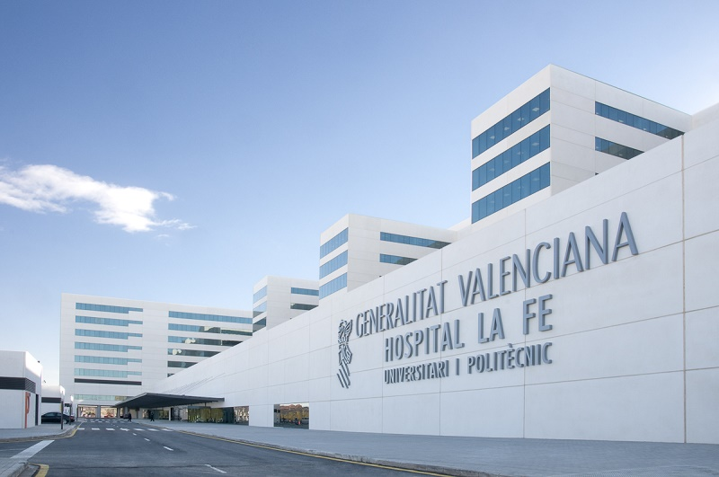
Absorbable mesh and permanent mesh for complex abdominal wall:
a multicenter prospective study
169 PATIENTS
2012
2016
HOSPITAL DEL HENARES
COSLADA
MA García-Ureña LA Blazquez A Robin
OSPEDALI DEI COLLI-MONALDI
NAPLES
D. Cuccurullo F. Corcione
HOSPITAL PUERTA DE HIERRO
MADRID
LA FE HOSPITAL VALENCIA
P. Garcia Pastore
J. López-Monclús V. Turrión

Slide 21
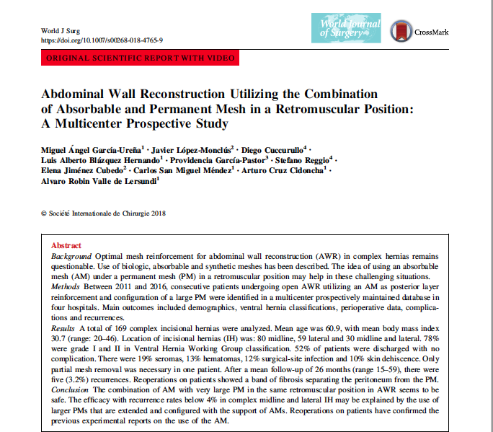

Slide 22
Our indications
Complex ventral hernia (real loss of substance)
Nonmidline (lateral,lumbar, subcostal etc.) ventral hernias
Lumbar hernia
Parastomal hernias

Slide 23
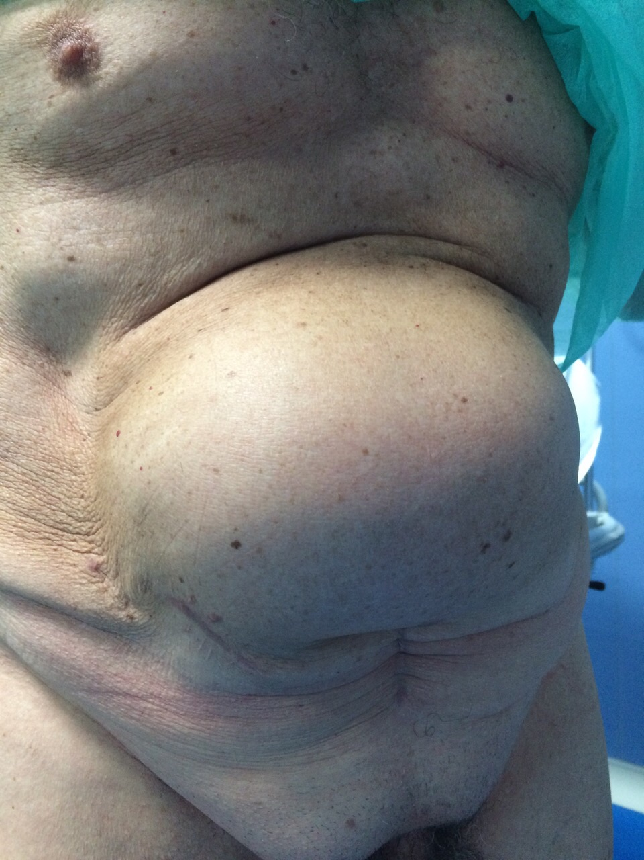
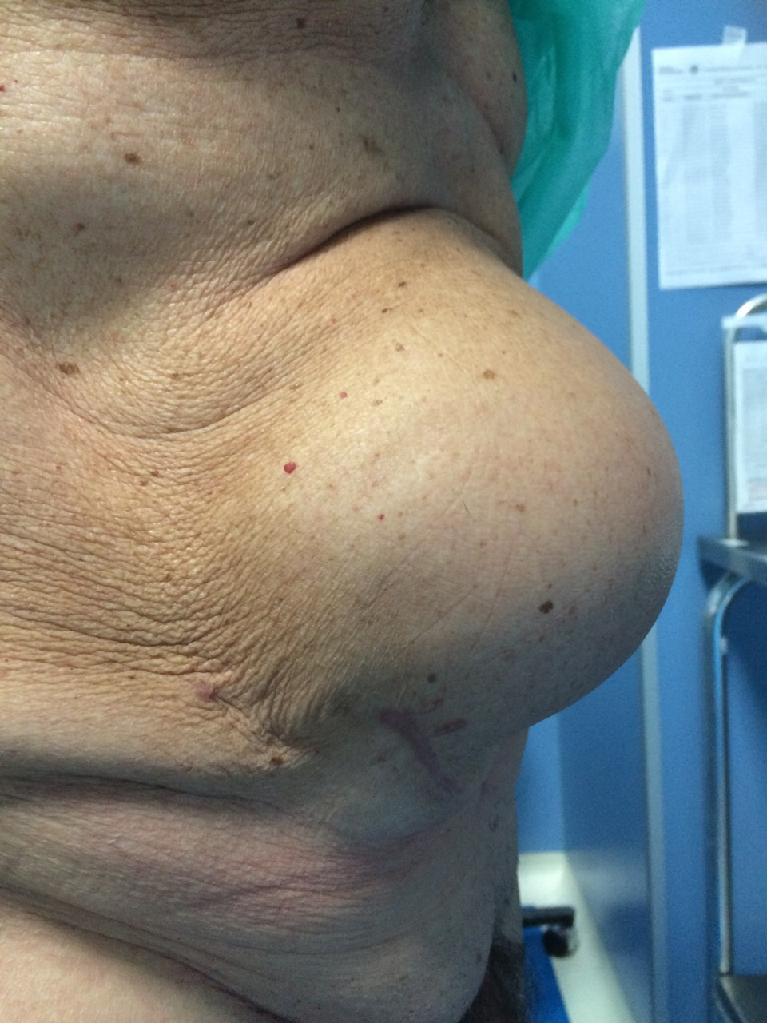

Slide 24
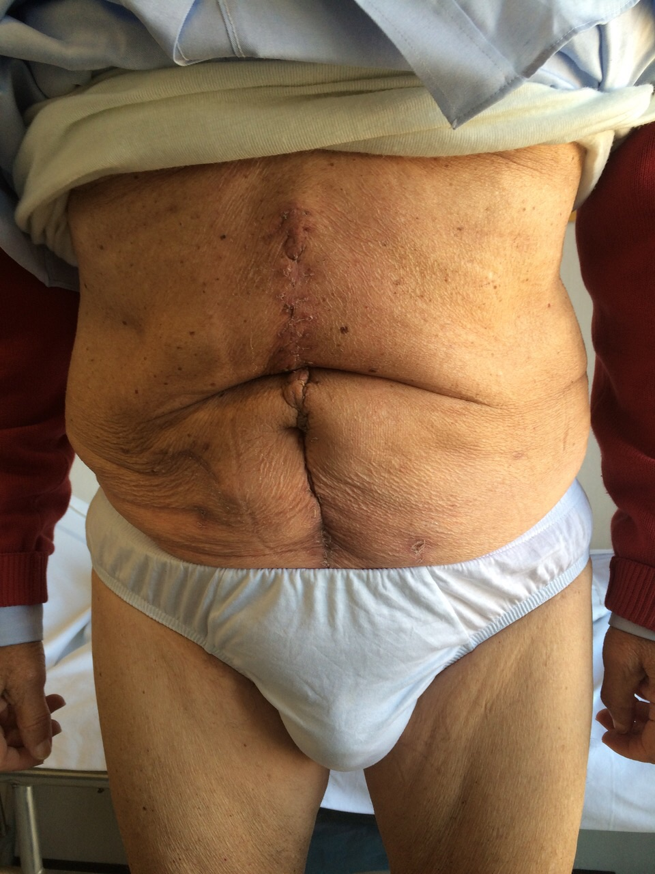
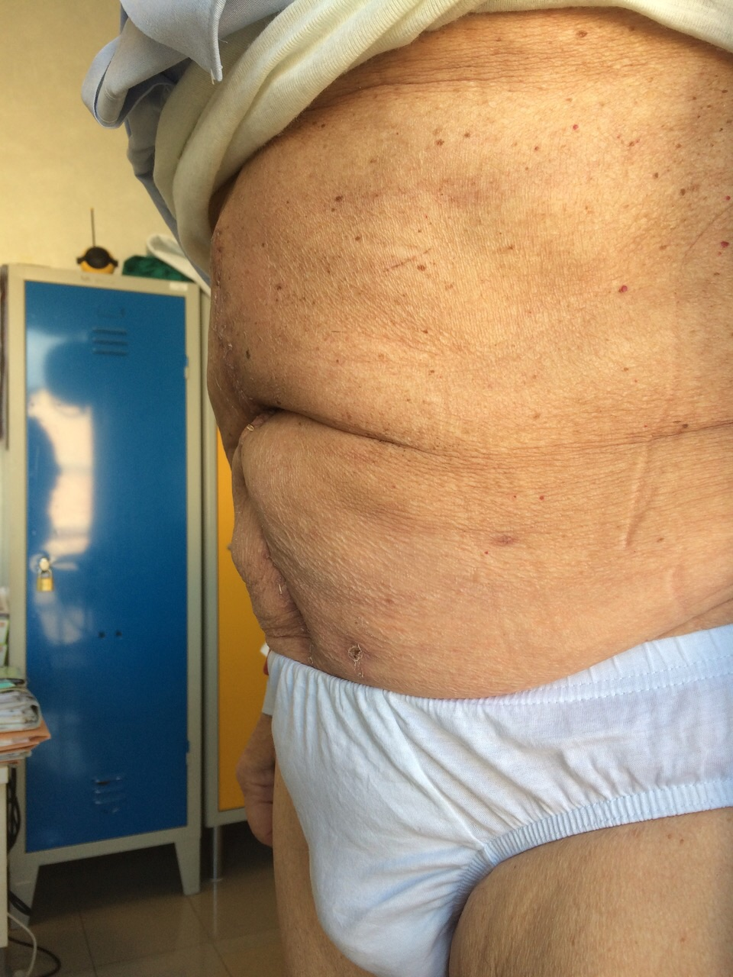

Slide 25
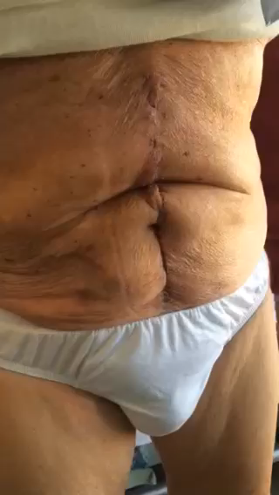

Slide 26
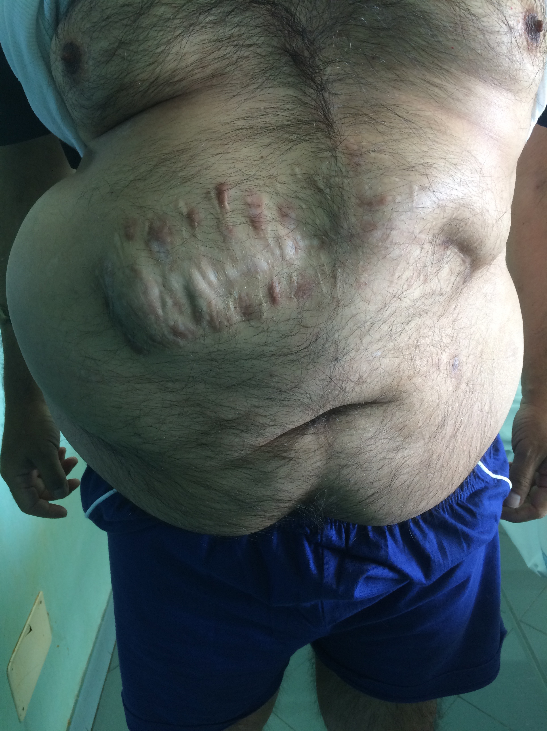
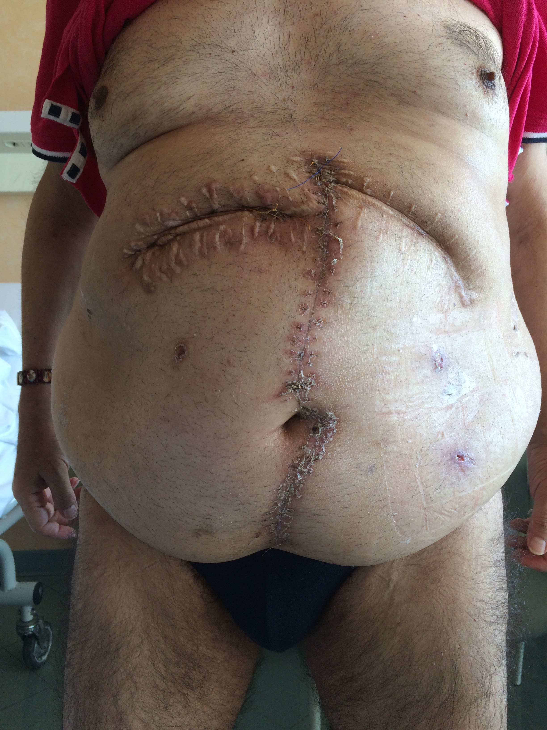

Slide 27
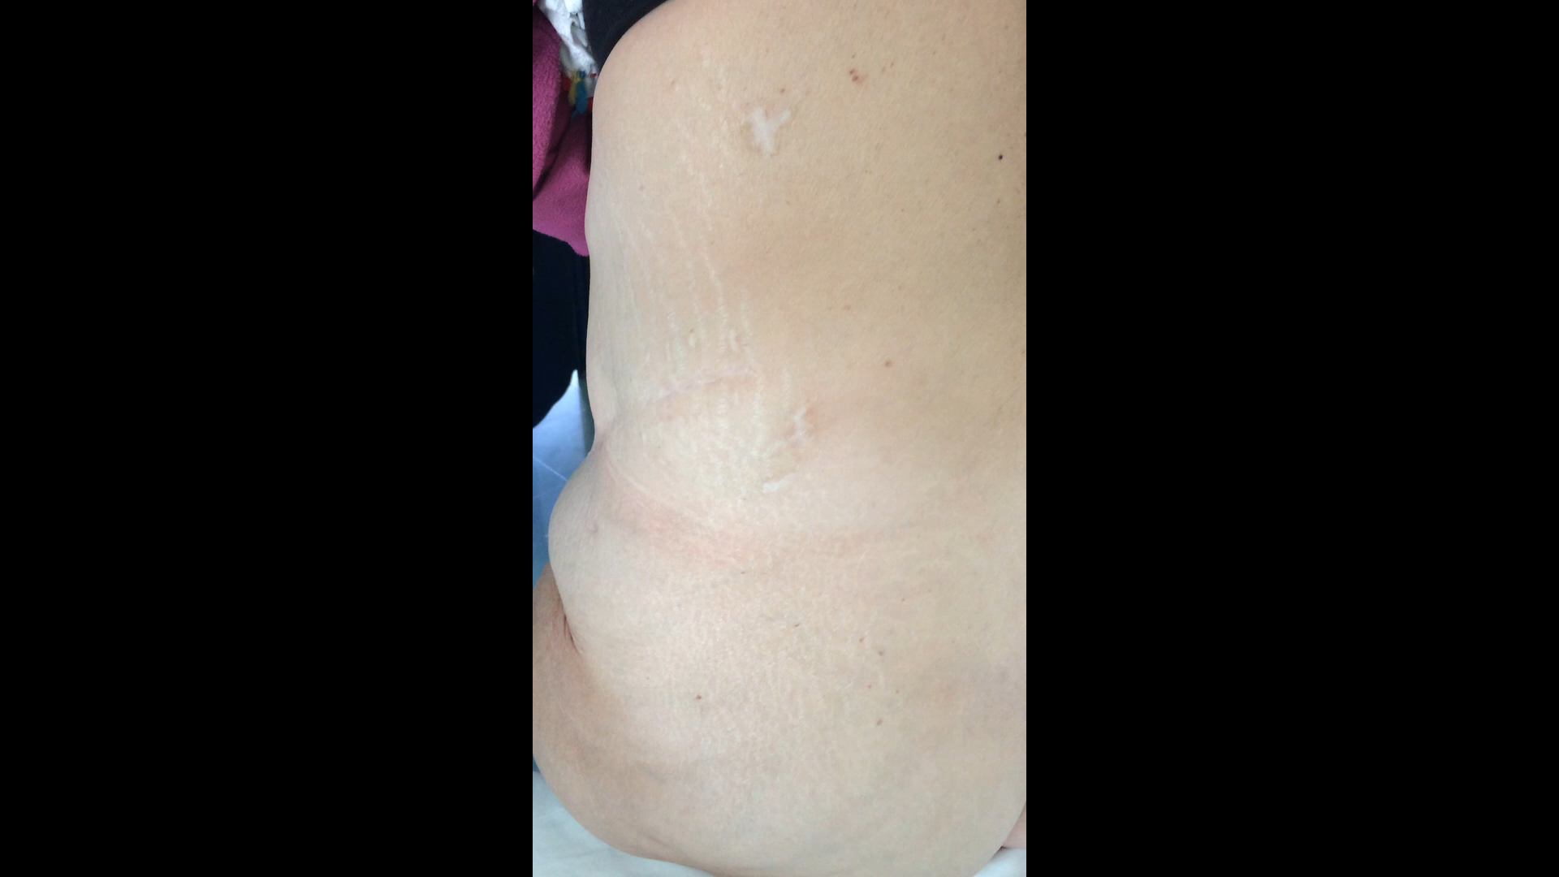

Slide 28
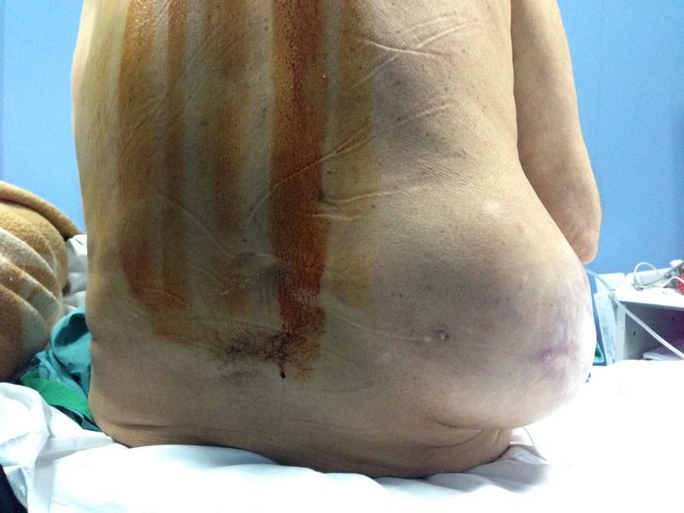

Slide 29
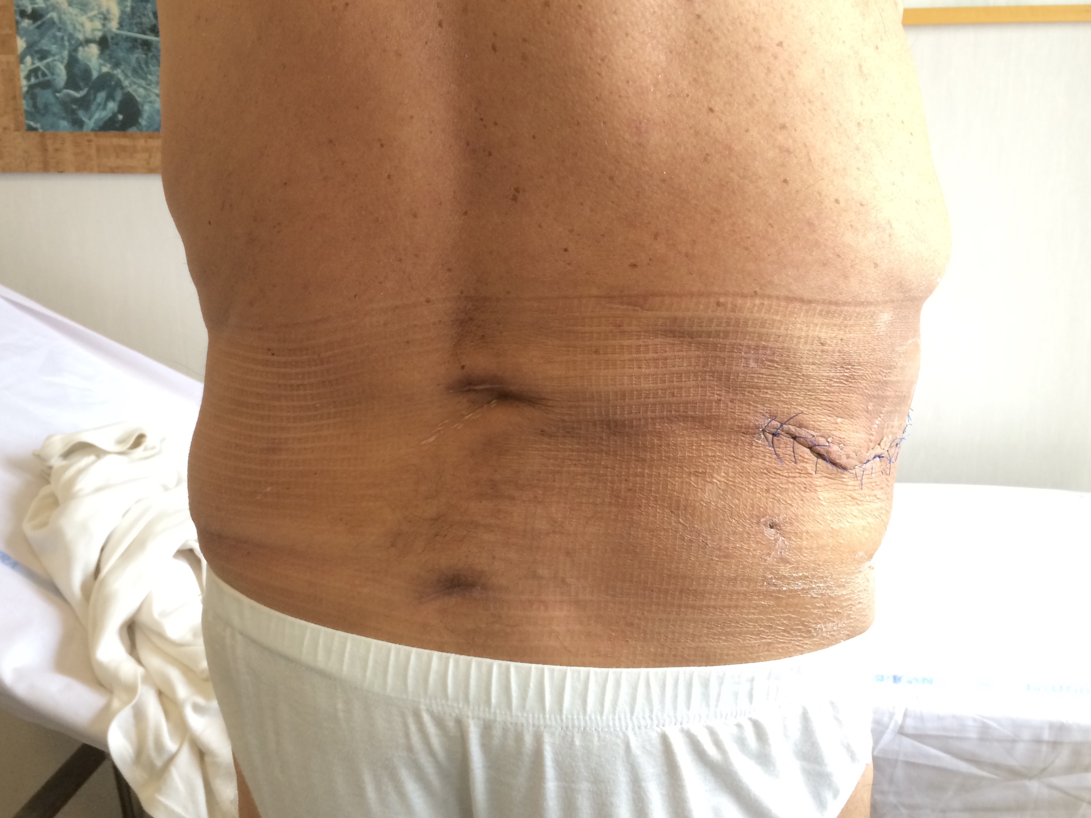
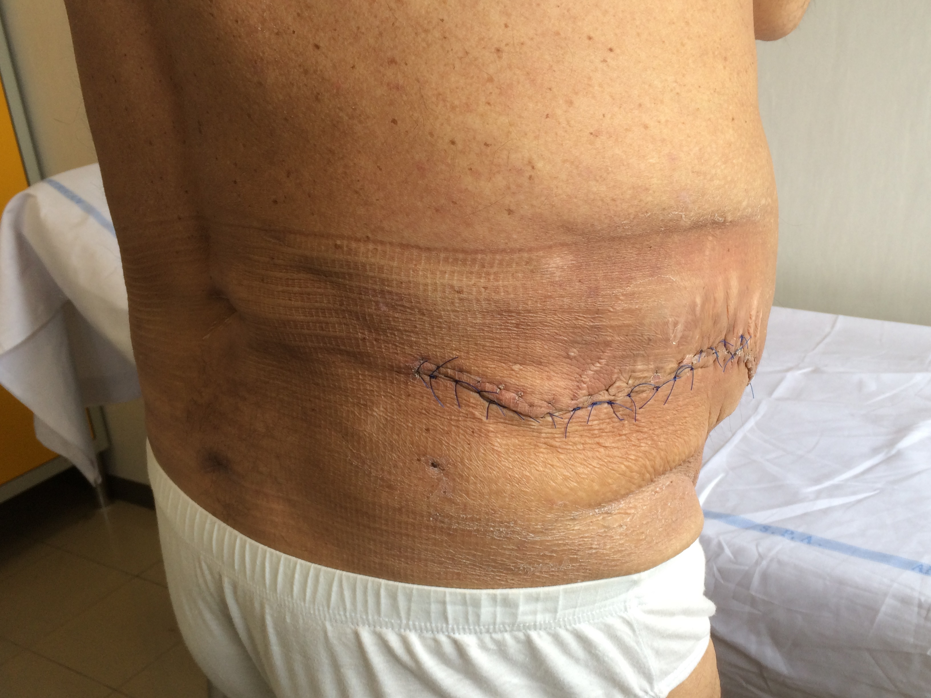

Slide 30
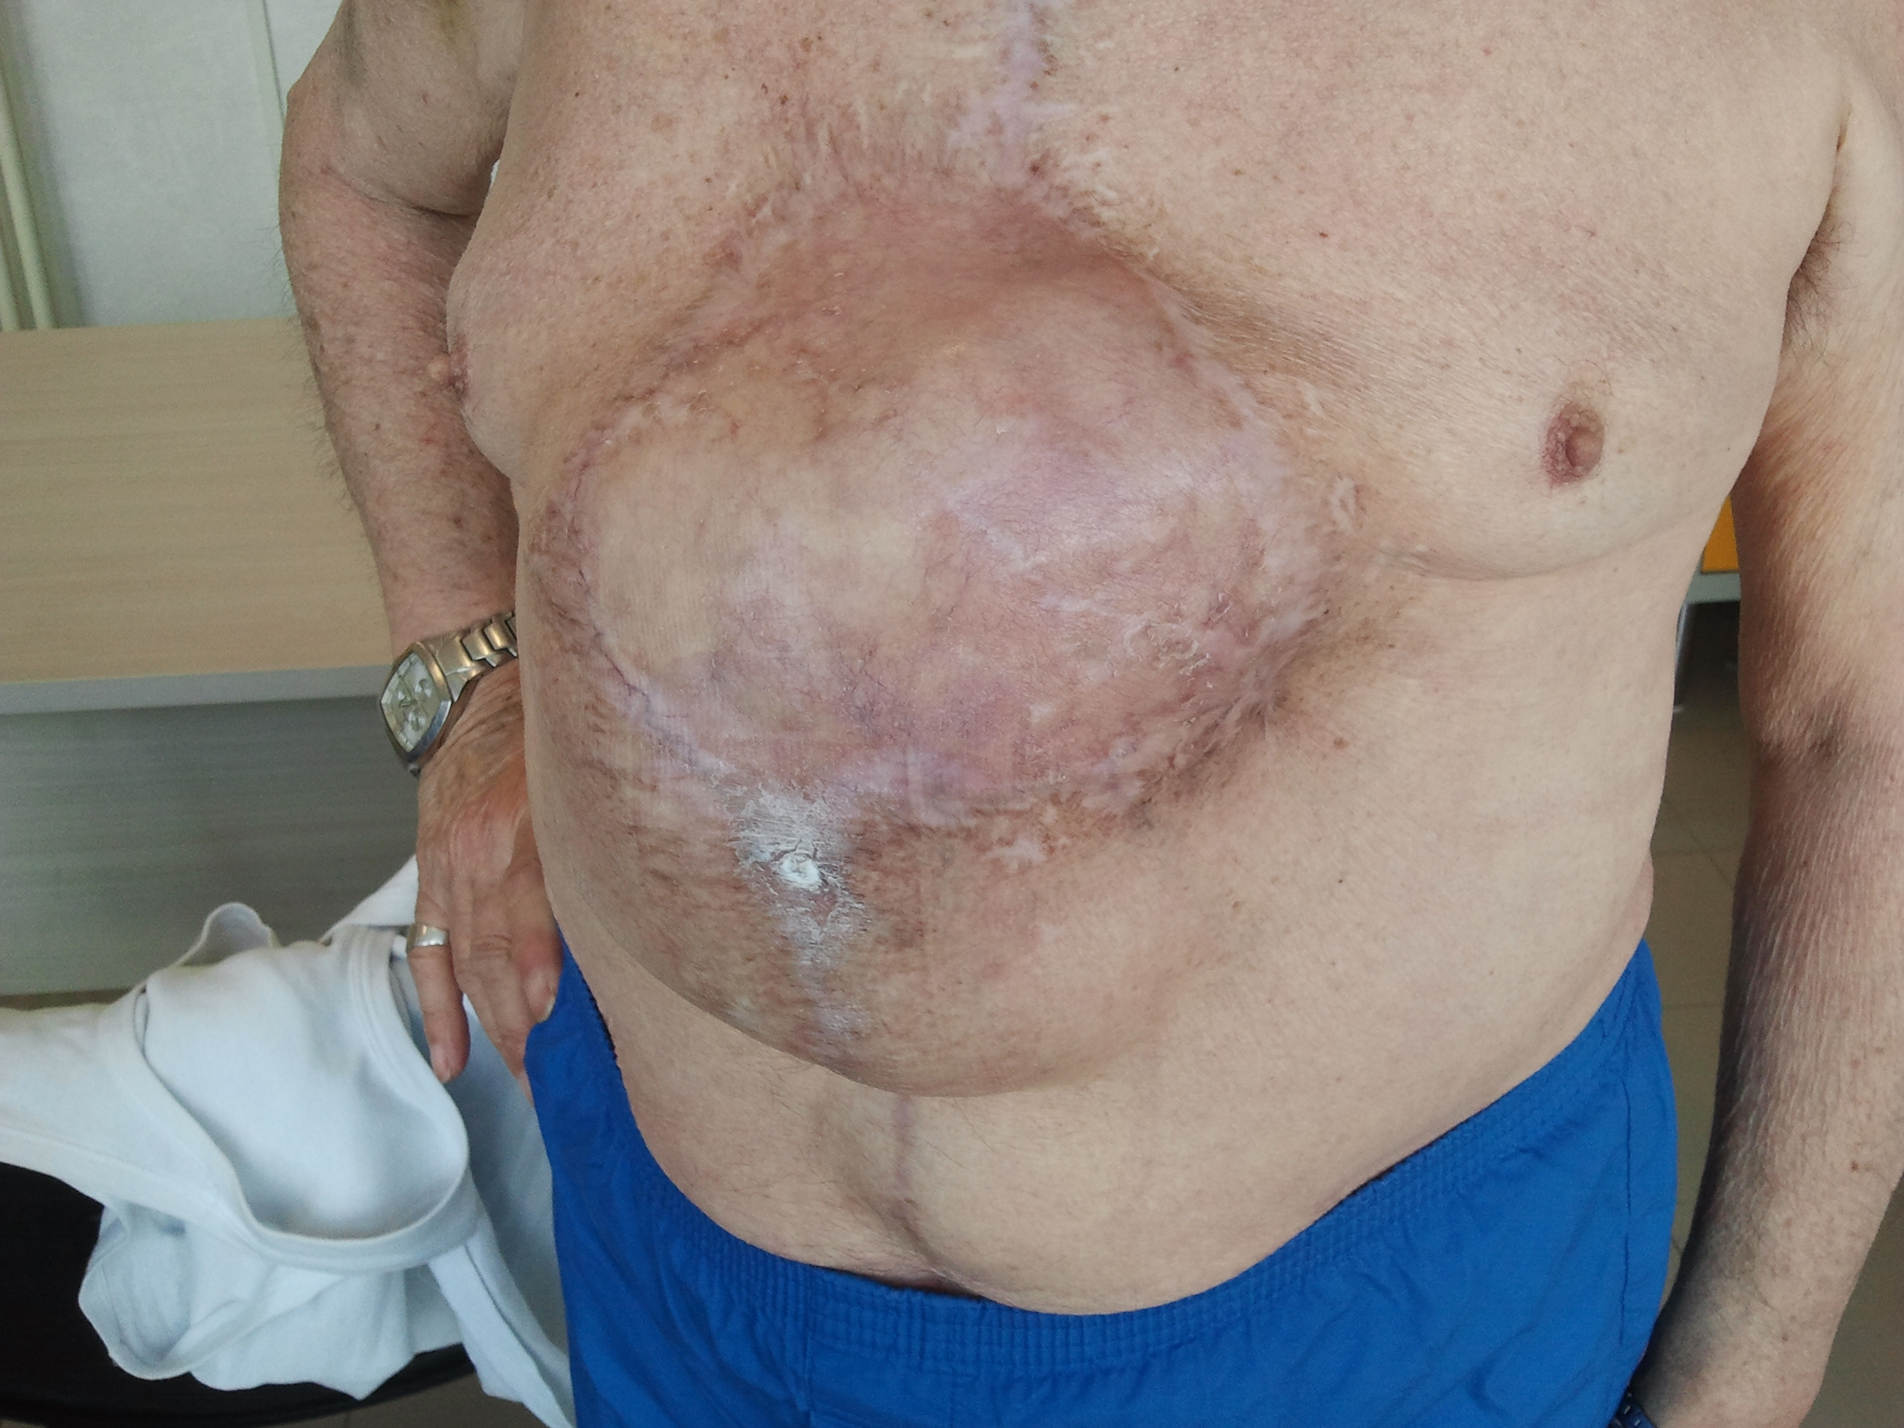

Slide 31
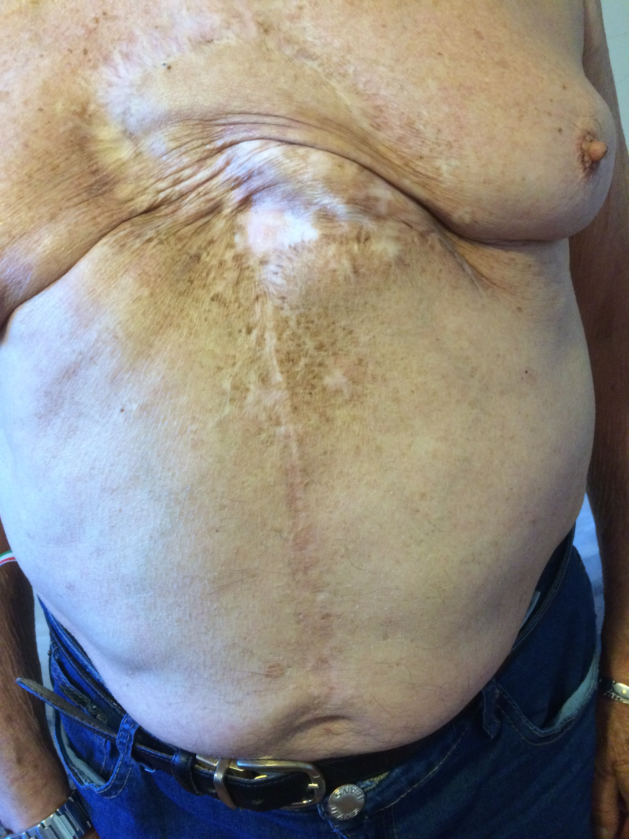
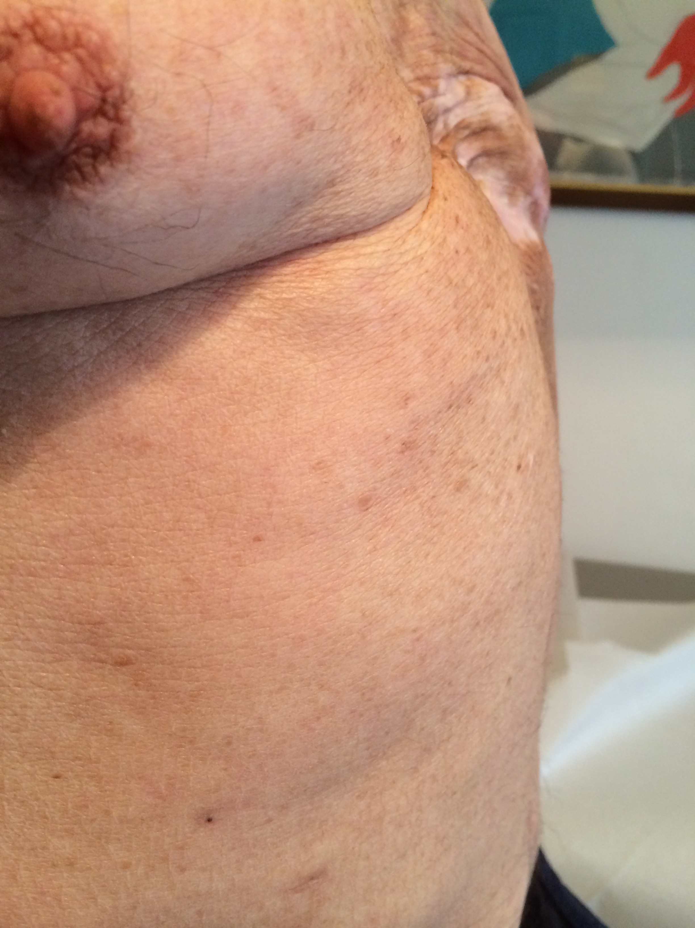

Slide 32

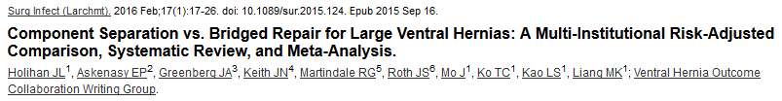
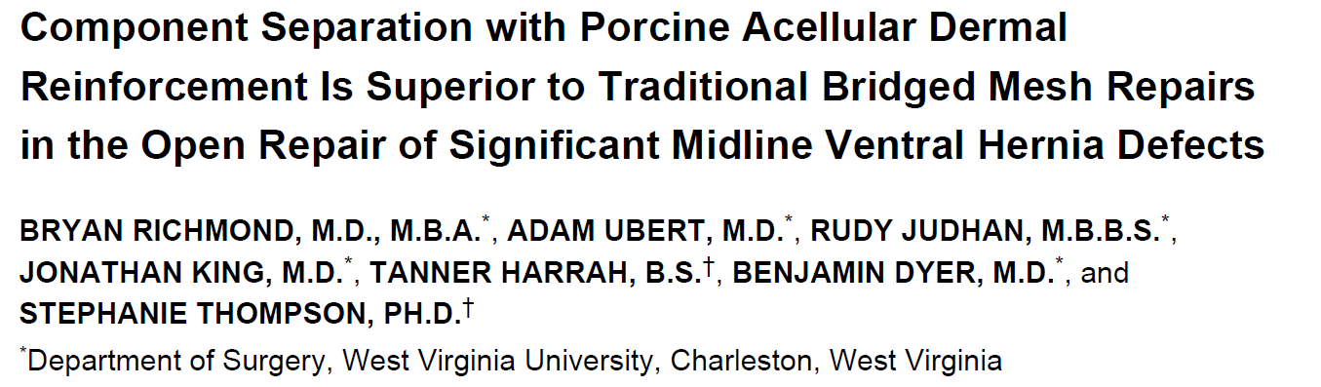
Our goal: AVOID THE BRIDGING

Slide 33
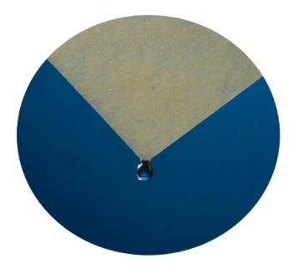

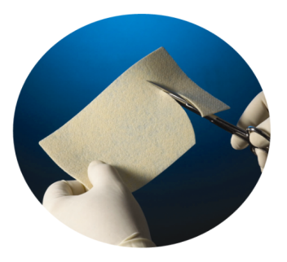

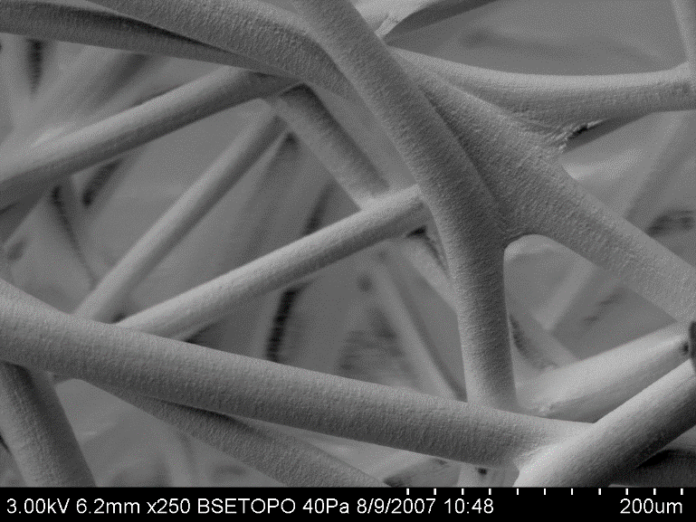

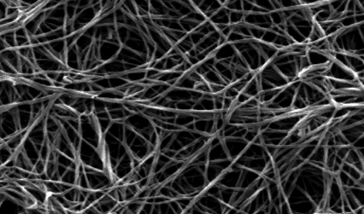
Uniquely designed web of biocompatible synthetic polymers
67% PGA : 33% TMC
Highly interconnected pores
Degradation occurs via a combination of hydrolytic (primarily) and enzymatic pathways this process should be complete within 6 to 7 months.
3D matrix facilitates tissue generation and healing
Cells infiltrate and form vascularized soft tissue
Scaffold is absorbed in six months
Versatile for use in multiple applications
Bioabsorbable web structure similar to a collagen fiber network

Slide 34
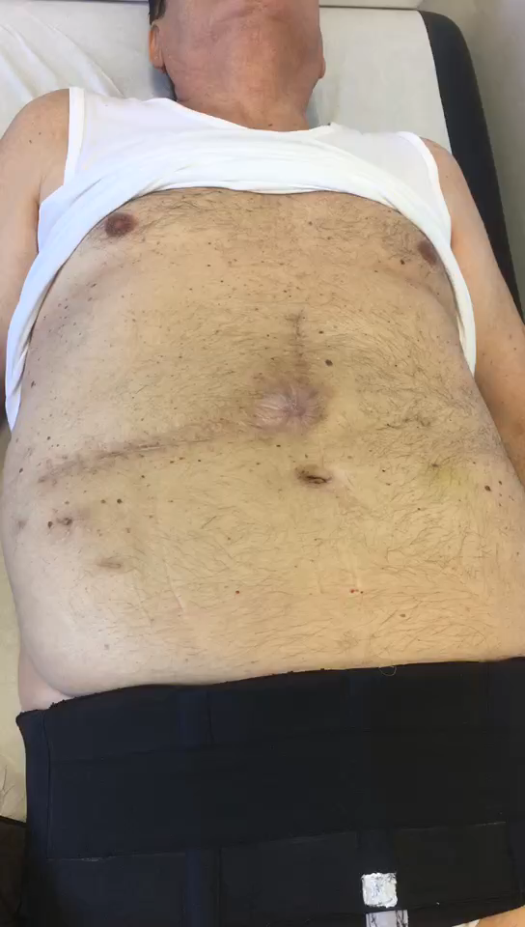

Slide 35
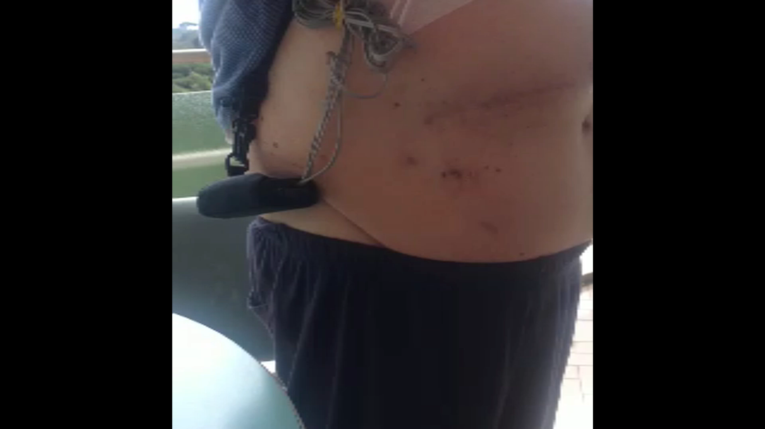

Slide 36
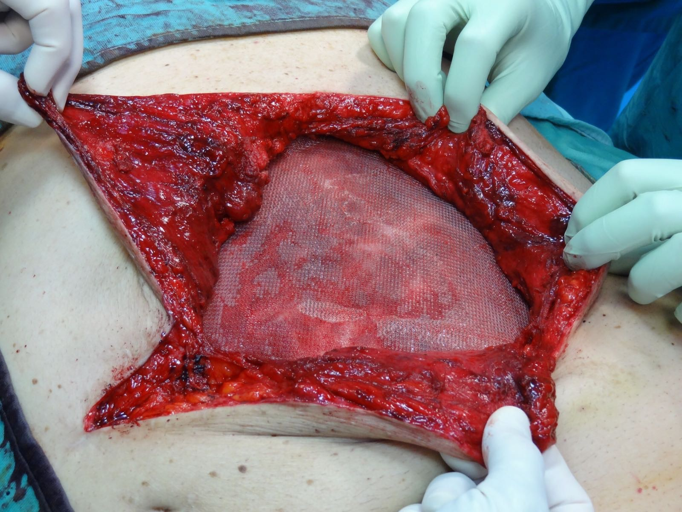

Slide 37
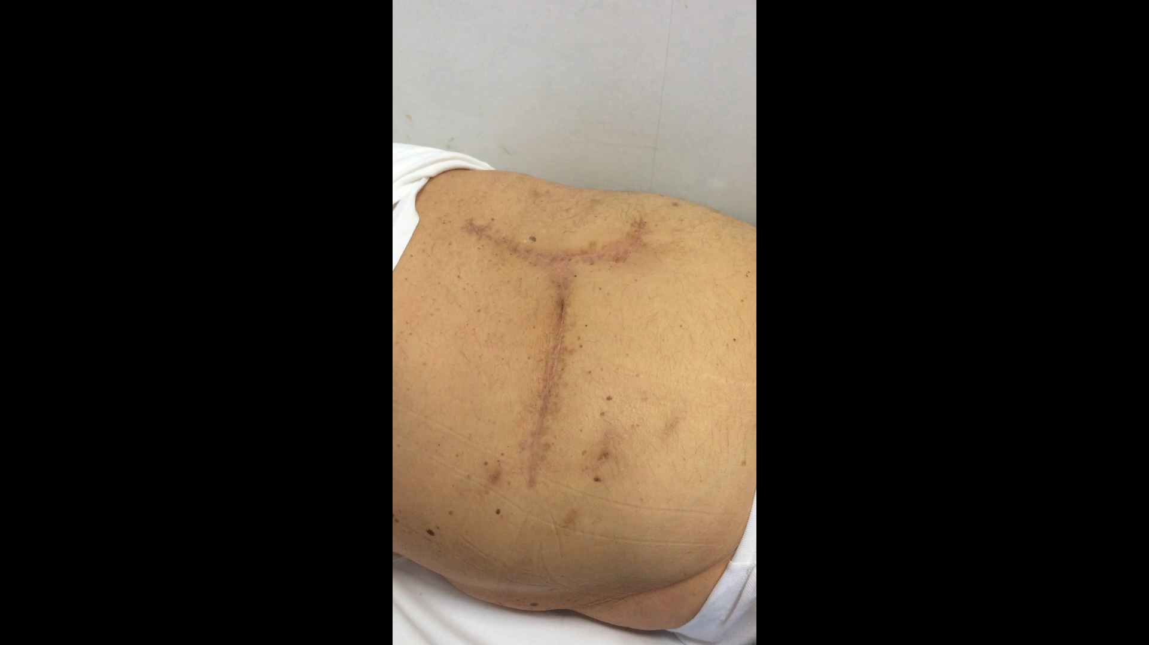

Slide 38
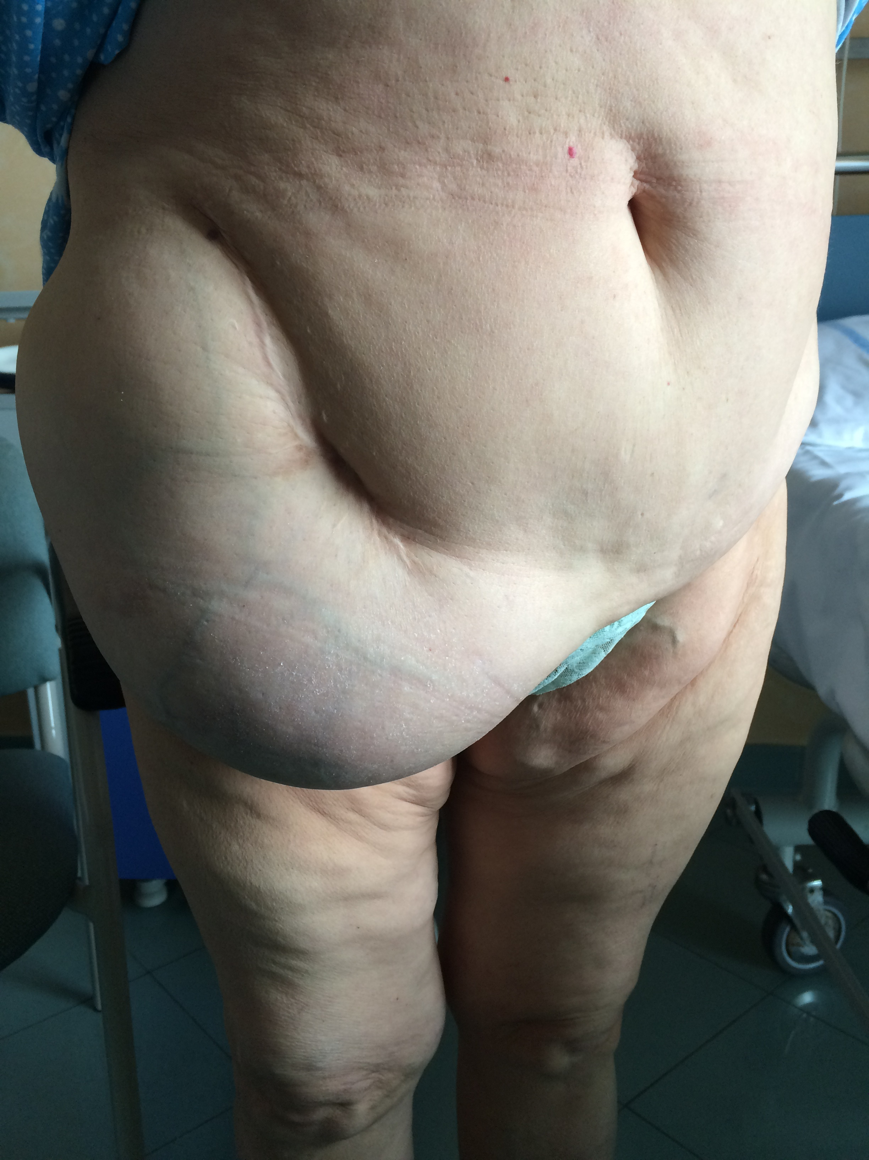
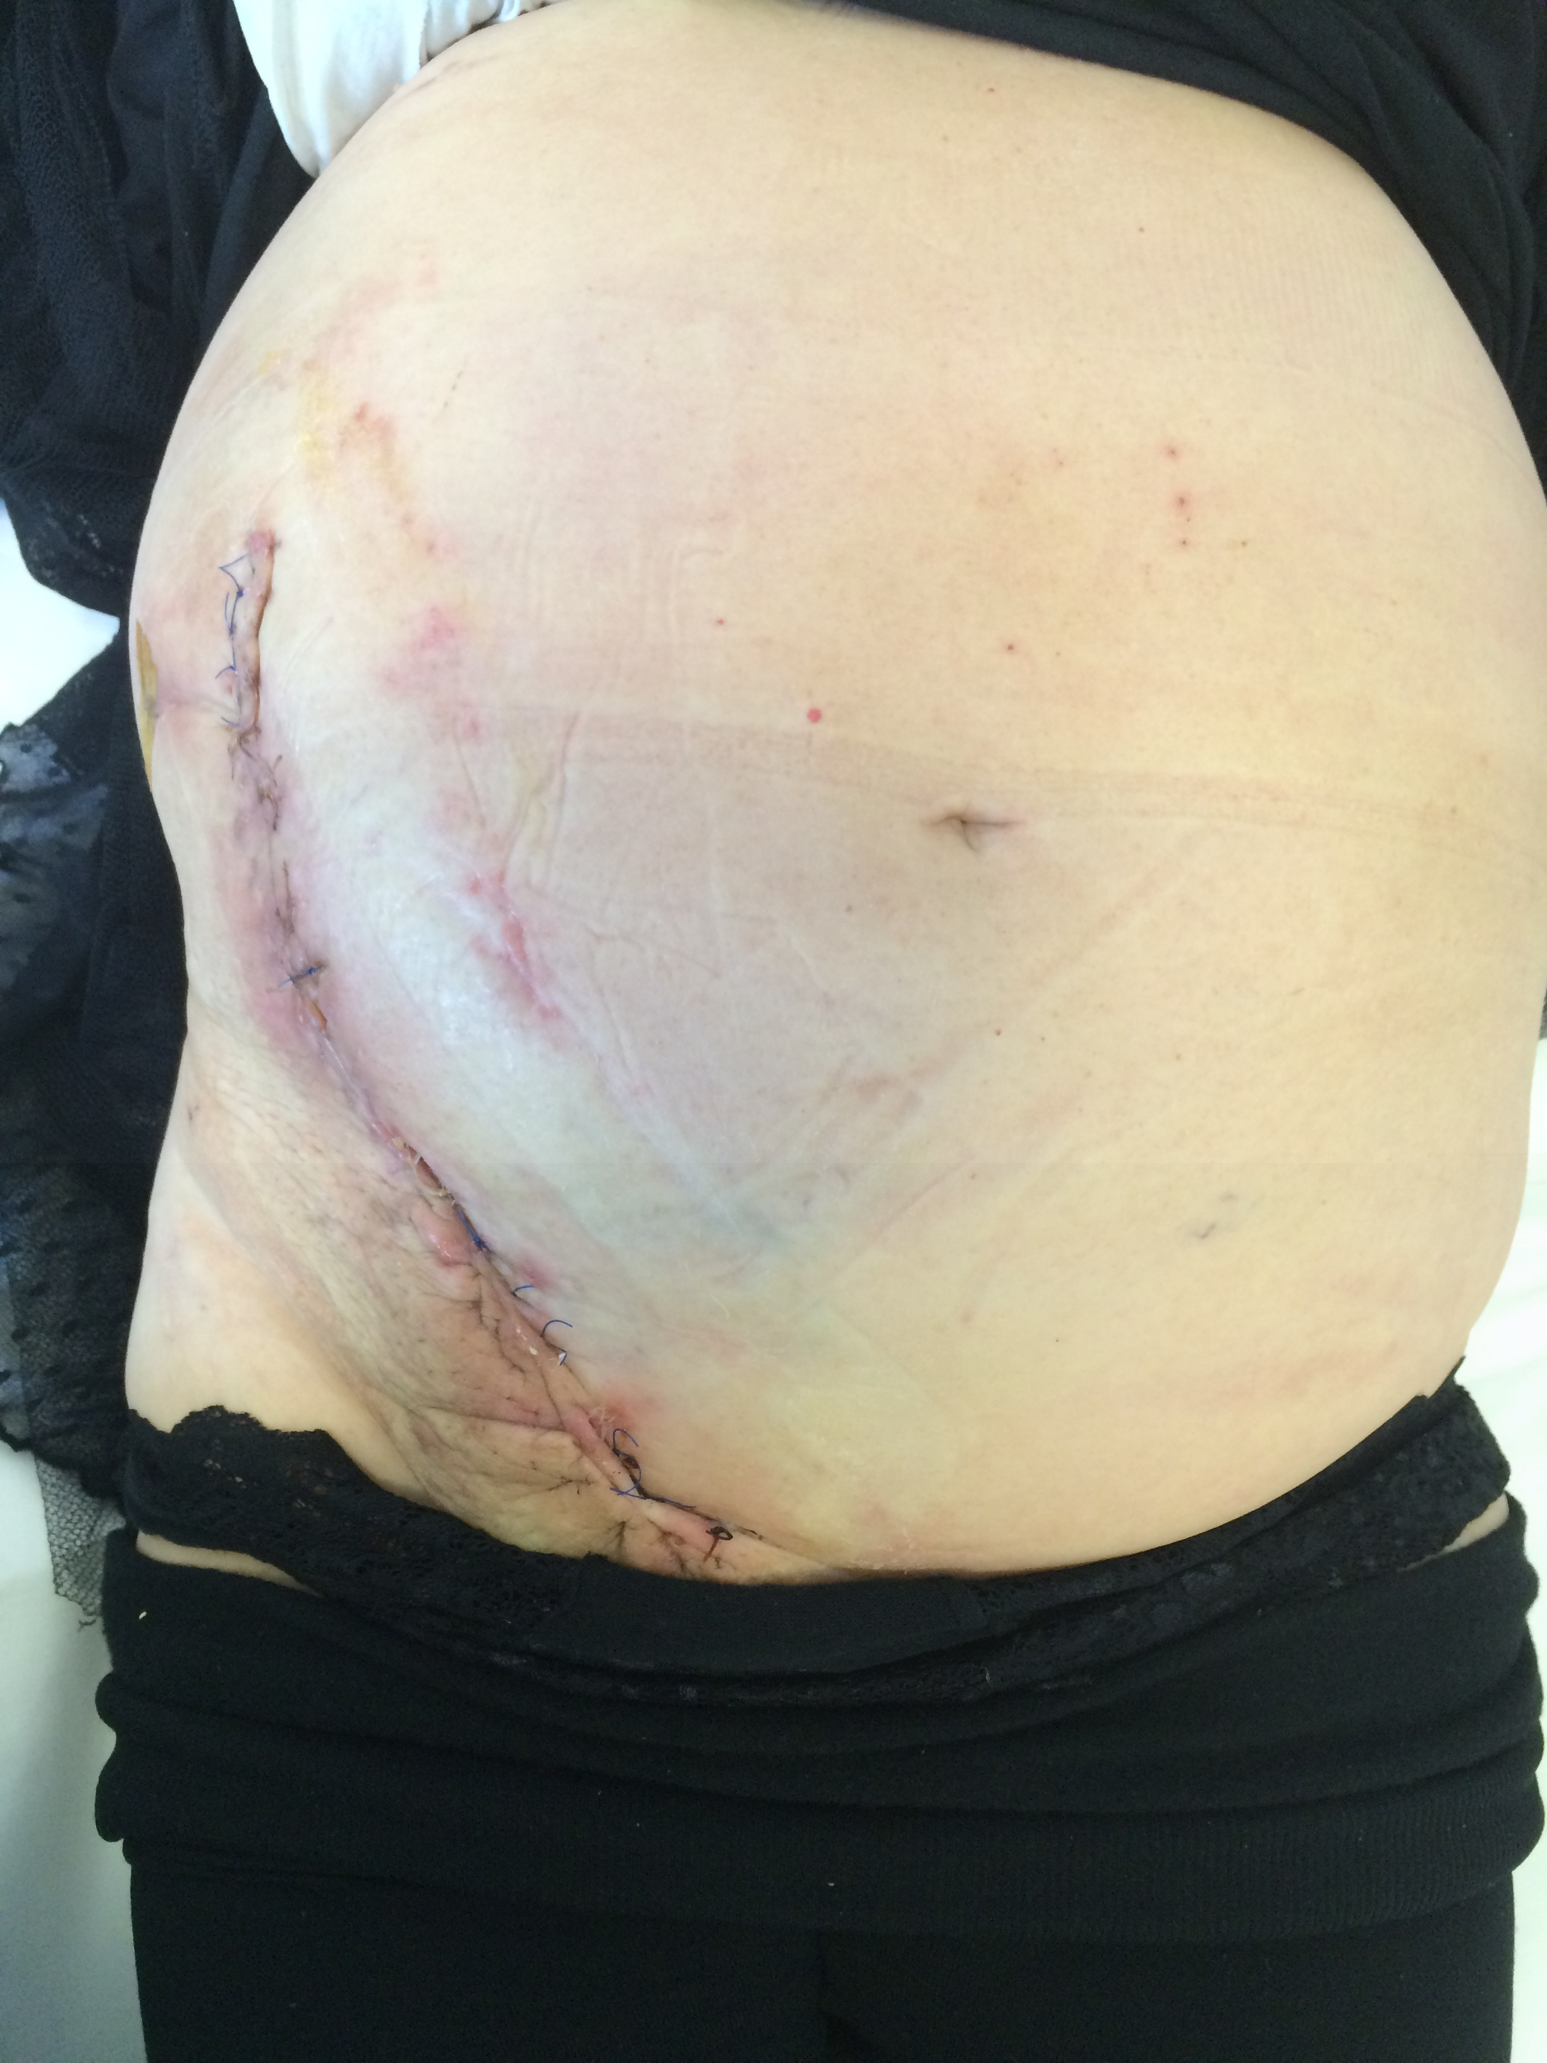

Slide 39
Operative Steps
Open Posterior Component Separation
POSTERIOR COMPONENT SEPARATION WITH INTRAMUSCULAR DISSECTION
The lateral edge of the posterior rectus sheat is incised, dividing the posterior aponeurotic sheath of the internal oblique muscle. (IO- TA).
(Division of neurovascular bundle).

Slide 40
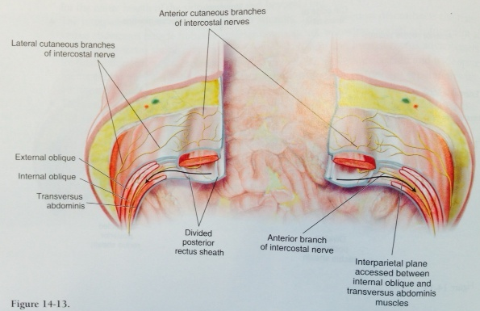
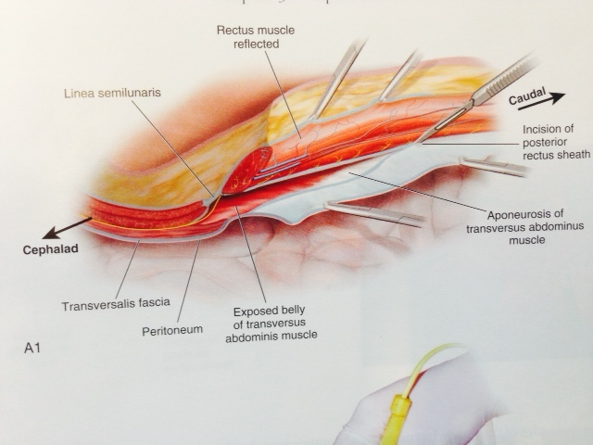


Slide 41
Operative Steps
Open posterior Component Separation
POSTERIOR COMPONENT SEPARATION WITH TRANSVERSUS ABDOMINIS RELEASE
Starting in the arcuate line, about 0,5 cm medial to the posterior rectus sheat junction to expose the underlying transverses abdomens muscle, then transection from down to up of the medial edge of transverses abdomens muscle.
The key component to the release is the division of the entire medial edge of the transverses abdomens muscle.
We are able to release the circumferential muscle tension and afford significant medial advancement of the posterior rectus fascia.

Slide 42
Operative Steps
Open posterior Component Separation
POSTERIOR COMPONENT SEPARATION WITH TRANSVERSUS ABDOMINIS RELEASE
Starting in the upper third of the abdomen, about 0,5 cm medial to the posterior rectus sheat junction to expose the underlying transverses abdomens muscle, then transection of the medial edge of transverses abdomens muscle.
The key component to the release is the division of the entire medial edge of the transverses abdomens muscle.
We are able to release the circumferential muscle tension and afford significant medial advancement of the posterior rectus fascia.

Slide 43
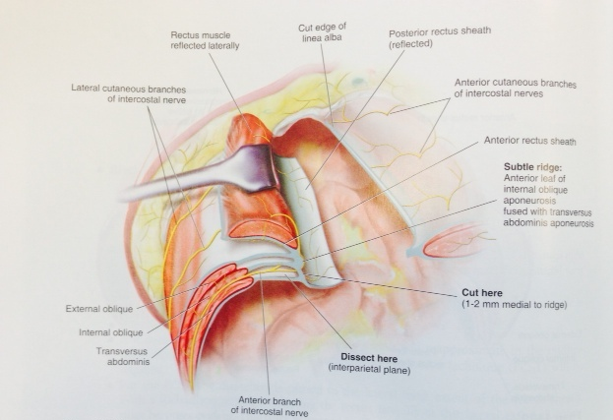
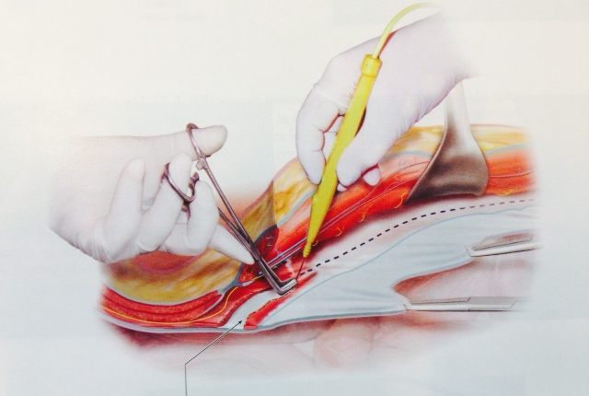

Slide 44
Operative Steps
POSTERIOR LAYER RECONSTRUCTION
The posterior rectus sheaths are reapproximated in the midline, fenestration in the transversals fascia should be repair. Complete exclusion of the abdominal viscera is essential to both avoid intestinal herniations and intestinal exposure to uncoated synthetic mesh. (Omentum, hernia sac, BIO A).

Slide 45
Operative Steps
MESH FIXATION
The mesh is placed as a sub lay in the retromuscolar space.
Inferior edge of the mesh is secured to both Cooper’s ligament.
Superior edge placed in retroxiphoid space.
Reconstruction of the Linea Alba (anterior rectus sheaths).

Slide 46
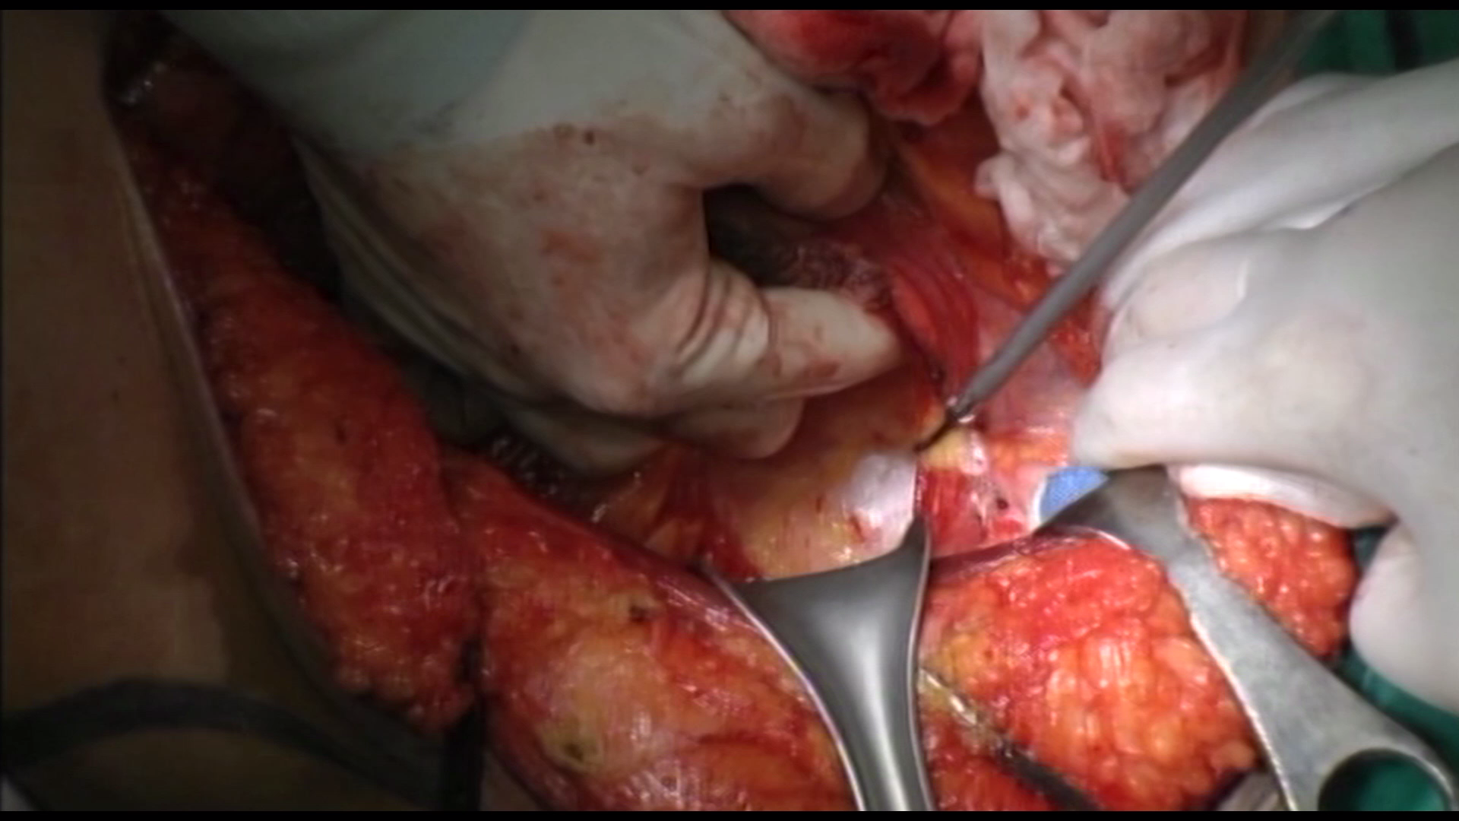

Slide 48


Slide 50



Slide 51


Slide 52


Slide 53


Slide 54


Slide 55
Release of the posterior rectus sheath (posterior component separation) could be achieved with or without transversus abdomens muscle release.
Posterior component separations should not be combined with any type of anterior release.
Retrorectus dissection could be combined with an anterior release(external oblique).

Slide 56


Post-operative ICU

Slide 57
Absorbable mesh and permanent mesh for complex abdominal wall:
a multicenter prospective study
169 PATIENTS
2012
2016
HOSPITAL DEL HENARES
COSLADA
OSPEDALI DEI COLLI-MONALDI
NAPLES
HOSPITAL PUERTA DE HIERRO
MADRID
LA FE HOSPITAL VALENCIA

Slide 58


Slide 59



Slide 60


Slide 61


Slide 62




Slide 63


Slide 64


Slide 65


Slide 66



Slide 67
Limitations of Previous Techniques
Classic Rives-Stoppa retromuscular
dissection to the edge of the rectus sheat only
Insufficient for large defects
Anterior Component Separation
- Wound related ischemia (cutaneous flap)
-Limitation in medial advancement
Preperitoneal Technique
Difficult to reproduce
Not a “reconstructive” option
Intra-muscular PCS
- Denervation of recti

Slide 68
HOW DOES TAR WORK?
TA is known as the “corset” of the abdomen, acting as a girdle
Creates intra-abdominal pressure and hoop tension through the thoracolumbar fascia
Release and Separation of TA
Allows to remove its contribution to the lateral abdominal wall tone
-Provide for medial advancement of both posterior sheat and rectus abdominis muscle

Slide 69
THE TAR PROCEDURE: ADVANTAGES
Effective in restoration of Linea Alba
- Preserves neurovascular bundles to rectus
Giant Prosthetic Reinforcement of the Visceral Sac
No skin flaps
Safe, effective, reproducible
Applicable in the broad range of patients

Slide 70

What else do you need?
TAR with double mesh
LEARN IT

Slide 71


Slide 72


Slide 73


Slide 74

WWW.ishaws.it

