Slide 1
Managing severe traumatic abdominal-wall injuries, a monocentric experience
Abo-Alhassan Fawaz, Perrin Thomas, Bert Marine, Delorme Theophile, Ortega-Deballon Pablo.
HERNIA Journal

Slide 2
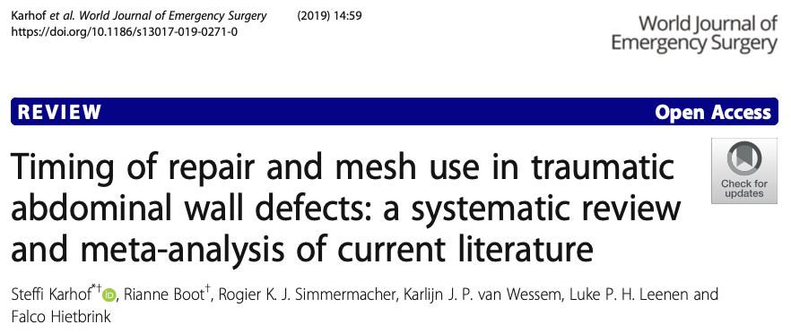
Abdominal Wall Injury (AWI)
INTRODUCTION | METHOD | RESULTS | DISCUSSION | CONCLUSION
AWI
Different severity
Weakness areas in abdominal wall
Inguinal
Umbilical
Lateral abdominal wall
Rare, but increasingly
Severe (<1% of all trauma)
Burst Abdomen
Recommendations sparce
Few case series reported
Biological or biosynthetic
Karhof S, Boot R, Simmermacher RKJ, et al (2019) Timing of repair and mesh use in traumatic abdominal wall defects: a systematic review and meta-analysis of current literature. World J Emerg Surg
Dennis RW, Marshall A, Deshmukh H, et al (2009) Abdominal wall injuries occurring after blunt trauma: incidence and grading system. The American Journal of Surgery

Slide 3
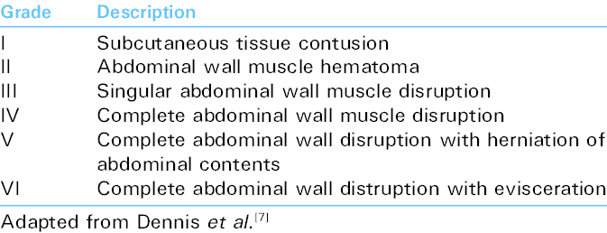
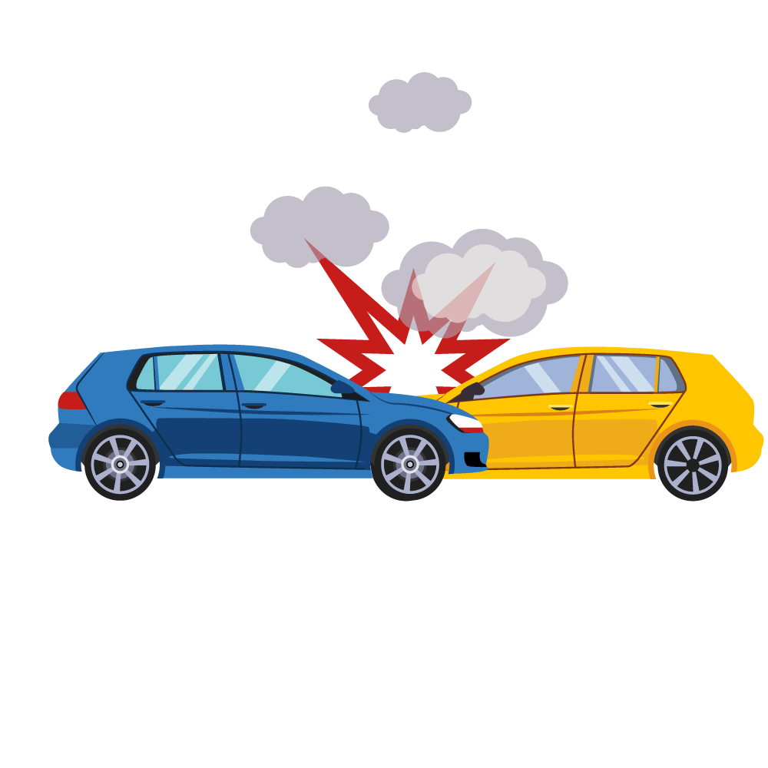
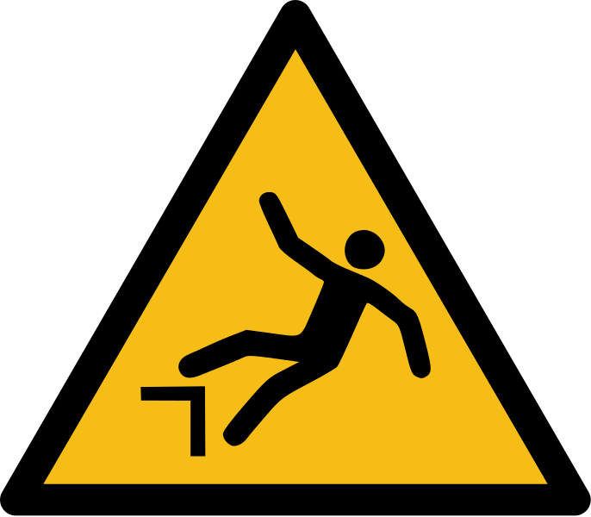
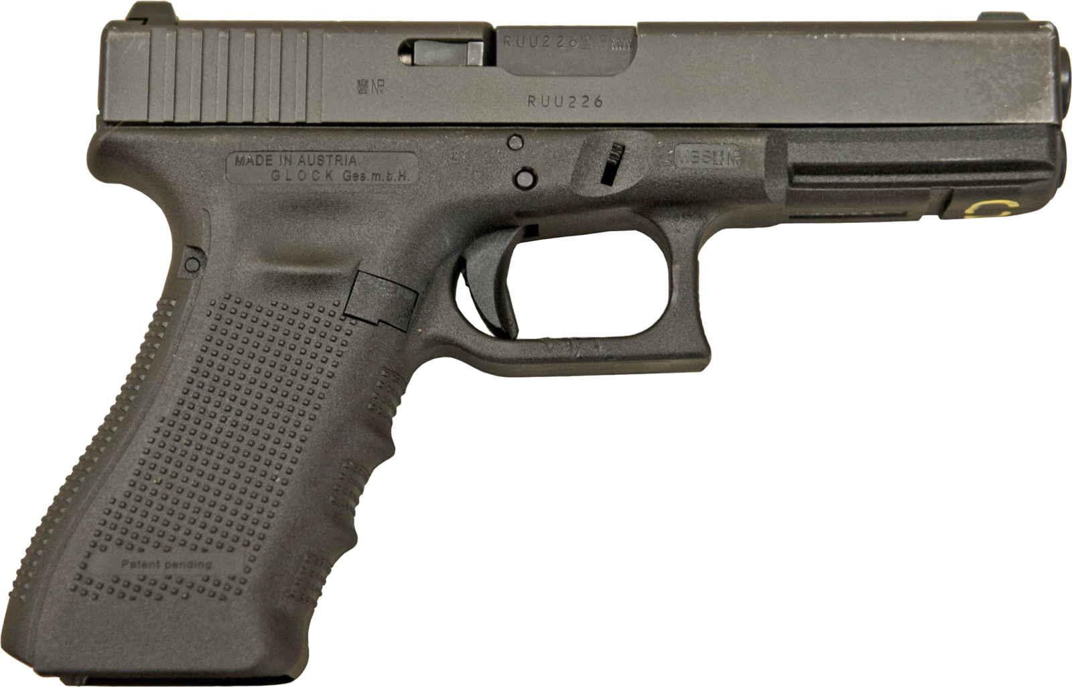
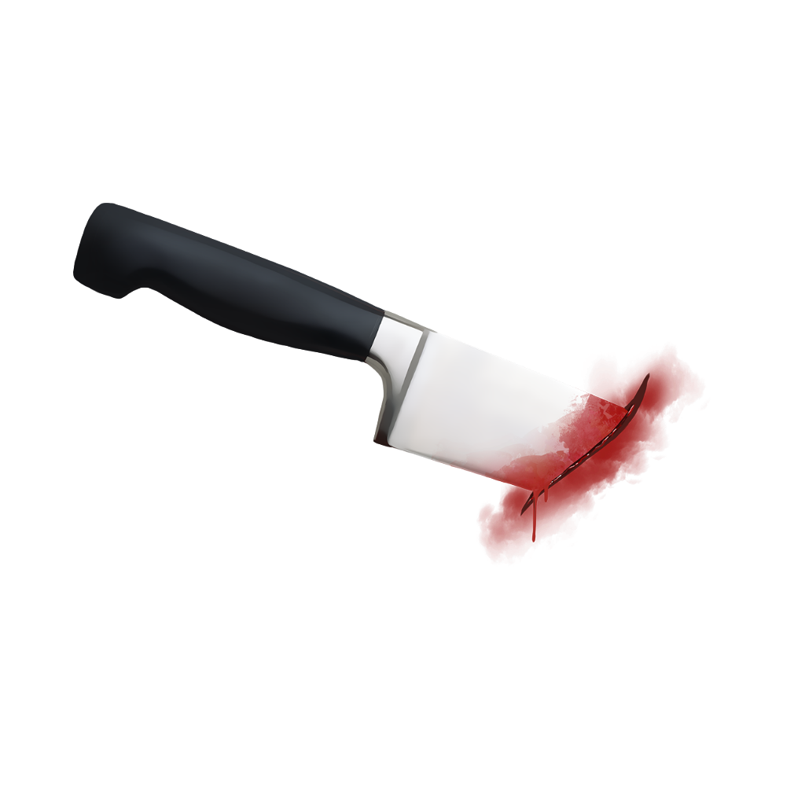
INTRODUCTION | METHOD | RESULTS | DISCUSSION | CONCLUSION
Abdominal Wall Injury (AWI)
Penetrating
Blunt
Dennis RW, Marshall A, Deshmukh H, et al (2009) Abdominal wall injuries occurring after blunt trauma: incidence and grading system. The American Journal of Surgery

Slide 4
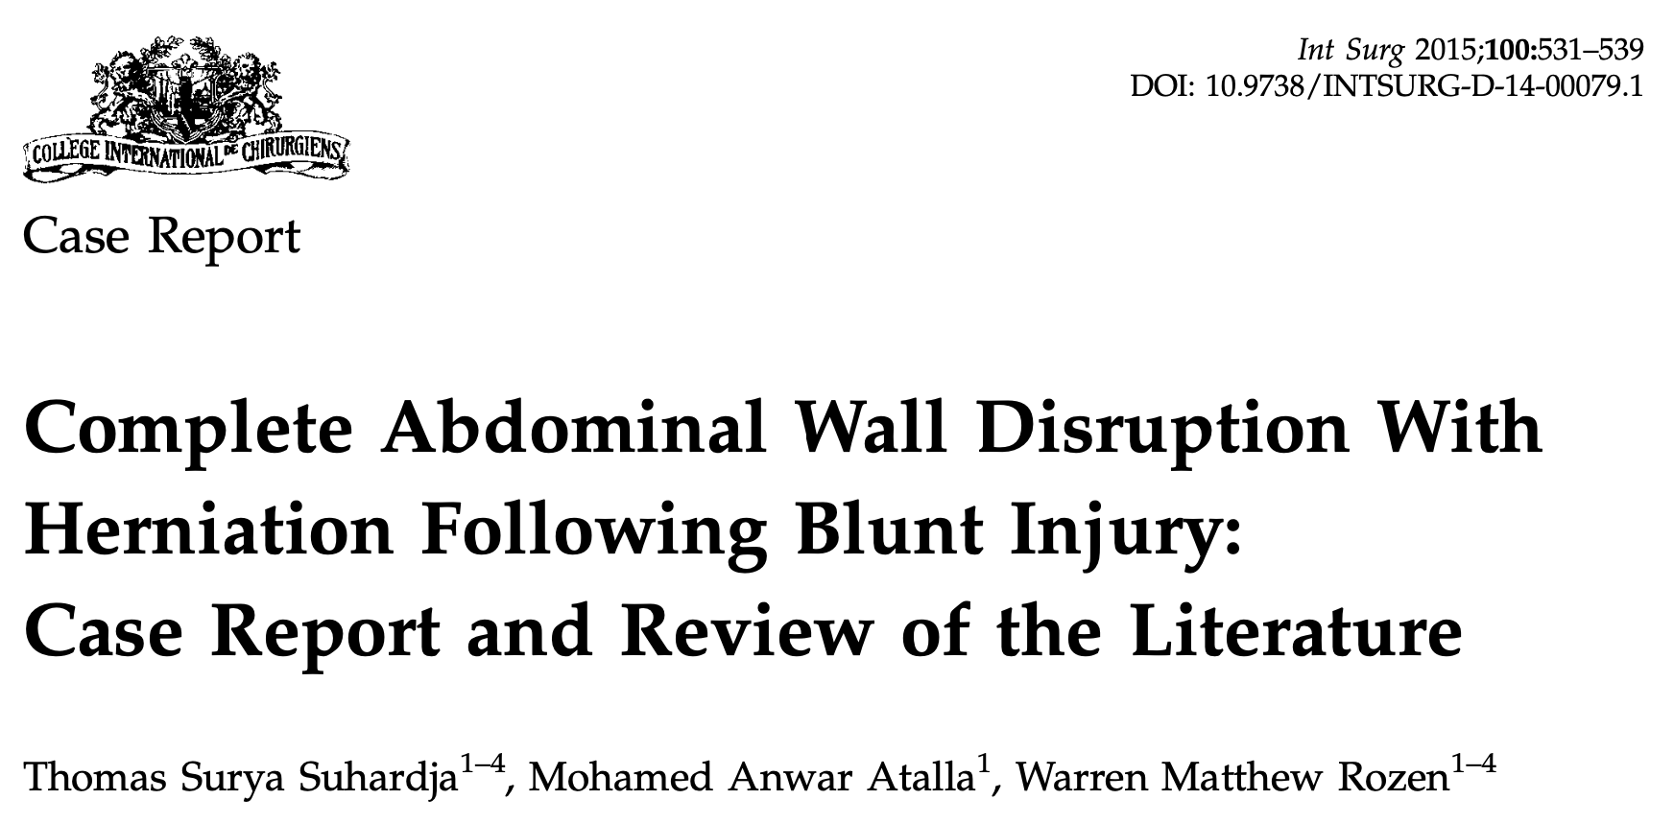
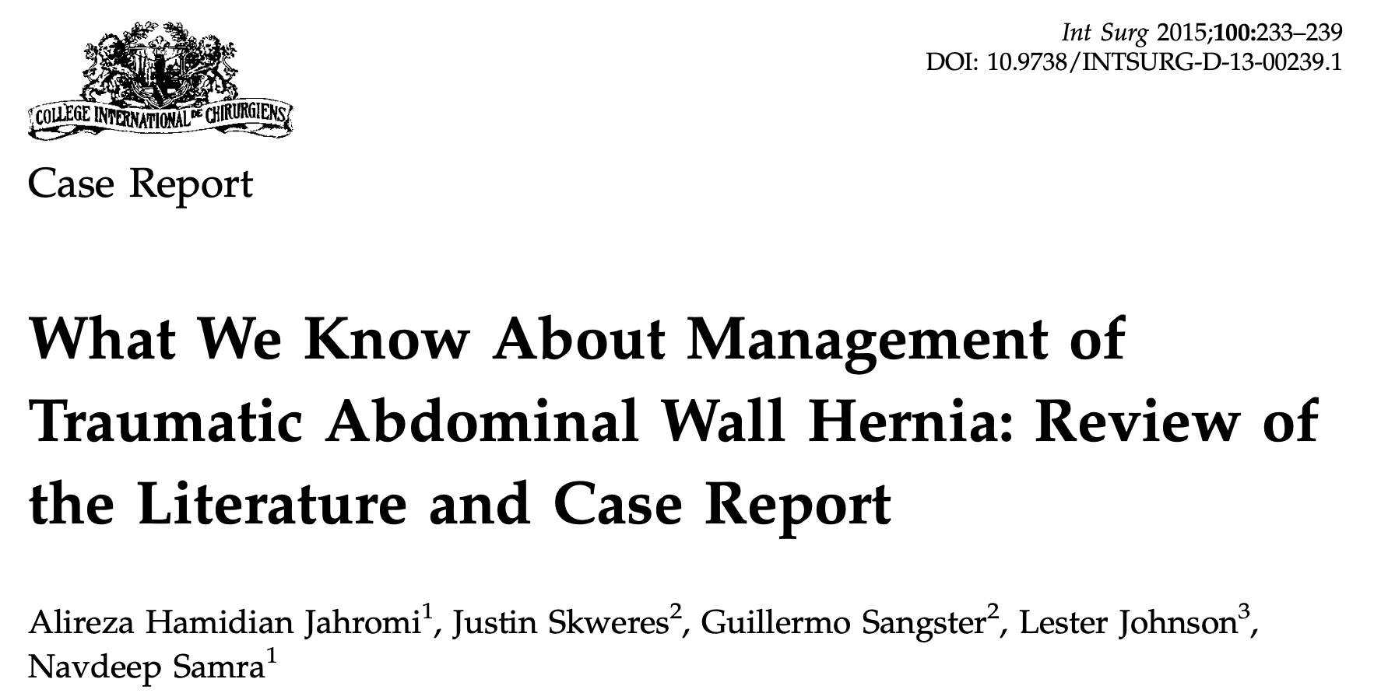
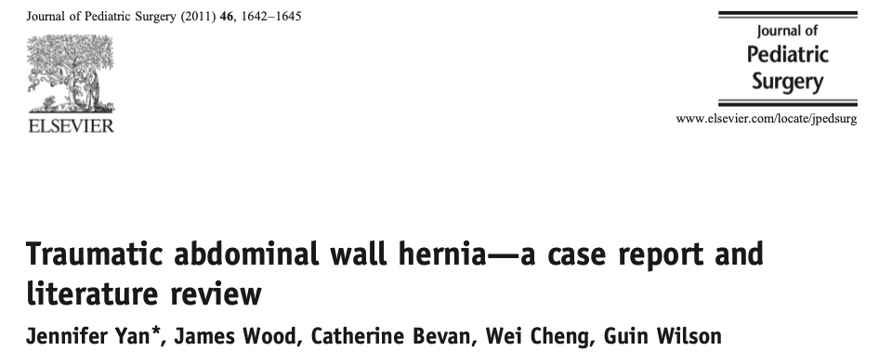
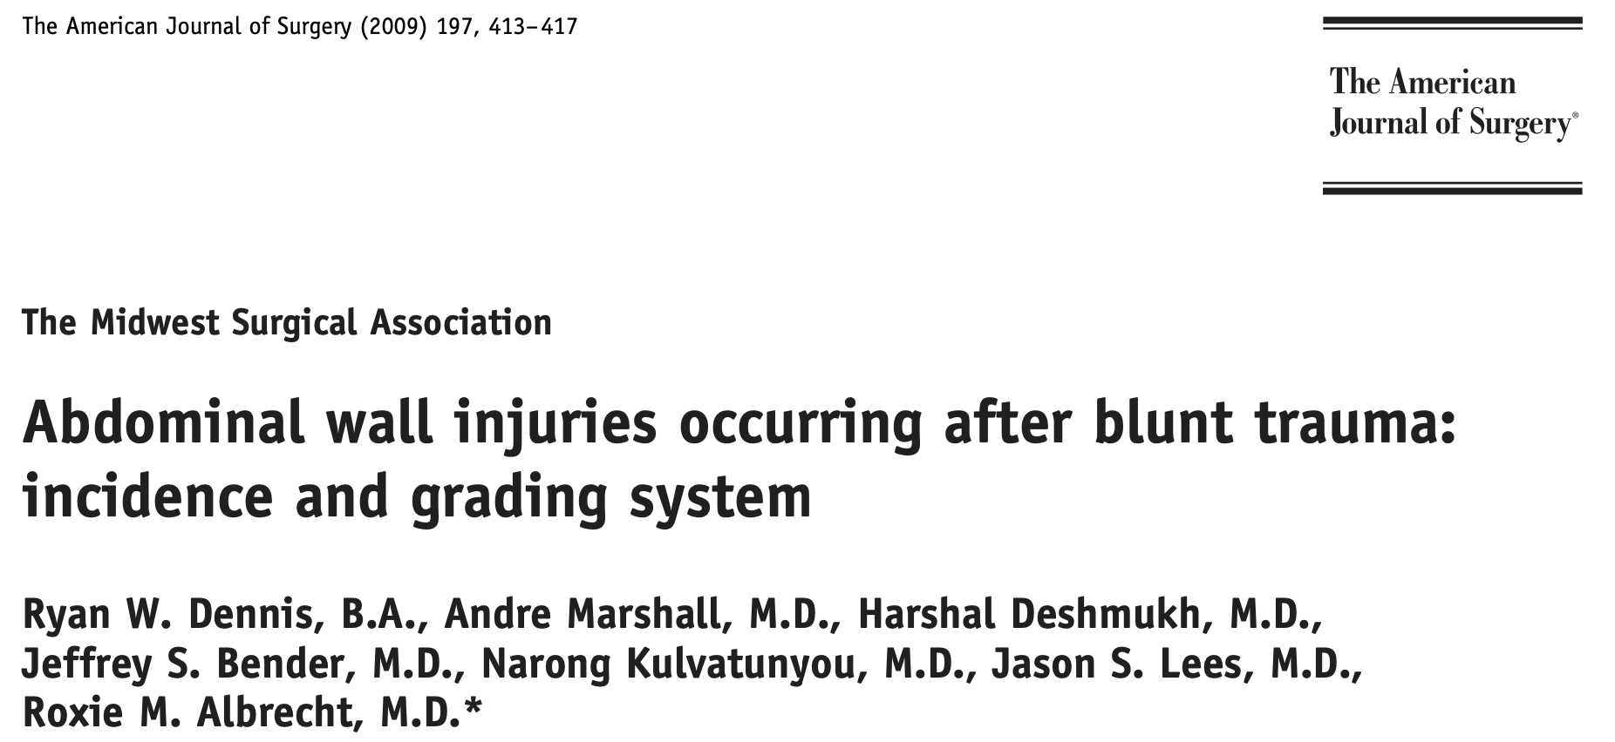
INTRODUCTION | METHOD | RESULTS | DISCUSSION | CONCLUSION

Slide 5
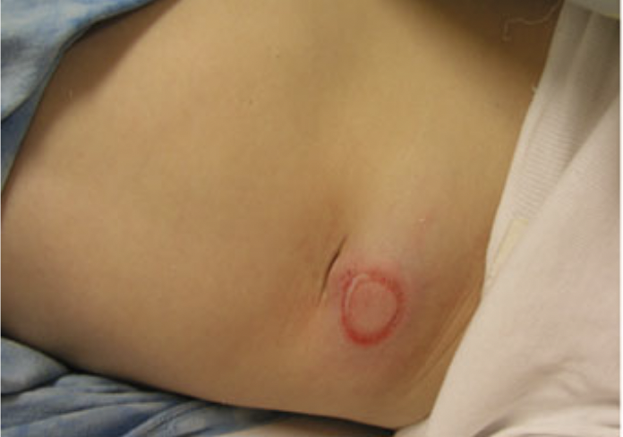
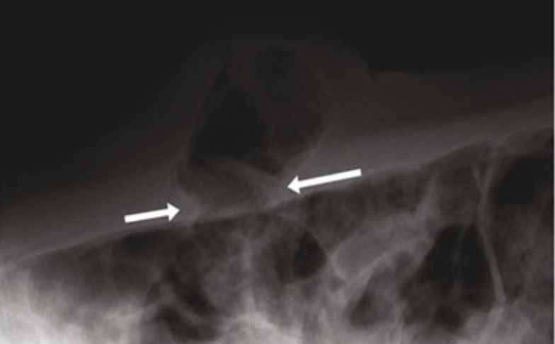
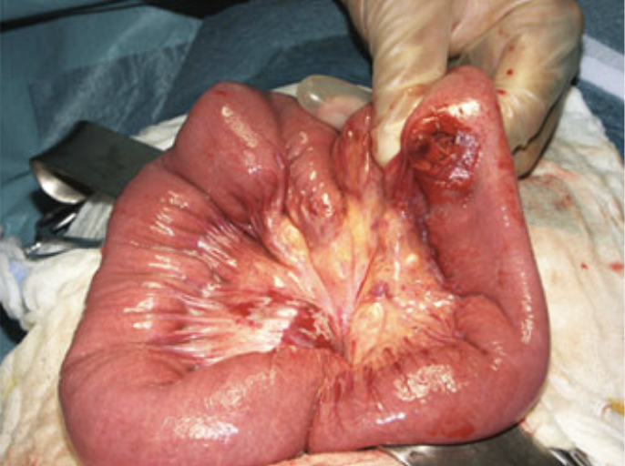
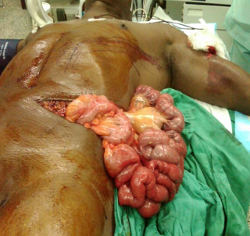
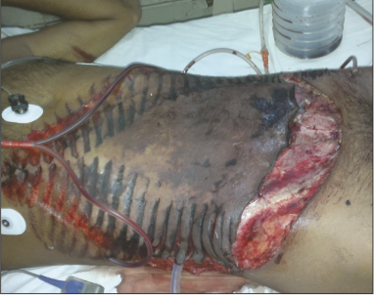
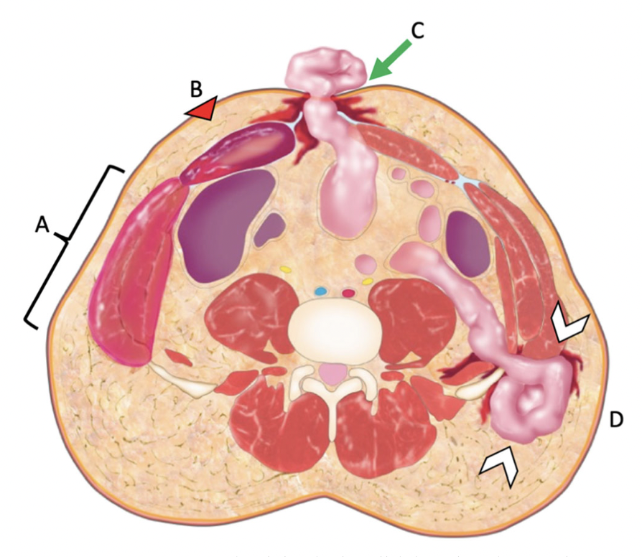
INTRODUCTION | METHOD | RESULTS | DISCUSSION | CONCLUSION

Slide 6
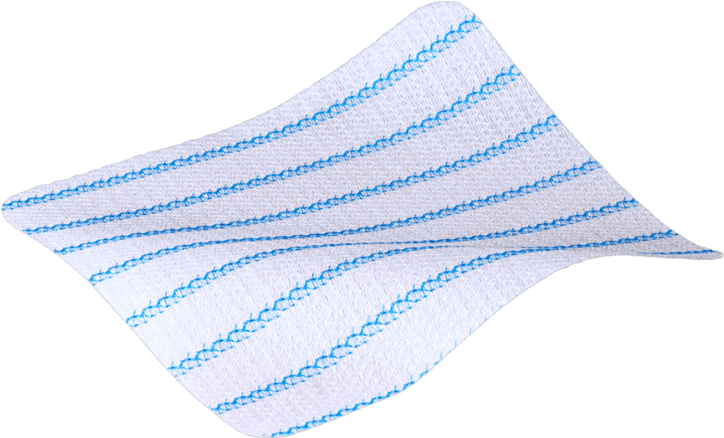
INTRODUCTION | METHOD | RESULTS | DISCUSSION | CONCLUSION
?
Method
Case Series
2014-2021
AWI IV, V, VI
Treated in CHU Dijon

Slide 7
INTRODUCTION | METHOD | CASES | DISCUSSION | CONCLUSION
Case | Year | Age | Gender | Type of injury | Grade of AWI* | Type of repair | Follow up | Recurrence
1 | 2014 | 63 | M | crush injury | V | primary suture | 7 years | no
2 | 2014 | 11 | F | RTA | V | primary suture | 7 years | yes
3 | 2015 | 20 | F | RTA | V | mesh | 5 years | no
4 | 2017 | 29 | F | stab | VI | mesh | 3 years | yes
5 | 2019 | 23 | M | RTA | V | mesh | 1 year | no
6 | 2020 | 85 | M | gunshot | VI | primary suture | 1 year | no
7 | 2021 | 70 | M | RTA | V | primary suture | 4 months | no
8 | 2021 | 33 | M | Fall | VI | primary suture | NA*** | NA
Table 2: Summary of the 8 patients treated in our center
* Abdominal wall injury
** Road traffic accident
*** Not available

Slide 8
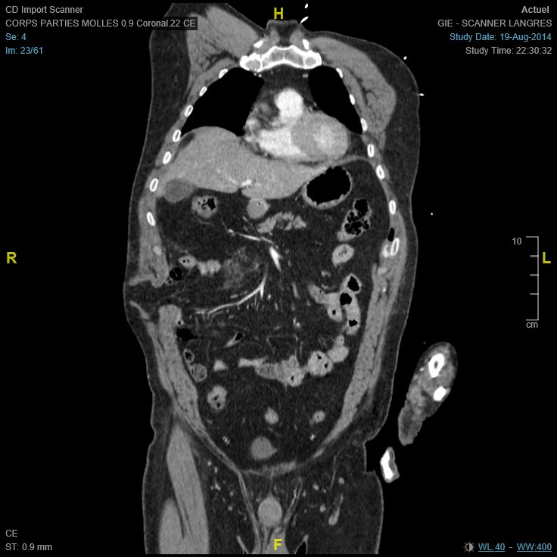
INTRODUCTION | METHOD | CASES | DISCUSSION | CONCLUSION
Year | Age | Gender | Type of injury | Grade of AWI* | Type of repair | Follow up | Recurrence
2014 | 63 | M | crush injury | V | primary suture | 7 years | no
Stable
Associated Injuries:
Pancreatic contusion
Right costal fracture
Epiploic herniation
Operated J1 laparoscopy

Slide 9
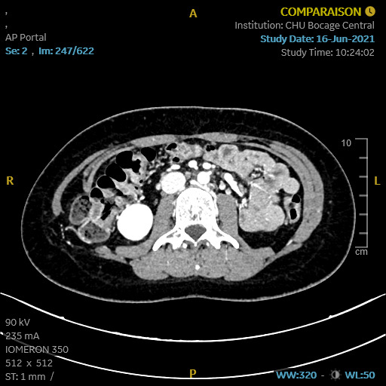
INTRODUCTION | METHOD | CASES | DISCUSSION | CONCLUSION
Year | Age | Gender | Type of injury | Grade of AWI* | Type of repair | Follow up | Recurrence
2014 | 11 | F | RTA | V | primary suture | 7 years | yes
Stable
Associated injuries:
Cecal necrosis
Right mesocolic rup
Right lat + rectus m.
Operated H6
Recurrence 6 month
Reoperated GORETEX
Recurrence 7 years
J0
7 years

Slide 10
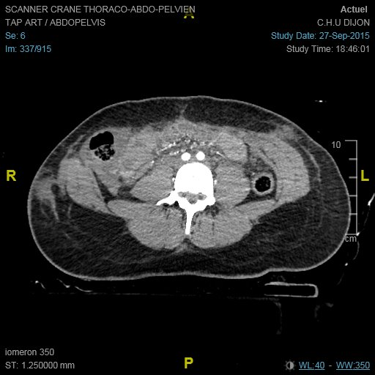
INTRODUCTION | METHOD | CASES | DISCUSSION | CONCLUSION
Year | Age | Gender | Type of injury | Grade of AWI* | Type of repair | Follow up | Recurrence
2015 | 20 | F | RTA | V | mesh | 5 years | no
Stable
Seat belt syndrome
Associated Injuries:
T12 complete luxation
Rt abdo muscl rupture
Rt colon herniation
Ileale perforation?
Vicryl mesh due to tissue loss

Slide 11
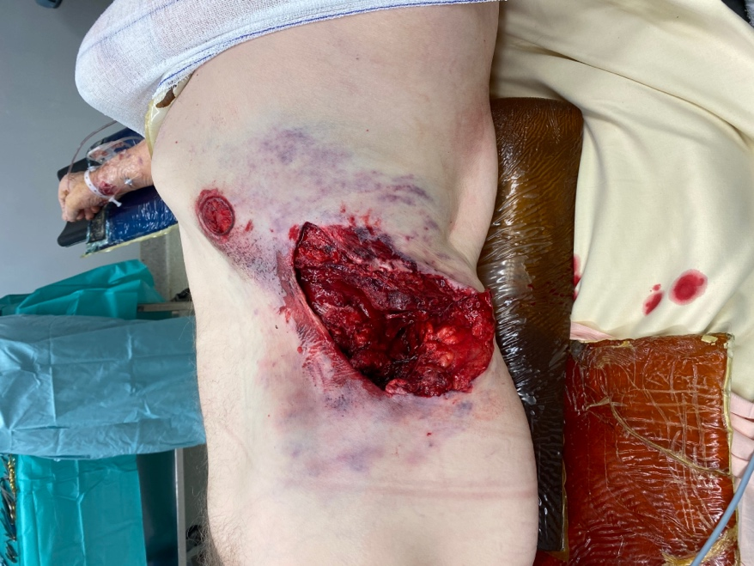
INTRODUCTION | METHOD | CASES | DISCUSSION | CONCLUSION
Year | Age | Gender | Type of injury | Grade of AWI* | Type of repair | Follow up | Recurrence
2020 | 85 | M | gunshot | VI | primary suture | 1 year | no
Stable
Associated injuries:
musculocut tissue loss
left iliac arc fracture
Layered fasciomuscular closure

Slide 12
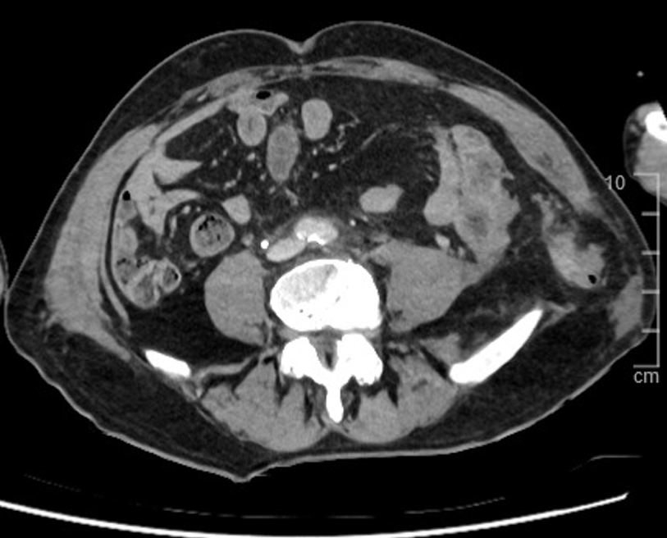
INTRODUCTION | METHOD | CASES | DISCUSSION | CONCLUSION
Year | Age | Gender | Type of injury | Grade of AWI* | Type of repair | Follow up | Recurrence
2021 | 70 | M | RTA | V | primary suture | 4 months | no
Unstable after CT
Associated Injuries:
Sigmoid perf
Left lat muscle rupture
Damage Control
48h – repair + colostomy

Slide 13
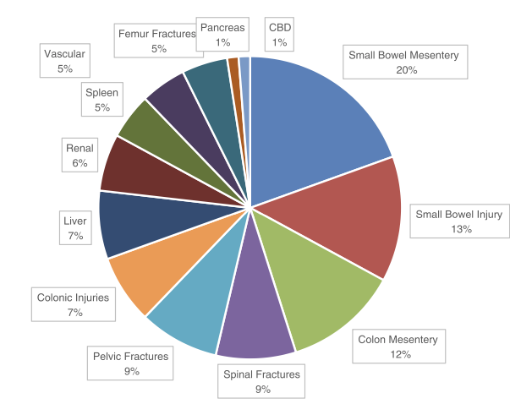
INTRODUCTION | METHOD | CASES | DISCUSSION | CONCLUSION
No recommendations
ATLS
Low threshold to operate
Strangulation, occlusion,
30% of severe AWI associated with bowel injuries
Delayed presentation (hematoma)
Rathore A, Murherjee I, Kumar P (2013) Traumatic abdominal wall injuries: a review. Minerva Chir 68:221–232
Honaker D, Green J (2014) Blunt traumatic abdominal wall hernias: Associated injuries and optimal timing and method of repair. Journal of Trauma and Acute Care Surgery

Slide 14
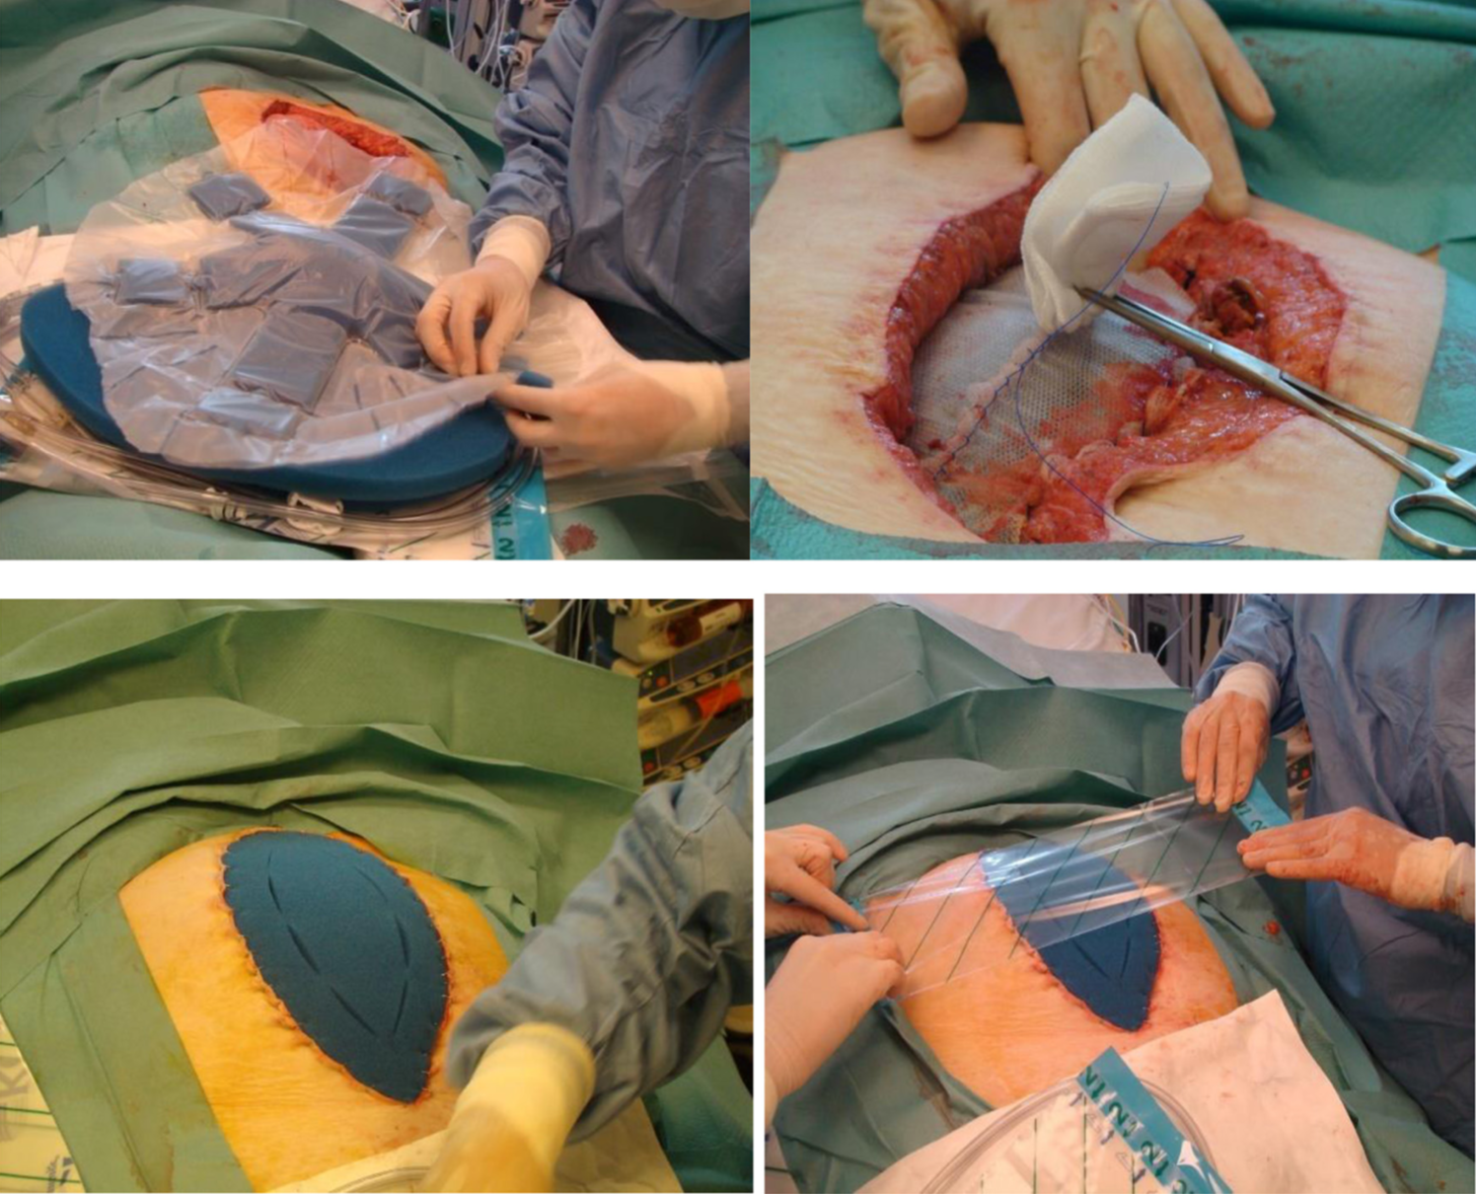
INTRODUCTION | METHOD | CASES | DISCUSSION | CONCLUSION
Tension free repair
Layered closure if possible
EHS – slowly absorbable monofilament “small bite”
Biosynthetic mesh repair
mesh-mediated fascial traction (MMFT)
associated with negative pressure wound therapy (NPWT)
Bridging (Inlay)

Slide 15
INTRODUCTION | METHOD | RESULTS | DISCUSSION | CONCLUSION
?

