Slide 1
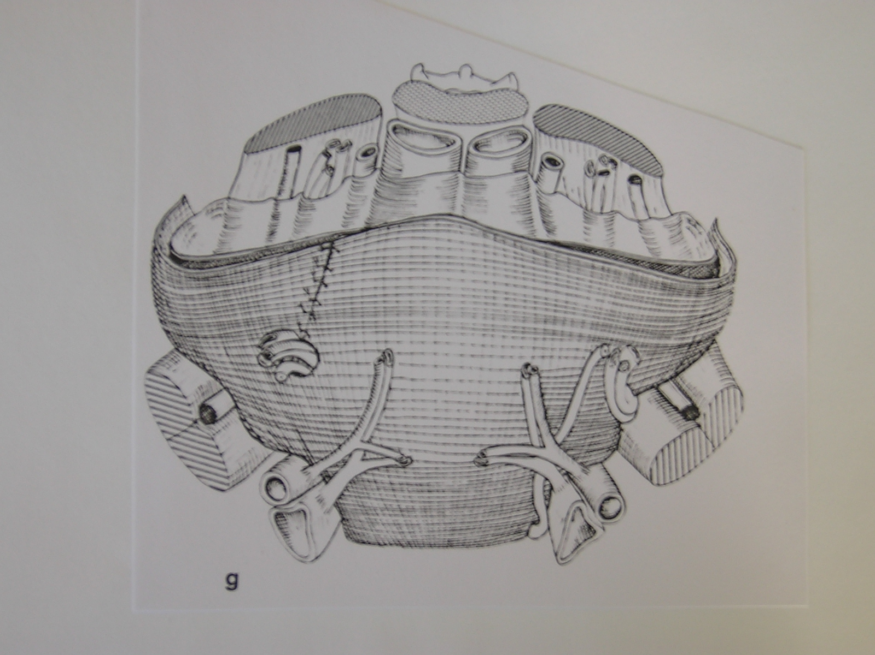
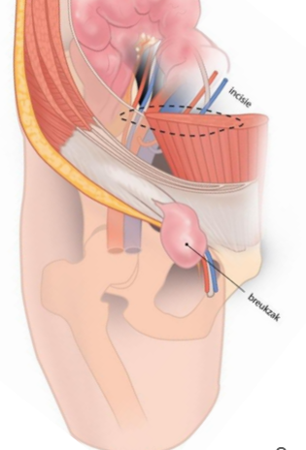
XVIII Symposium sur les prothèses pariétales Mesh 2022 Paris 17 JUIN 2022
Session 3: OPEN PREPERITONEAL FOR GROIN HERNIA REPAIR:
« GOING OPEN IS NOT GOING BACK » « Gabriel de oliveira »
OPEN PREPERITONEAL REPAIR: STORY & HISTORY; Marc Soler
TREPP TECHNIQUE, TRAINING AND EDUCATION; Willem Akkersdijk The Netherlands
QUALITY MANAGEMENT, PATIENT EXPECTATIONS AND PERSPECTIVES, ACCEPTANCE FOR THE SURGEON
Gabriel de Oliveira (Hospital Garcia de Orta, Almada, Portugal)
UPDATED GUIDELINES FOR PREPERITONEAL APPROACH Ralph Lorenz (Berlin, Allemagne)
Notes:
Jean François, Thank you so much to give us the opportunity to speak about the open preperitoneal technique
As Gabriel de Oliveira said with his nice slogan “GOING OPEN IS NOT GOING BACK »we will show you what it is possible de put a very large mesh in the pre peritoneal space mesh with A really minimal invasive techniques
100% endoccopic surgery is not possibleI will start with the history of this approach
Willem Akkersdijk will present the trepp technique. It is the only pure open posterior technique with the Ugahary technique
here is the slogan invented by I have start to learn how to operate hernias with René Stoppa so i always keep in mind its wonderful principle
Open preperitoneal is

Slide 2
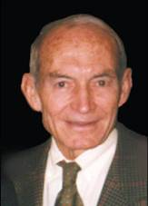
XVIII Symposium sur les prothèses pariétales Mesh 2022 Paris 17 JUIN 2022
Open Preperitoneal – A better Inguinal hernia mesh repair
Story and History
Marc Soler Cagnes sur Mer
Notes:
I have start to learn how to operate hernias with René Stoppa always keeping in mind its wonderful principle

Slide 3
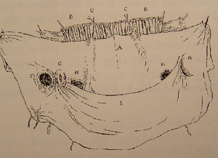
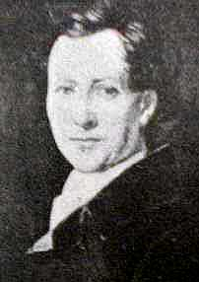
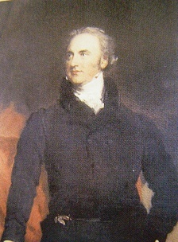
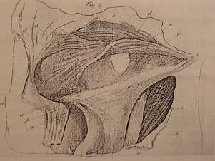
ANATOMIST AGE
The postérior inguinal wall as seen from the preperitoneal approach. In Recherches anatomiques sur les hernies de l’abdomen, by J Cloquet, Paris: Mequigon-Marvis, 1817
J. G. CLOQUET (1790-1883)
Description of the Tranversalis fascia: A. P Cooper ( 1768-1841)
The etiology of groin hernias is mainly related to a congenital deficiency of the fascia tranversalis

Slide 4
Anesthesia 1848
It will allow penetration through the abdominal wall and therefore the posterior approach
Notes:
But nothing was possible before the before decisive progress of Anesthesia

Slide 5
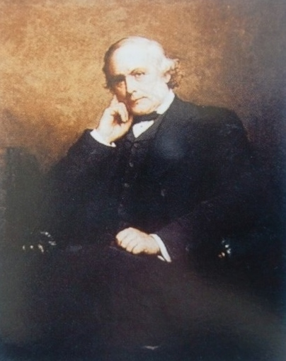
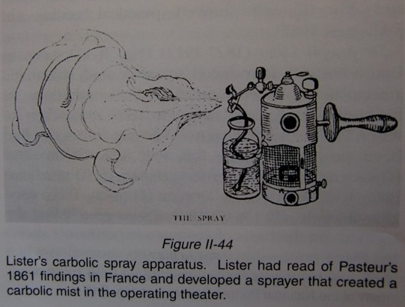
ASEPSIS 1867-1873
Lister
The application of these rules of asepsia by Lucas Championnière in 1885 will allow the inguinal approach: the Antisepsis
Notes:
THE PRINCIPLES OF ASEPSIA
Championniere was the fist surgeon to cut the external oblique aponeurosis muscle, before bassini

Slide 6
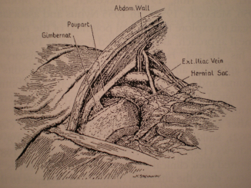
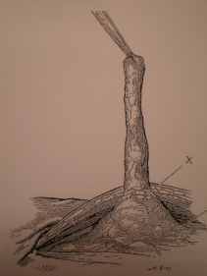
THE PIONEERS
Annandale: In 1876 he reported the concept
of the preperitonel posterior approach.
Lawson Tait of Birmingham reported in 1883 and 1891 on the median abdominal section in hernia.
Maunsell (1887), and Marcy (1892) made the same suggestion
Sir G. Lenthal Cheatle of London (1920, 1921) had sutured inguinal and femoral hernias through a midline preperitoneal approach

Slide 7
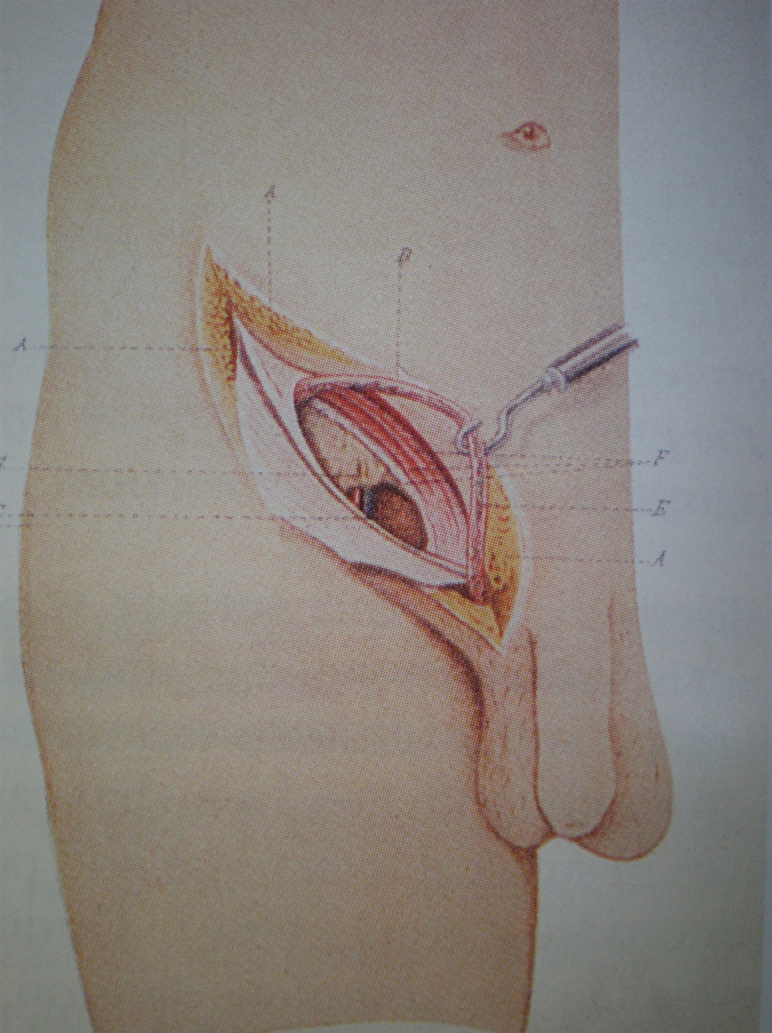
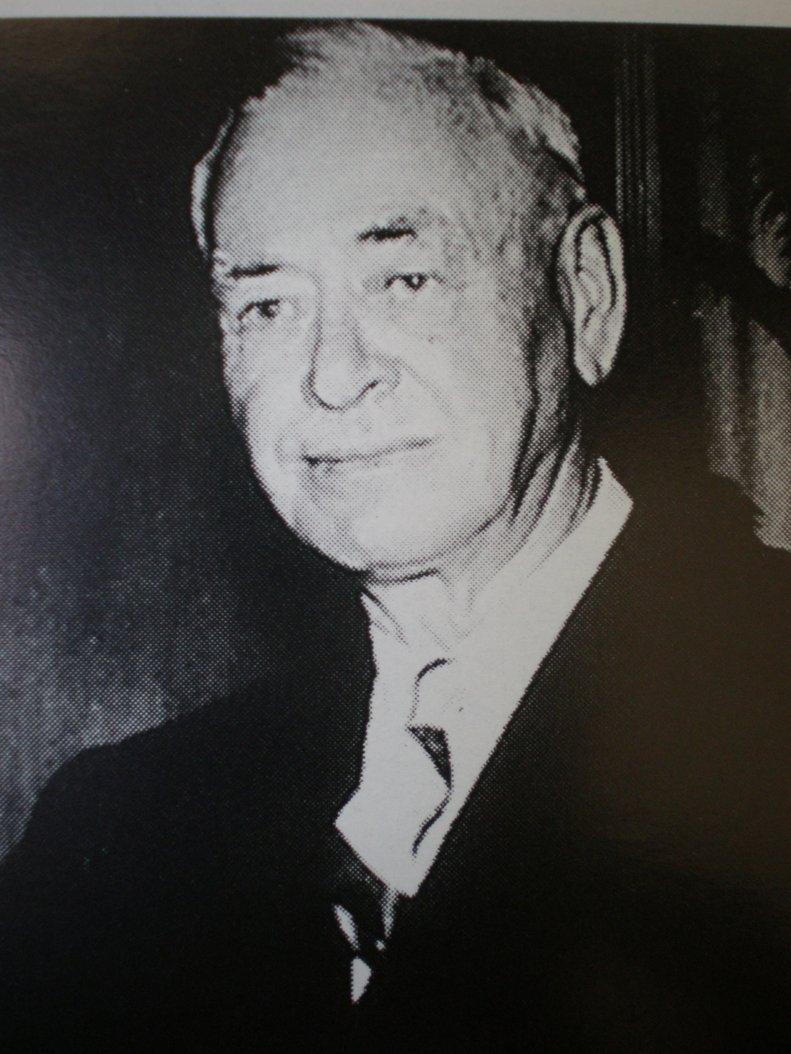
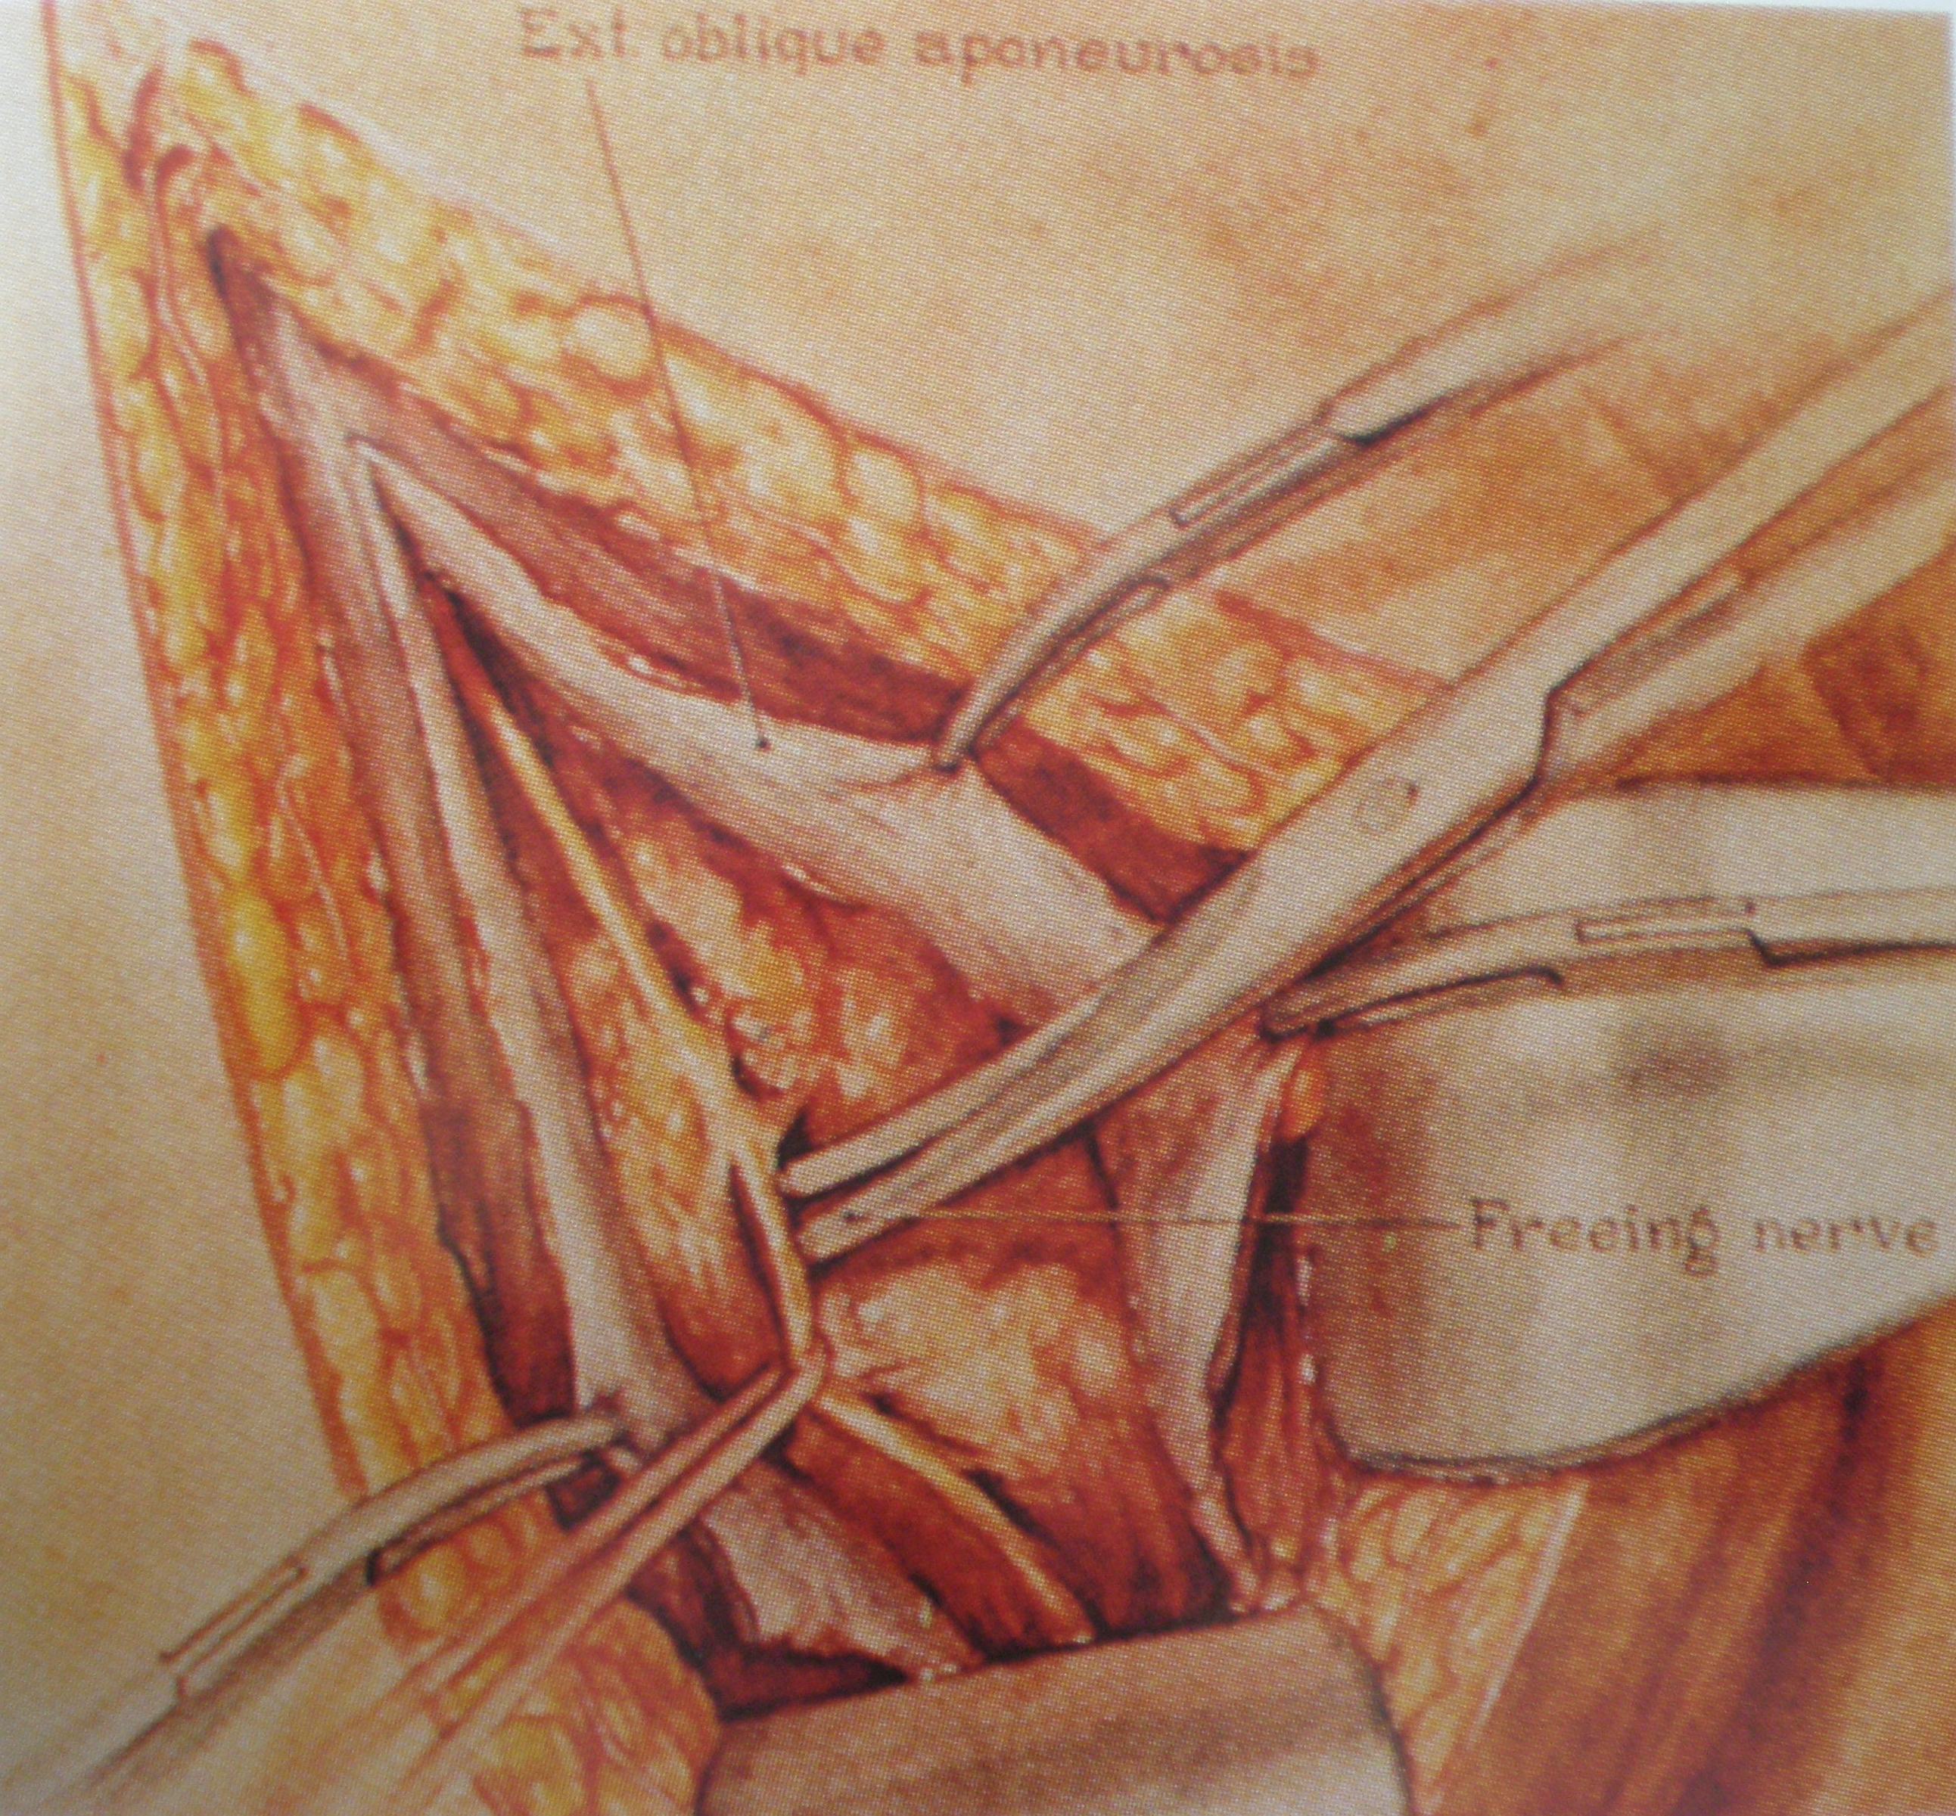
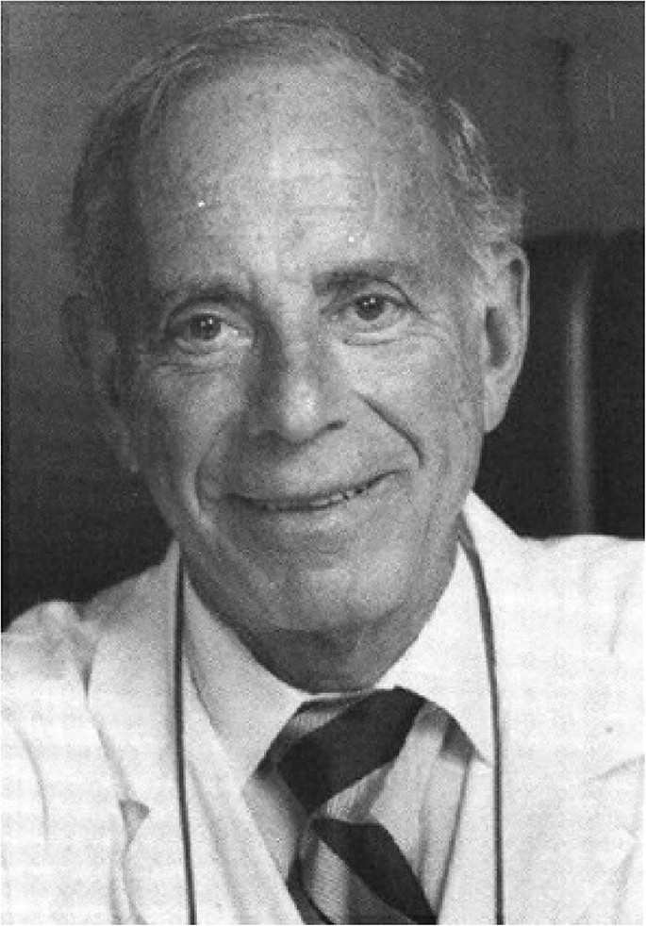
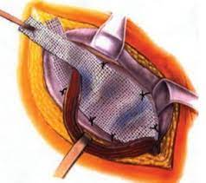
Eduardo Bassini (1844-1924)
E. Earle Shouldice (1890-1965)
I. L. Lichtenstein
Notes:
Since the biginning it was a battle …
AND THE FIRST STANDARD GOLD WERE FOR THE ANTERIOR APPROACH
With the marvellous Catterina drawings: the mission of Catterina was to clarify bassini’s original technique

Slide 8
Acquaviva/ Corti: the innovators the hammock prosthesis
D. Corti Thesis 1949: Page 19
Groin Hernias
Retro funicular approach:
"The plaque can not only be firmly fixed to the arch, but above all be placed as a" hammock "up to Cooper's ligament, thus forming an insurmountable obstacle to a lower recurrence and at the same time blocking the femoral orifice. (Obs 28,33,34,36)
doi: 10.1007/s10029-021-02398-5. Online ahead of print.
Don Eugène Acquaviva (1897-1976): The real founder of modern parietology using a prosthetic mesh!
M Soler , J A Giuly , R Bendavid
Notes:
It is my pleasure to honor French surgeons who are a little forgotten Acquaviva and his step son corti described how to operate hernias with a big prothesis years before Fruchaud

Slide 9
Acquaviva/Corti: the innovators Closure of the musculopectineal orifice
D. Corti Thesis 1949: Page 20
Femoral hernias:
“In femoral hernias, the safest procedure, although we have no supporting findings, appears to be inguinal treatment with fixation of the plaque to Cooper's ligament after sac treatment.
A real diaphragm is thus placed above the femoral orifice which must ensure a long-lasting result”
doi: 10.1007/s10029-021-02398-5. Online ahead of print.
Don Eugène Acquaviva (1897-1976): The real founder of modern parietology using a prosthetic mesh!
M Soler , J A Giuly , R Bendavid
Notes:
he said this, although a surgeon had never used a prosthesis to treat a femoral hernia at this moment. it was revolutionary

Slide 10
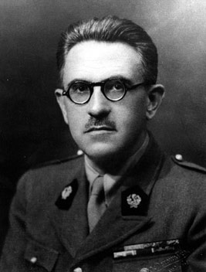
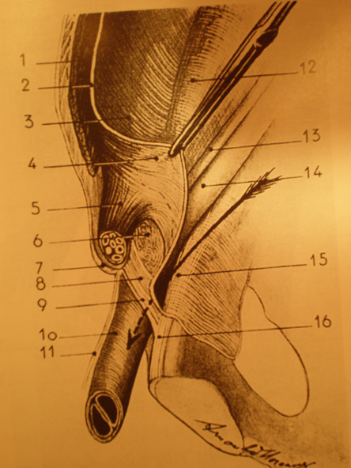
Henri R Fruchaud, 1956 Surgical Anatomy of groin hernia Surgical treatment of groin hernia
Notes:
But of course Fruchaud's work was considerable

Slide 11
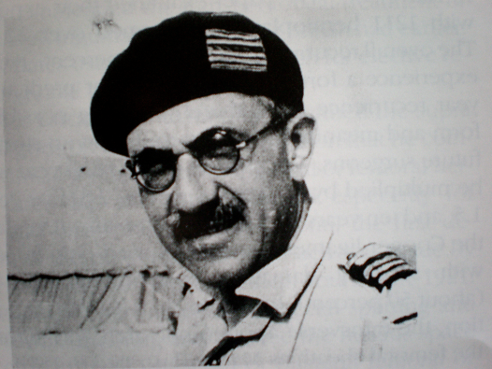
Henri R Fruchaud, 1956
The surgical treatment of inguinal or femoral hernias must not be the closure of the inguinal canal or the femoral ring, but the « deep reconstruction » of the abdominal wall in the whole groin region
Notes:
the wide coverage of the musculoperiteneal orifice, called Fruchaud orifice, but years after the hammock principle from corti and Acquaviva

Slide 12
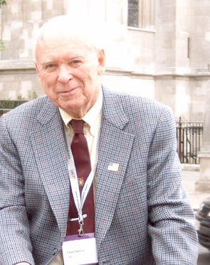
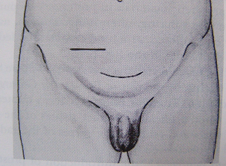
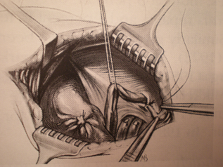
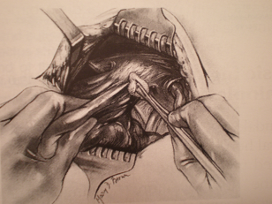
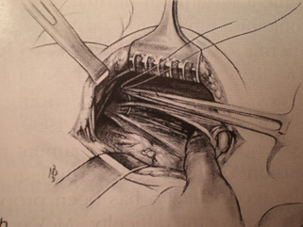
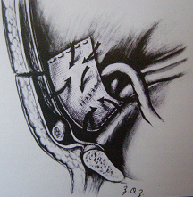
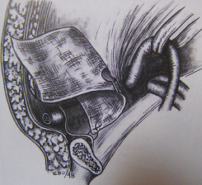
The Nyhus Preperitoneal Repair, 1960
Notes:
the first surgeon who popularized the posterior approach is nyhus, who began to put on prostheses after treatment failures for big medial hernias using this approach.

Slide 13
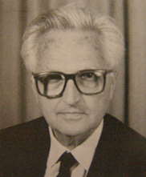
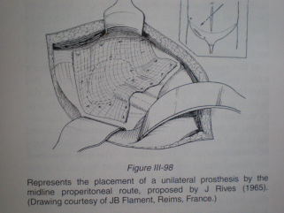
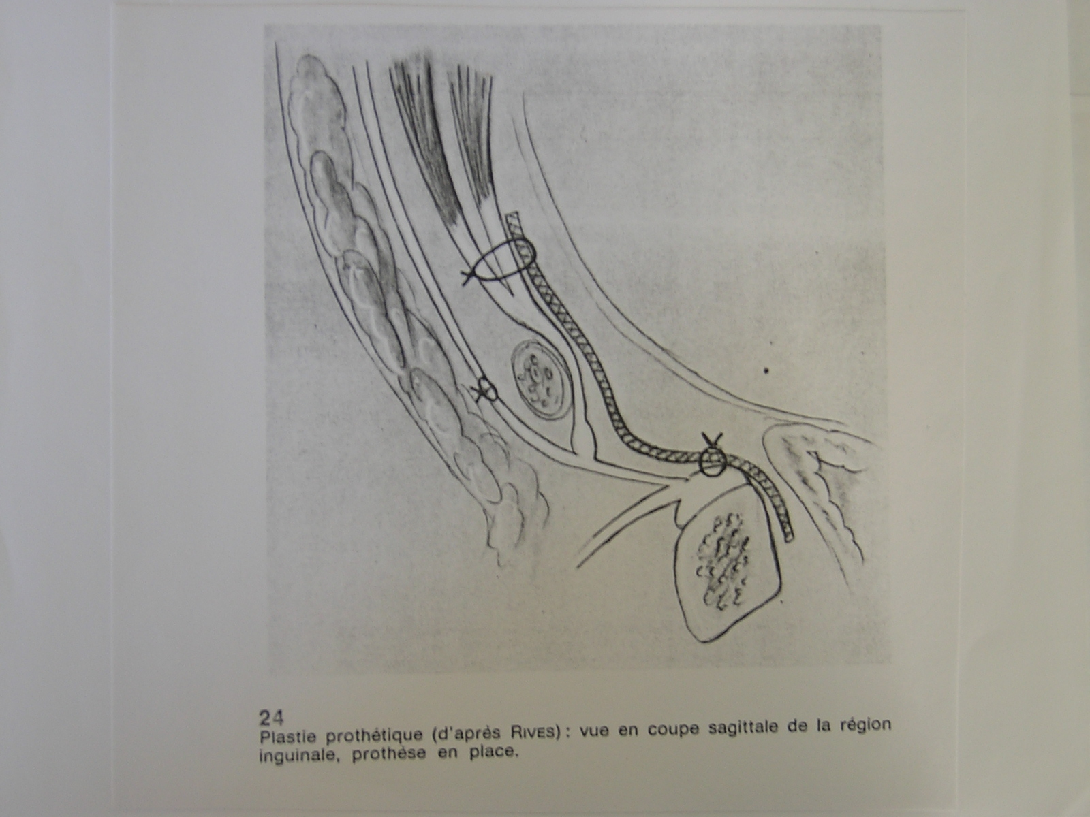
Jean RIVES 1965

Slide 14
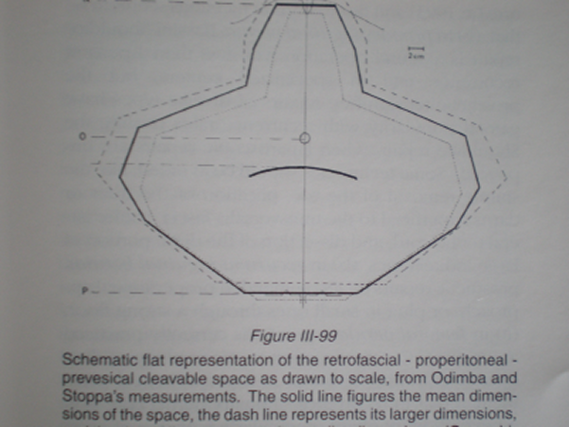
René Stoppa
Giant prosthetic reinforcement of the viscéral sac
1967: First tension free and sutureless hernia repair
Notes:
fruchaud was their mentor, they worked with him in De Ribet's anatomy laboratory at the Faculty of Algiers

Slide 15
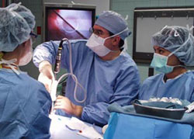
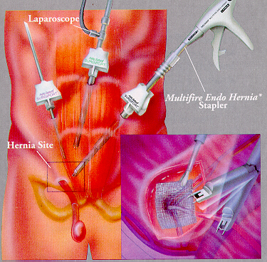
Laparoscopic hernia surgery 1992
Transperitoneal approach
J. Leroy, G. Fromont
Propéritoneal approach
G.Begin, Dulucq
Notes:
Before the open pre preperitoneal here is the endoscopic principle

Slide 16
Laparoscopic hernia surgery 1992
Minimal ACCESS surgery
But not minimal invasive surgery
- general anesthesia with endotracheal intubation and curarisation
-technique is complex
-high cost of instrumentation
-Specific vascular and visceral… complications
-Use of lots of single-use plastic materials and Gaz
Notes:
Open preperitoneal

Slide 17
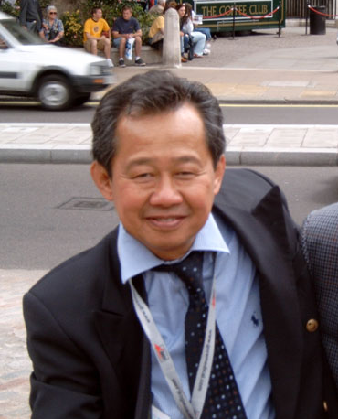
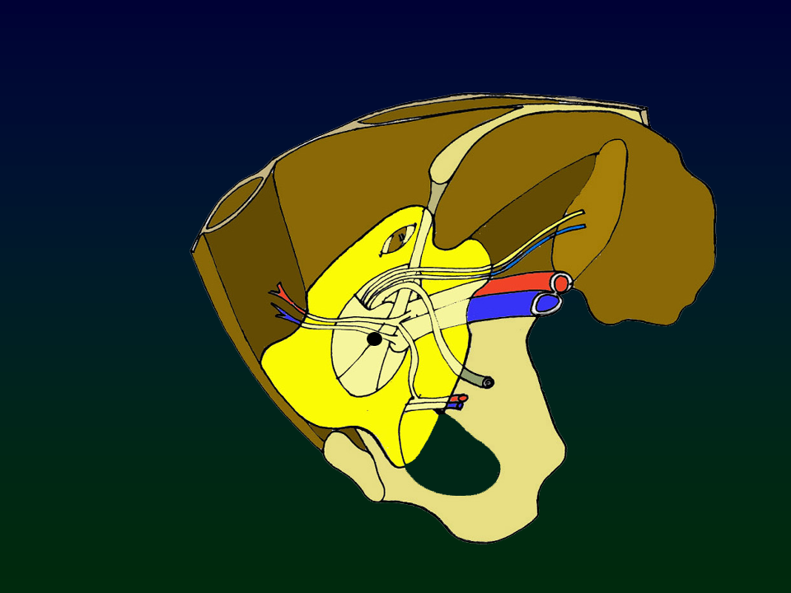
Franz Ugahary
1995
Notes:
For me the real pionniers of the modern Open preperitoneal approach is Franz Ugahary with the GRID IRON technique

Slide 18
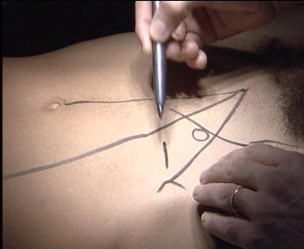
Skin incision 3-4 cm
The anatomical landmarks should always be drawn on the skin
Inguinal ligament
Lat border of rectus muscle
Projection of inf epigastric
vessels
Internal ring
Medial line
Notes:
With a small incision 3 cm above the deep inguinal rong

Slide 19
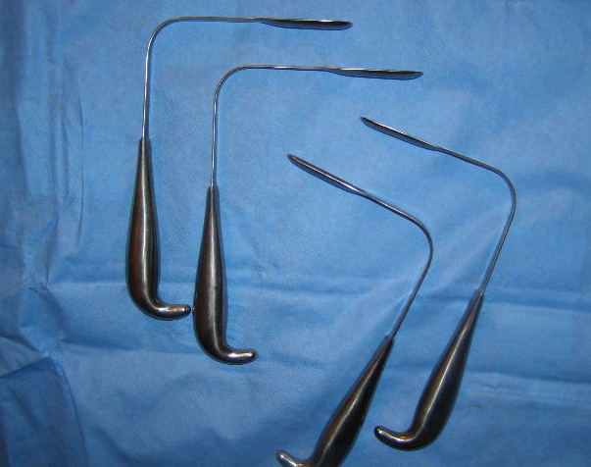
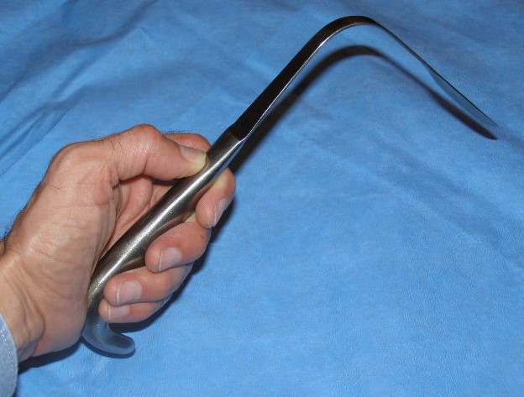
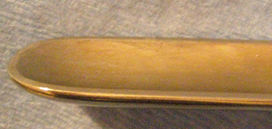
SPECIFIC MATERIAL

Slide 20
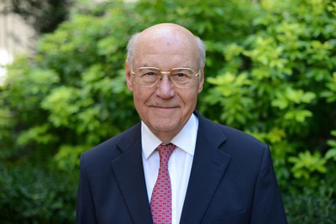
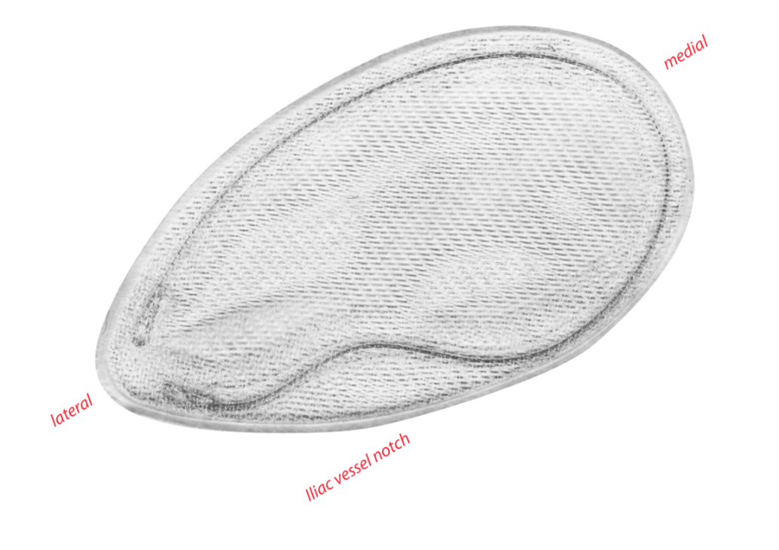
« Trans Inguinal Pre Peritoneal » technique: TIPP 2005
Creation by E. Pellissier of this prosthesis with rigid ring facilitating its implantation in the preperitoneal space and creation of the TIPP technique (2005)
Edouard Pélissier
New prosthesis Created by E. Pellissier with a rigid ring facilitating the implantation in the preperitoneal space: creation of the TIPP technique (2005)
4. Pélissier Hernia. 2001
5. Pélissier Hernia. 2006
Notes:
But thanks to Edouard Pélissier it was easier to unroll a big prothesis in the preperitoneal space

Slide 21
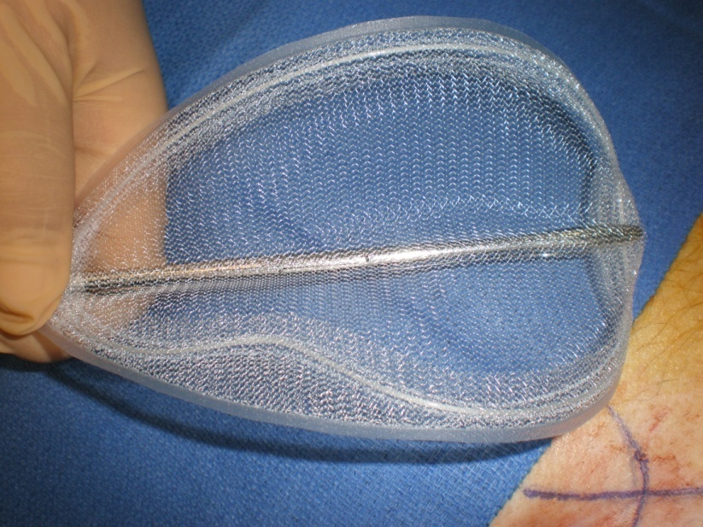
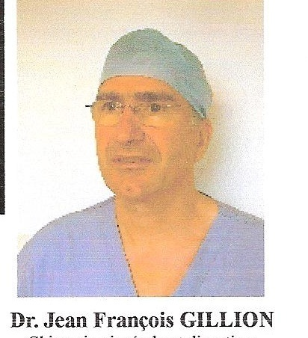
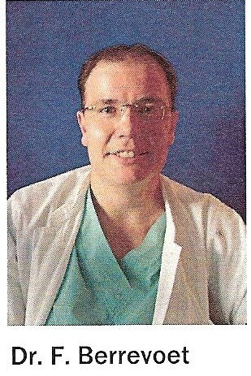
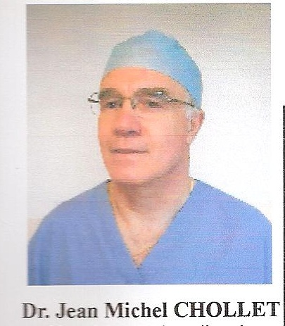
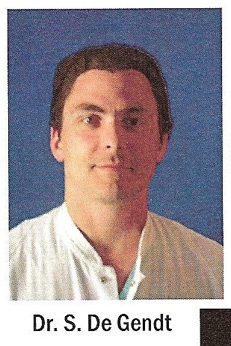
TIPP TECHNIQUE 2005

Slide 22
Comparaison Between MOPP/TIPP AND UGAHARY incision
UGAHARY
TIPP/MOPP
Notes:
Here is the difference between the two techniques. With the MOPP / TIPP technique the incision is in front of the deep inguinal ring and the Ugahary incision is 3 cm above. For me, the Ugahary technique remains the best for operating recurrences after Lichtenstein or no mesh technique

Slide 23
+
= MOPP, 2011
Notes:
And for me the MOPP technique it is TIPP with the specific instrument

Slide 24
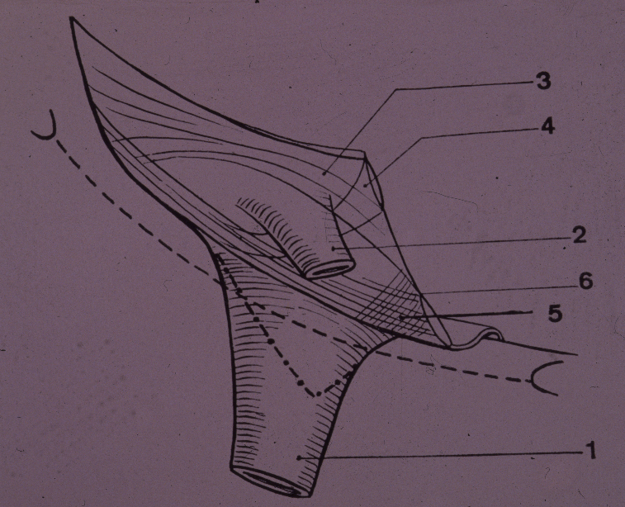
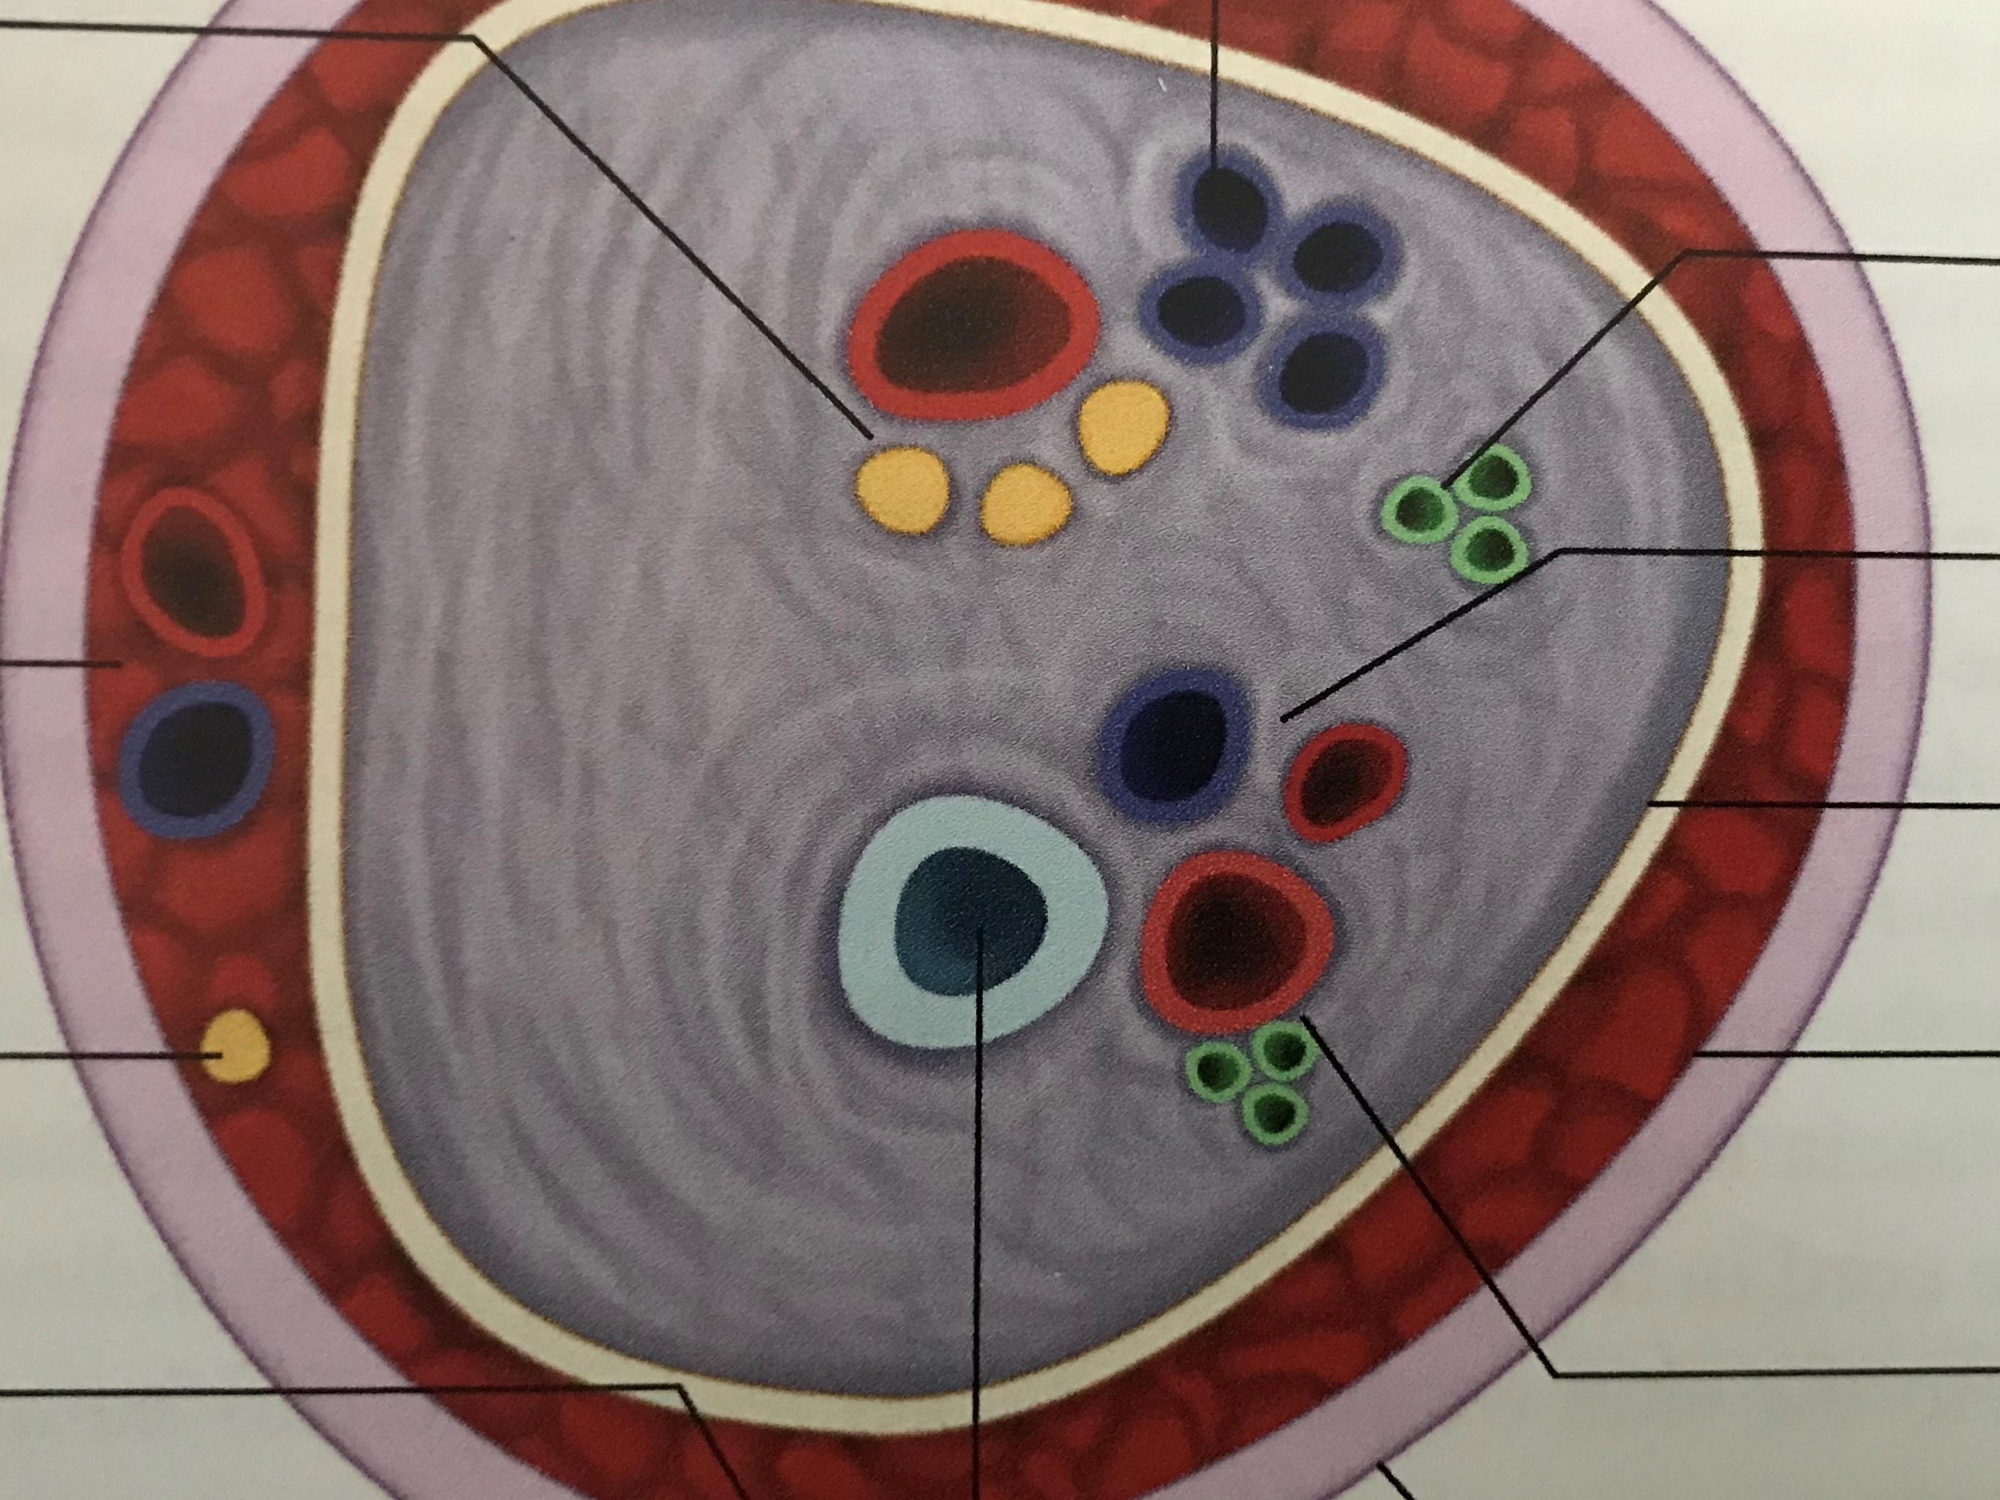
Transversalis fascia and anterior approach TIPP/MOPP technique
Fibrous sheath of the cord
[External and internal spermatic fascia (Transversalis fascia)]
Loriau J. (2018) Anatomy of the Inguinal Region. In: Campanelli G. (eds) The Art of Hernia Surgery a step by step guide. Springer, Cham, pp159-173. https://doi.org/10.1007/978-3-319-72626-7_17
Femoral sheath
Notes:
But the transversalis fascia is still the star anatomical element this is the Jerome loriau drauwing in one of the campanelli book
In the new classification of the fascia
we discern at the level of the cord
the External and the internal spermatic fascia and the internal spermatic fascia is an extension, of the transversalis fascia
And we will see what it can be very interesting to initiate the parietalization of the cord. For me the key to avoid a lateral recurrence

Slide 25
Notes:
Here is on the right, iliac spine here, pubic spine here
And in an other hand you can find next, in continuity with the internal spermatic fascia the transversalis fascia,
which covers the deep inguinal orifice in contact with the cord when the cord emerges from the deep inguinal orifice,
and you can see medially the inferior epigastric vessels

Slide 26
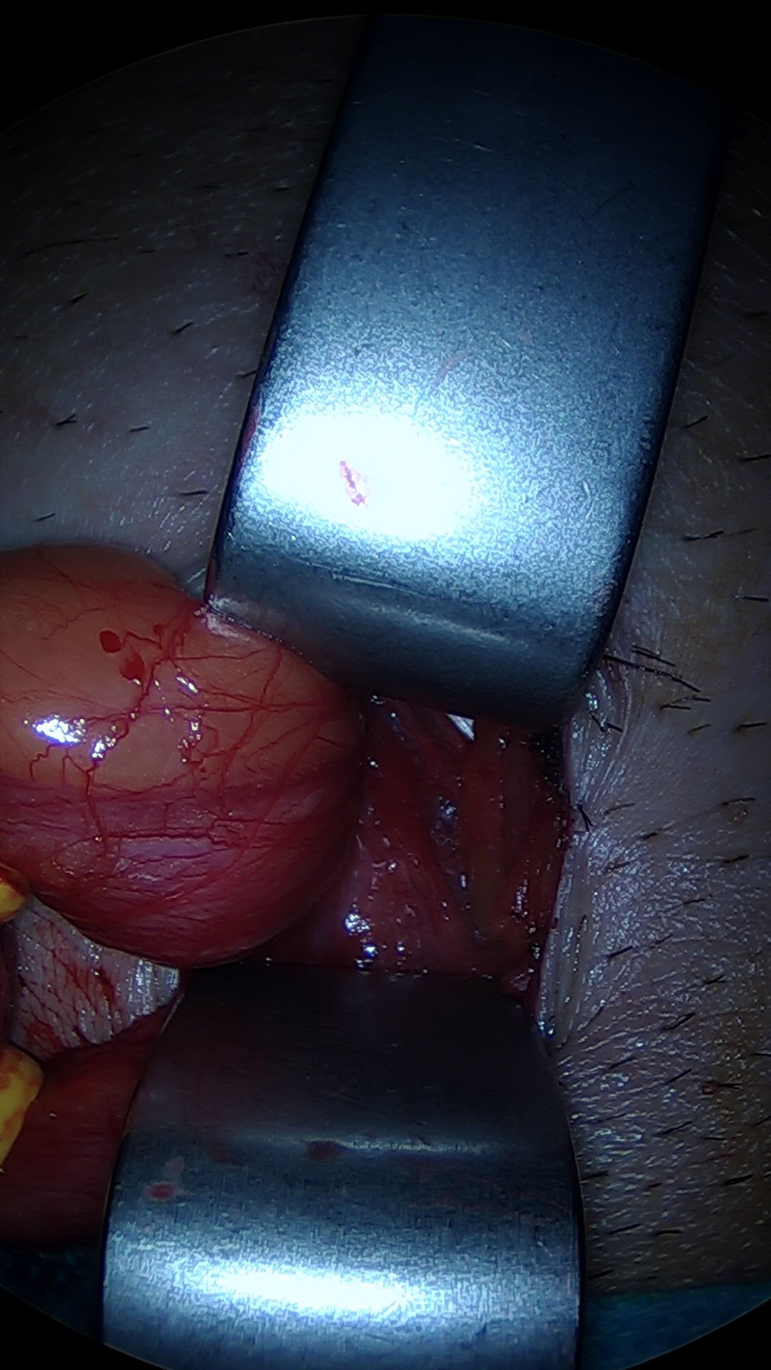
Fig 13 Visualization of the inferior epigastric vessels
Notes:
here is the deep inguinal ring covered by the transversalis fascia, medially the inferior epigastric vessels

Slide 27
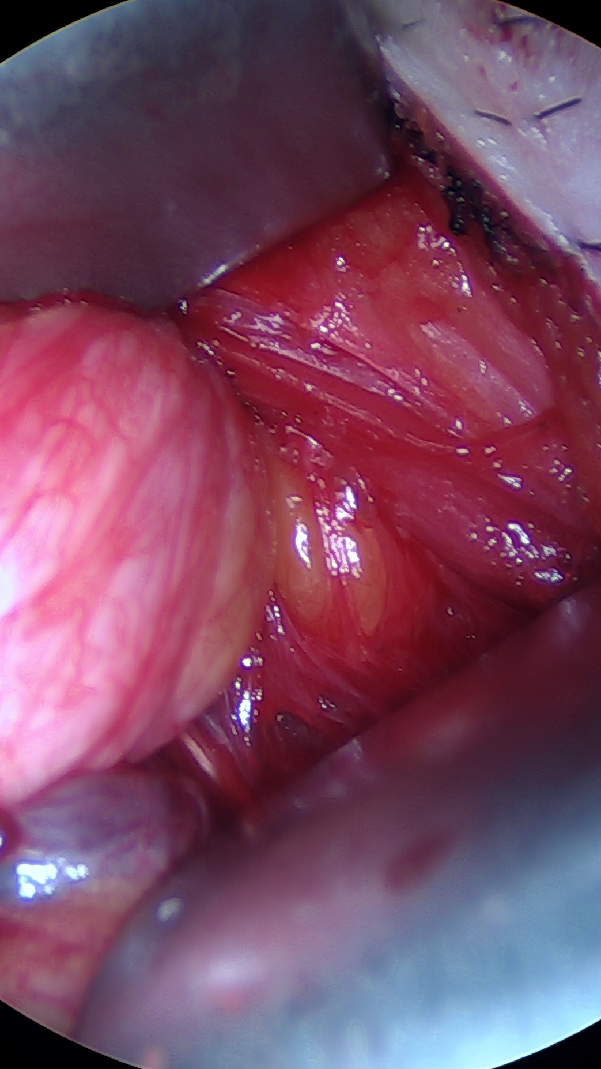
Fig. 12 Penetration throught the deep inguinal ring : the yellow fat
Notes:
if you push the fascia transversalis medially, you bring out the preperitoneal yellow fat.

Slide 28
Notes:
And you can easely enter in the préperitoneal space

Slide 29
Internal spermatic fascia
Notes:
After pusching medially the cremaster fibers we can find the internal spermatic fascia, witch is in a close contact to the vas deferent
and after cuting the internal spermatic fascia you can open the space to do the parietalization of the cord.
this is the right way to practice especially in the absence of a lateral sac
indeed in this situation with no lateral sac it is sometimes difficult to initiate the parietalization of the cord

Slide 30
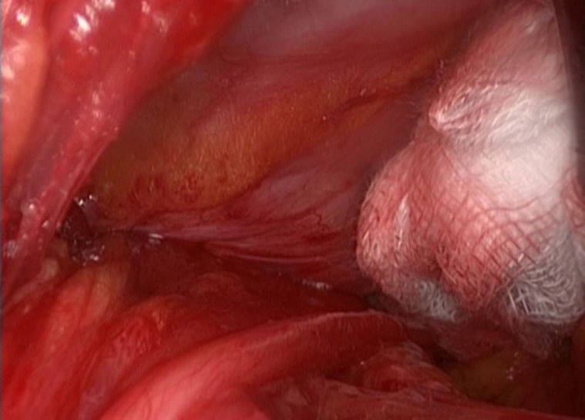
Fig 16 Parietalization of the cord visualization of the parietalization triangle
Notes:
And so it is easy to open the space And to realise the parietalization on the cord necessary to easily unroll the upper and outer part of a large prosthesis and make a lateral recurrence practically impossible
when you want to do a tipp mopp techniques for example.
And you can do this dissection
preserving the fascia between vas deferens and spermatic vessels

Slide 31
Parietalization of the cord
Parietalization triangle
Notes:
dissection is sufficient when visualizing the parietalization triangle

Slide 32
Open Preperitoneal (TIPP/MOPP) results N=1401
Ambulatory setting 1322 ( 94,36%)
ambulatory sitting PLANNED AND NOT ACHIEVED N = 23 ( 1,64%)
re hospitalization: 2 cases
Mild general anesthesia
Laryngeal Mask without curarisation =1265 (90,29%)
Deep infected collection: 0
POST OPERATIVE PAIN one YEAR: trouble N= 89 (7,74 %):
LOWER THAN PREOP, discomfort: 83
SUPERIOR THAN PRE OP, discomfort: 6
in these 6 cases the result is judged: excellent: 2; good: 3; bad: 1 (superficial infection, reoperation, outcome very simple)

Slide 33
1 Interest of the Open Preperitoneal (MOPP/TIPP) compared to endoscopic surgery in the elderly (Less endoscopic surgery in octogenarians and nonagenarians in the club hernia data base)
two particular situations
:
2 Interest of the MOPP technique compare to Lichtenstein?

Slide 34
ELDERLY PATIENTS: C.H. DATABASE
Surgical procedure | Control group[ 18-79] N=12108 | Octogenarians N= 1759
 |  |  | P | CHI 2 | Cramer: V | Odd Ratio
Laparoscopic % | 52,02 | 38,80 | p<0,001 | 106,1 | 0,09 | 0,58
TEP | 53,96
TAPP | 46,75
Open Pre Perit. | 19,91 | 23,08
Anterior with Prosthesis | 26,03 | 34,54
No prosthesis | 2,03 | 3,56
Notes:
French surgeons operate less often by endoscopy the elderly and they do more anterior approach as Lichtenstein procedure

Slide 35
CLUB HERNIE DATABASE
Surgical procedure | Control group[ 18-79] N=12108 | Nonagenarians N= 289
 |  |  | P | CHI 2 | Cramer: V | Odd Ratio
Laparoscopic % | 52,02 | 24,01 | p<0,001 | 100,5 | 0,55 | 0,29
TEP | 53,96 | 50,63
TAPP | 46,75 | 48,10
Open Pre Perit. | 19,91 | 23,08
Anterior with Prosthesis | 26,03 | 34,54
Notes:
it does not make sense to change the technique because of the age of the patient, for us total reparation must remain the rule even in the elderly

Slide 36
Groin hernias: minimally open approach pre peritoneal prosthesis
MOPP TEP TAPP Lichtenstein
N=1338 NS N= 5685 N=6334 NS N=6010
Women: 129 583 868 587
Men: 1209 5317 5702 5423
Age 67 63 63 67
Age > 80 263/1323 (19,9%) 670/ 5685 ( 11,78%) 832/ 6199 (13,42%) 1262/5953 (21,19%)
% 20 11,8 13,2 21,2
BMI N= 1336 N= 5780 N= 6307 N= 5990
BMI: 26 26 26 26
ASA N= 1336 N= 5821 N= 6214 N= 5606
ASA I: 761 (57%) 3720 (63,9%) 3164 (50,91%) 2127 (38%)
ASA II+ III 578 (43,26%) 1968 (33,80%) 948 ( 15,25%) 3461 (61,73%)

Slide 37
Groin hernias: minimally open approach pre peritoneal prosthesis: one year follow up
MOPP TEP TAPP Lichtenstein
Disconfort N= 970 N=2062 N= 3456 N= 2586
Yes 49 132 170 161
normal activities 44 103 135 119
Possi to do the act 2 25 28 34
Arret temporaire 4 4 3 8
Impossible to do it 0 0 4 8
Discomfort/ pre op N= 821 N= 2054 N=2880 N= 2045
Discomfort > pre op 2 20 18 24
Discomfort< pre op 45 106 151 133
Patient feeling: N=816 N=2039 N=2866 N= 2006
Excellent- good 809 1989 2798 1938
Medium 7 38 I 58 I 52
Bad 1 13 I 10 p<0,001 16 Chi2= 12,87 p<0,001

Slide 38
Minimal Open Pre Peritoneal technique / endoscopic
More per operative complication rate for endoscopic surgery :
+bladder injury
+Vasc injury
+ Small bowel obstruction p around 0,05
More Day surgery and less hospitalization duration, p<0,001
Non invasive Technique
General anesthesia without intubation, without curarisation
Better patient feeling at one year
Notes:
Open preperitoneal/ endoscopic surgery:
The per complication rate about bladder injury Vasc injury Small bowel obstruction it's almost significant

Slide 39
MOPP better than Lichtenstein? What about the femoral hernias
Looking for a femoral hernia?
LICHTENSTEIN (N=591) TIPP (N=473)
CONTROL 438 (74,11%) 472 (99,78%) p<0,001
NO CONTROL 153(25,88%) 1 (0,21%) p<0,001
EHS Guidelines 2009:
the existence of a femoral hernia should be excluded in all cases of a hernia in the groin(chap.2.7)

Slide 40
TIPP better than Lichtenstein? What about the femoral hernias
LICHTENSTEIN (N=397) TIPP (N=472)
Femoral hernia 12 (3,02%) 14 (2,96%)
Pre operative diagnostic 3 6
Per operative diagnostic 9 8
But in the licht. group 112 cases the femoral area are not cheked!
In the licht. Group 3 femoral hernias was probably mised
EHS Guidelines 2009: the existence of a femoral hernia should be excluded in all cases of a hernia in the groin(chap.2.7)

Slide 41
85 year old Woman ilio-inguinal block inguinal ambulatory setting
MOPP/TIPP Technique

Slide 42
Scary abdominal wall
MOPP Technique
Notes:
appendectomy

Slide 43
After colectomy: Right and left hernias
MOPP Technique

Slide 45
Notes:
some original drawings of rené stoppa on the technique of Ugahary on the way back between tiel and amiens
The ugahary technique, The first minimal invasive open pre peritoneal route

Slide 49
ONSTEP
Effondrement au doigt du fascia transversalis, fente pour passage du cordon
Partie inféro-interne prépéritonéale, partie supéro-externe entre OE et T. conjoint
Notes:
Always the open preperitoneal route with the ONSTEP technique if you dont want to do the pariétalisation of the cord

Slide 50
TREPP
Notes:
in the same open preperitoneal spirit is the TREPP technique with some similarity to the technique of Nyhus

Slide 51
Loriau J. (2018) Anatomy of the Inguinal Region. In: Campanelli G. (eds) The Art of Hernia Surgery a step by step guide. Springer, Cham, pp159-173. https://doi.org/10.1007/978-3-319-72626-7_17
Notes:
If now if we consider the internal spermatic fascia at the level when the cord emerges throught the deep inguinal ring

Slide 52
Notes:
here is in my practices
how to use the fascia transversalis
And to penetrate the preperitoneal space for all the groin hernias

Slide 53
BARCELONA 7 MAY 2009
Fist Bard european symposium
Why the preperitoneal repair?
History from Annandale to the modern and minimal
invasive approach: Grid iron technique
Marc Soler, Cagnes sur Mer – France
Notes:
I am speaking about open preperitoneal minimal invasive technique since years, Ugahary is the pionner

