Slide 1
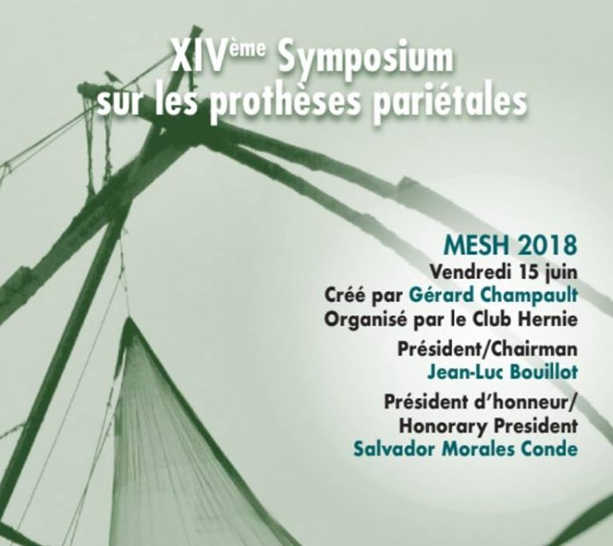
The real truth about Botox, Goni~Moreno or both in large incisional hernia repair:
Is there any?
Prof.Dr.F.Berrevoet
Dept. of General and HPB Surgery
Ghent University Hospital

Slide 2
Preoperative strategy is the most important, but often also the most difficult

Slide 3
Depending on evaluation:
Component separation technique
Endoscopic anterior
Open anterior
Transversus Abdominis Release
Botulinum toxin application
Progressive pneumoperitoneum

Slide 4
Hernia development is associated with lateral wall shortening and oblique muscle atrophy….
Oblique muscles exhibit significant decreased extensibility and increased stiffness.

Slide 5
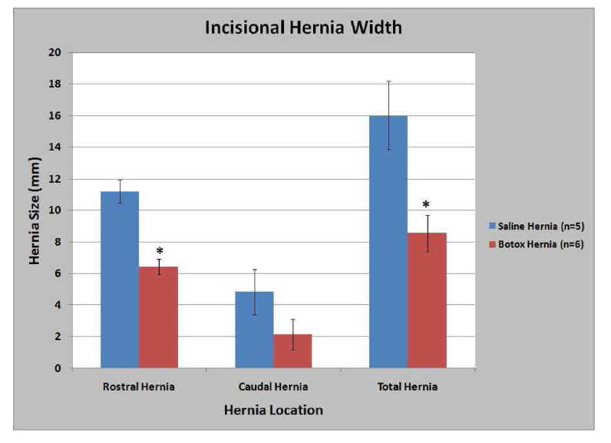
Partial paralysis of the abdominal muscles decreases the size of incisional hernias….

Slide 6
BTA effects
Total flaccid paralysis; 7-10 days
Maximum muscular lengthening in 30-60 days (~35%)
Increase of the abdominal capacity (~20%)
Asymptomatic procedure all the time
No effects on trunk movement or breathing function
Muscular paralysis by 6 to 8 months

Slide 7
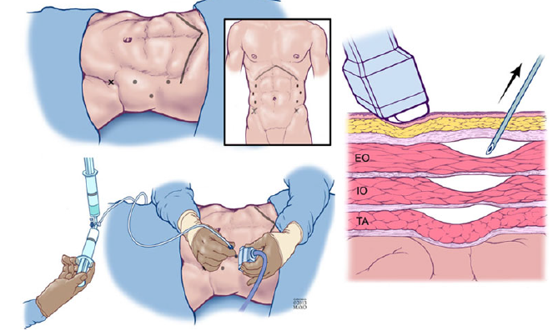

Slide 8
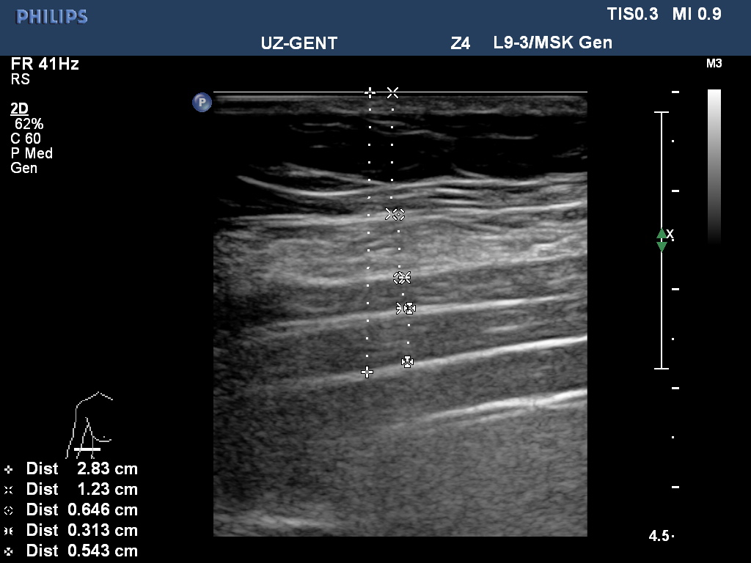

Slide 10
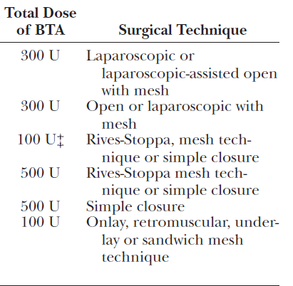
What dosage do we need to use?
“All things are poisons, and there is
nothing that is harmless;
the dose alone decides that something
is a poison” Paracelsus (1493 – 1541)
300 Units in 150cc of saline
8.3cc (?) per muscle
25cc per injection site

Slide 11
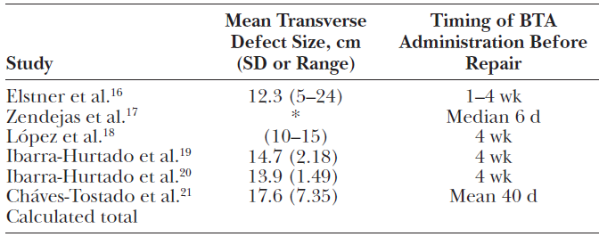
What is the ideal waiting period?
Might be of importance in OA closure….
Better a little too long than too short waiting time?

Slide 12
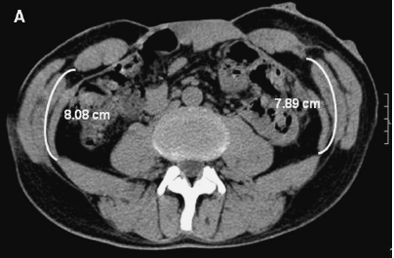
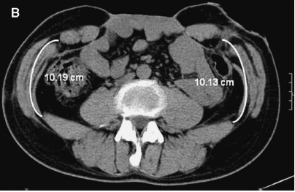

Slide 13
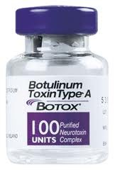
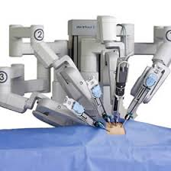
BOTOX is HOT

Slide 14
But biological meshes were once hot as well….
No doubt that BTA infiltrations might help relaxing the abdominal wall musculature…..
What about the application?
How do we know whether the application is correct?
How does it work along the whole flank?
What dosage?
What is the ideal waiting period?
What are the precise indications compared to PPP and CST?
What is the muscle length gain compared to CST?
Does it add to CST alone?

Slide 15
How to evaluate a correct application?

Slide 16
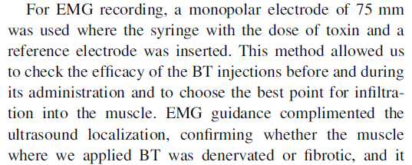
Role of EMG?
Bueno-Lledo et al Hernia 2017

Slide 17
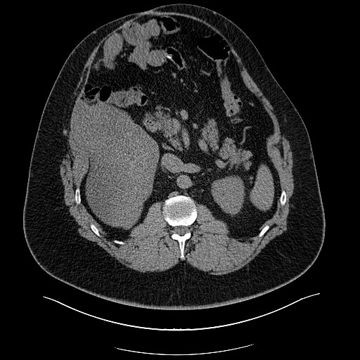
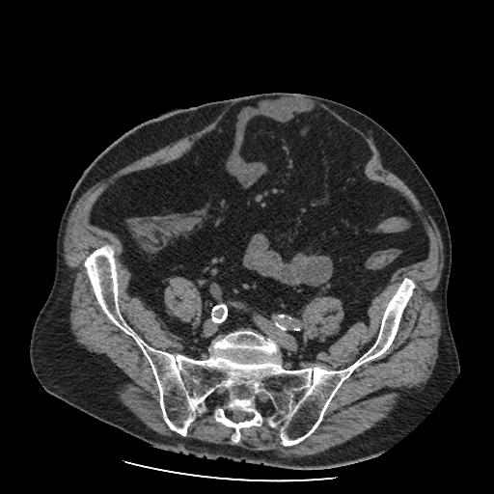
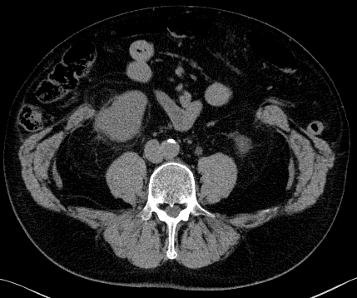
What are the correct indications?
Only when thick muscles are present?
Only in moderate hernia gaps?
Only for giant hernia defects >20cm?

Slide 18
Real benefit compared to CST and PPP?

Slide 19
Soltanizadeh et al. 2017

Slide 20
Conclusions
Botox infiltration is certainly an important asset to the hernia surgeon’s armentarium
As costs are considerable, the right indications should be determined to prevent overuse
Follow-up on the (very) longterm is absolutely necessary to know the down-sides of its use
Botox alone will not be sufficient for treating loss of domain issues…..

Slide 21
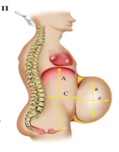
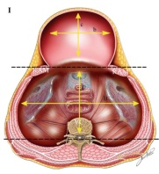
Preoperative imaging:
Tanaka et al. 2010
CT might offer easy method to calculate hernia sac and abdiminal cavity volume with loss of domain.
PPP is necessary when volume hernia sac divided by abdominal cavity is over 20-25%

Slide 22
Algorythm (Hernia Width)
<10cm 10-14cm 14-18cm 18-22cm >22cm
Loss of domain
Loss of domain
Bilateral
Open
Anterior CST
Retromuscular
repair
Bilateral
Open
Anterior CST
No
Yes
Botox infiltrations
PPP
Bilateral
Endoscopic
Anterior CST
Bilateral
Open
Anterior CST
Botox infiltrations
Bilateral
Open
Anterior CST
Botox infiltrations
(PPP)
Notes:
Personal made diagram

Slide 23
BTA + Pneumoperitoneum
Both techniques simultaneously:
The effects of pneumo are enhanced?
Reducing the days of pneumo?
Greater and easier increase of the abdominal capacity?
Our practice:
Day 0 injection of botox
Day 14 placement of intraperitoneal catheter
Day 28 Abdominal wall reconstruction

Slide 24
Preoperative progressive pneumoperitoneum
Goals:
Diagnostic
Therapeutic
Tolerance of the created IAH
It determines the patient’s tolerence to hernia reduction.
Increases the size of the abdominal cavity
Pneumatic lysis of adhesions to increase reducibility

Slide 25
How we do it?
Before admission:
Cardiological evaluation
Respiratory evaluation (respiratory rehabilitation)
The patient is admitted to the hospital 14 days before surgery
On the first day of admission:
Placement of the catheter into the peritoneal cavity
Insufflation of 2L of air
Starting thromboprophylaxis at therapeutic dose

Slide 26
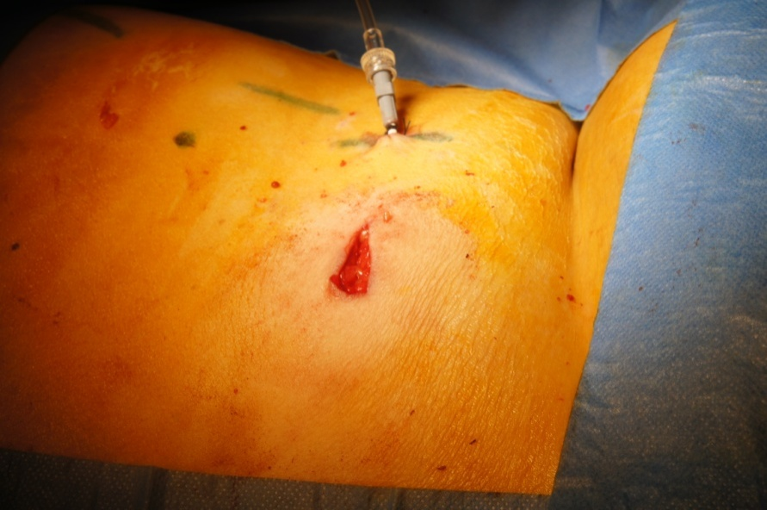
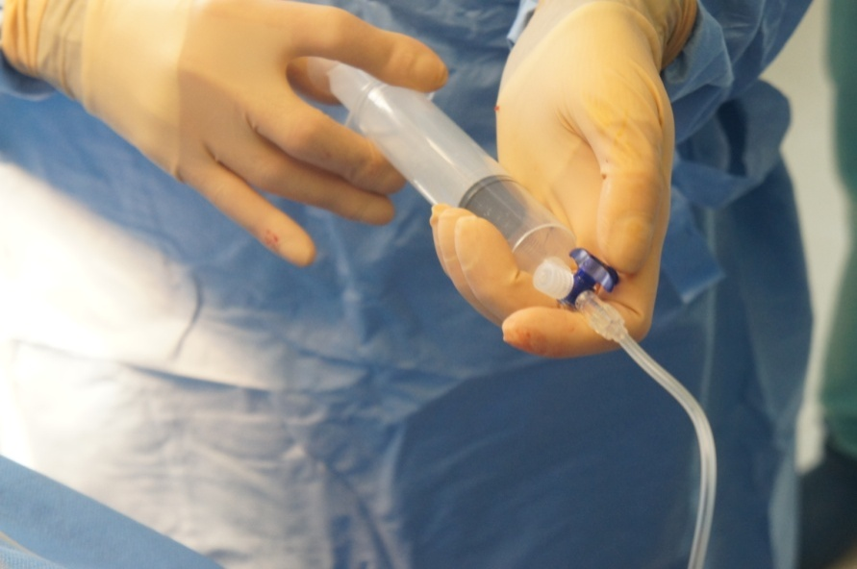
Our first case
What did we do?
Placing a 5 Fr pigtail over the anterior side of the liver to apply progressive pneumoperitoneum (day 0)

Slide 27
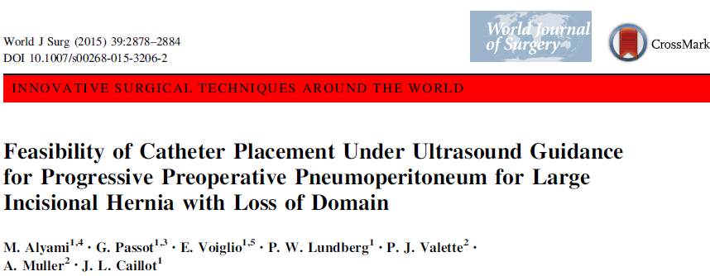
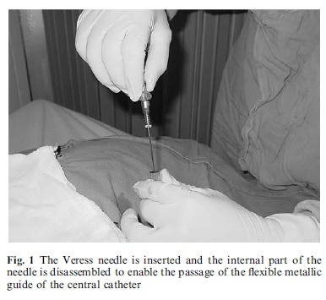
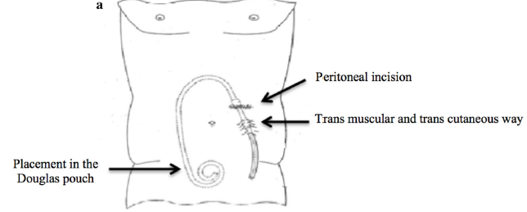

Slide 28
Over the next days
Sitting position
Insufflation of 1000 ml of air
Shoulder pain or dysnea
In-patient procedure

Slide 29
How much insufflation do we aim for?
Depends on the outcome and efficiency
Within 14 days, CT after 7 days
Not always an efficient expansion of the abdominal wall
Patient’s tolerance

Slide 30
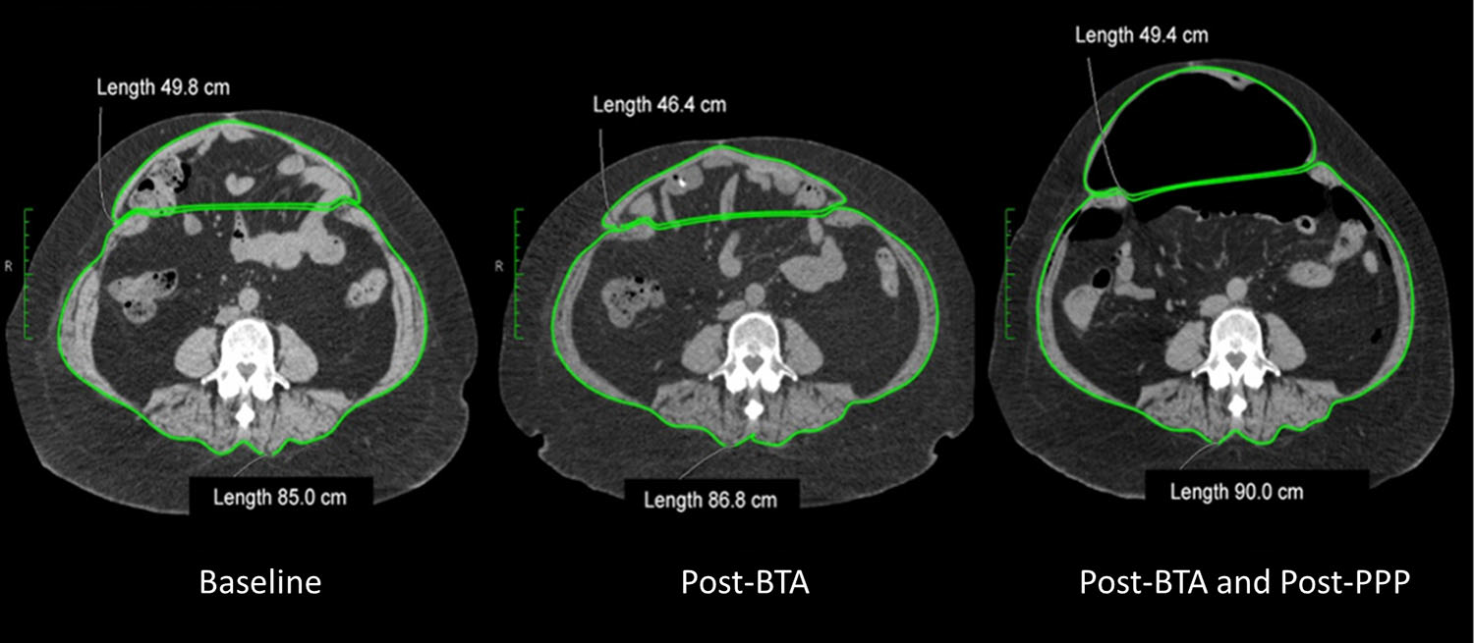
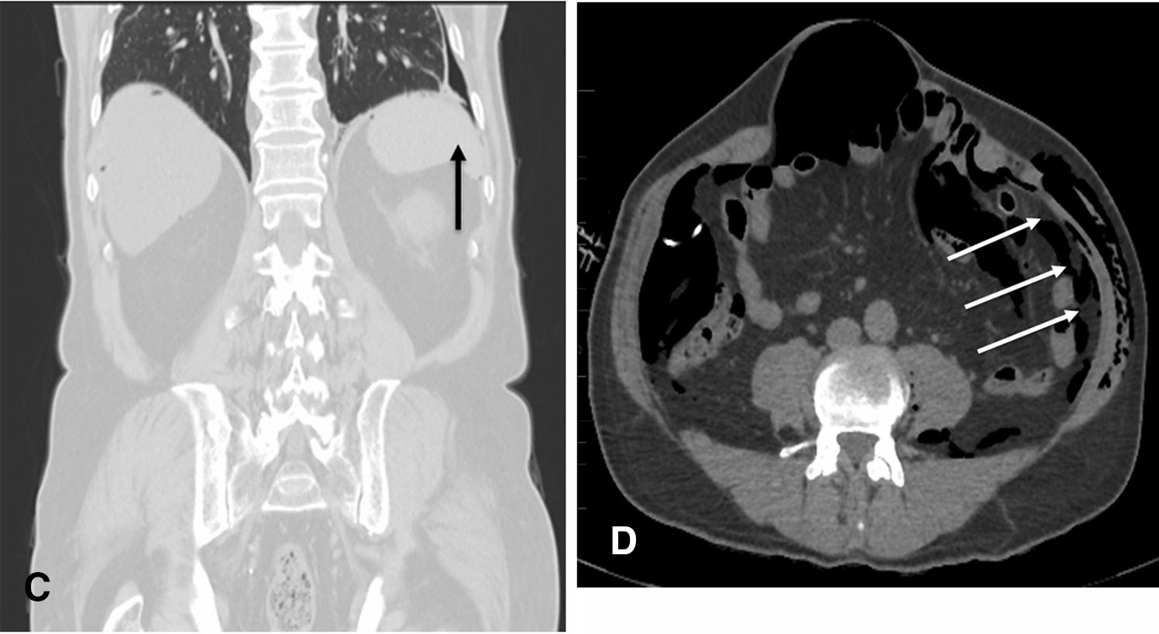
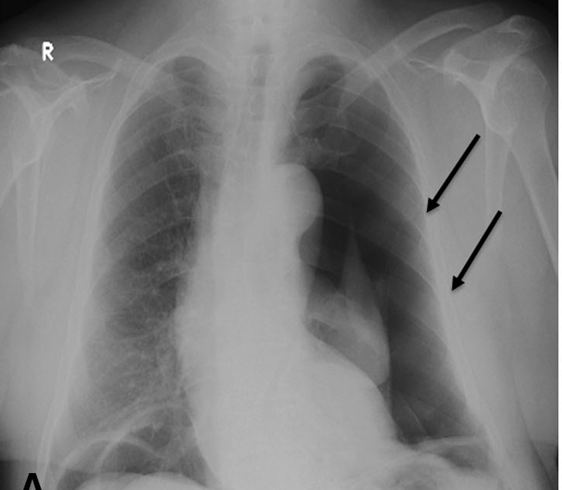
Elstner et al. 2017

Slide 31
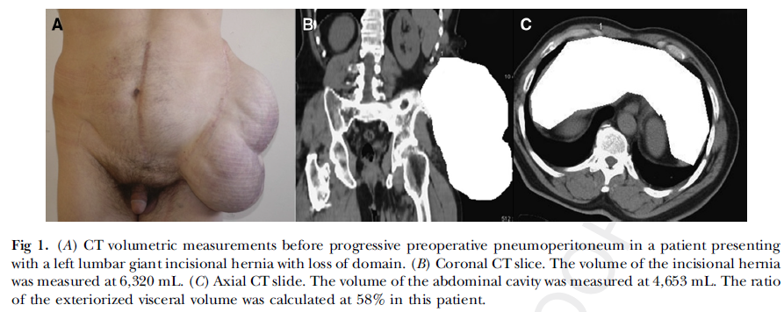
Management of large incisional hernias with loss of domain: prospective series
45 patients treated

Slide 32
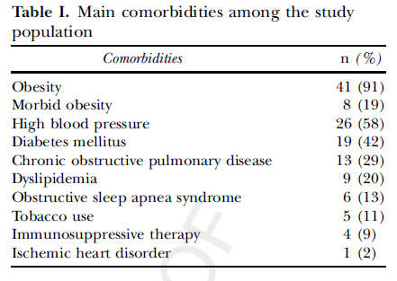
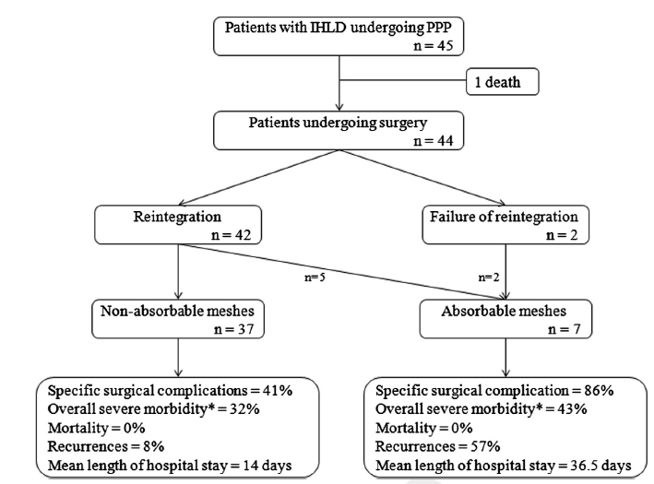
45 out of 899 pts (5%)
38% loss of domain
Mean width of 15cm…..
Large pore meshes
No component separation used

Slide 33
Conclusion on PPP:
A useful adjunct in the treatment of loss of domain of >20-25%
Passively expands the abdominal cavity
Minimizes the risk for abdominal compartment syndrome
But certainly a higher complication rate than botox application…..

Slide 34
Conclusions
Botulinum toxin: Large AWH defects
Safe and efficient
Not efficient as a single tool to treat loss of domain
Pneumoperitoneum: Loss of domain
Higher morbidity
High efficacy
Their role in relation to CST has still to be determined…..

Slide 35
An unmanageable hernia is often manageable: If you won’t, maybe a colleague will…..
Thank you!

