Slide 1
Que faut-il penser des hernies inguinales douloureuses en pré-opératoire?
Dr. L. Montana¹, Dr. J.P. Cossa² et le Club Hernie
1Service de Chirurgie digestive et métabolique, Hopital Avicenne, Assistance Publique-Hôpitaux de Paris (AP-HP), Université Paris XIII-UFR SMBH “Léonard de Vinci”, Bobigny; 2Clinique Bizet, Paris

Slide 2
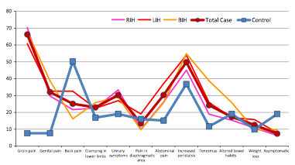
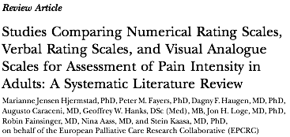
Introduction
"an unpleasant sensory and emotional experience associated with actual or potential tissue damage, or described in terms of such damage”

Slide 3
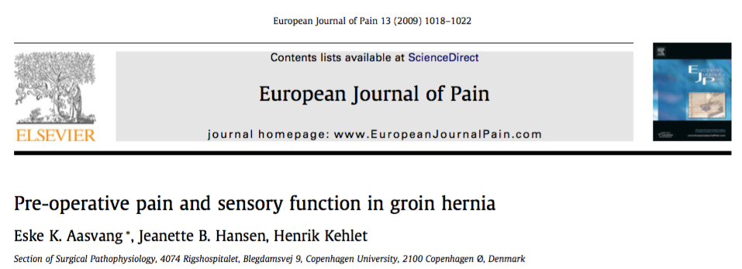
Groin pain physio-pathology
A large number of manifestation depending by organ involvement in the hernia sac
Is groin pain consequence of neuronal compression?
Neuropathic
Non-neuropathic: somatic / visceral
Central or peripheral neuronal sensibilisation
Inappropriate neuronal plasticity
Immune
alteration

Slide 4
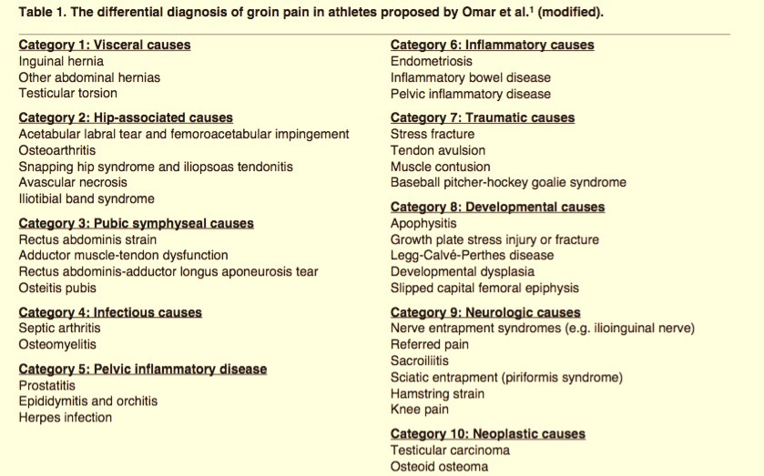
Groin pain…differential diagnosis

Slide 5
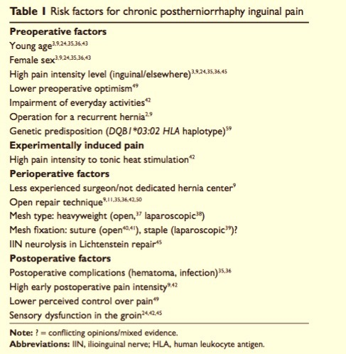
….Postoperative chronic pain
Preoperative groin pain is an independent risk factor of postoperative chronic pain
(Franneby 2006, Kalliomaki 2008, O’Dwyer 2005, Poobalan 2001)
In the literature, out of complicated hernias, groin pain has an incidence around 36%-69%.
But in the most of cases is a discomfort like a pincement that disappear after rest.
Natural history is accentuation.
Few studies are available with a complete preoperative stratification of pain and relative comparaison with postoperative follow-up

Slide 6
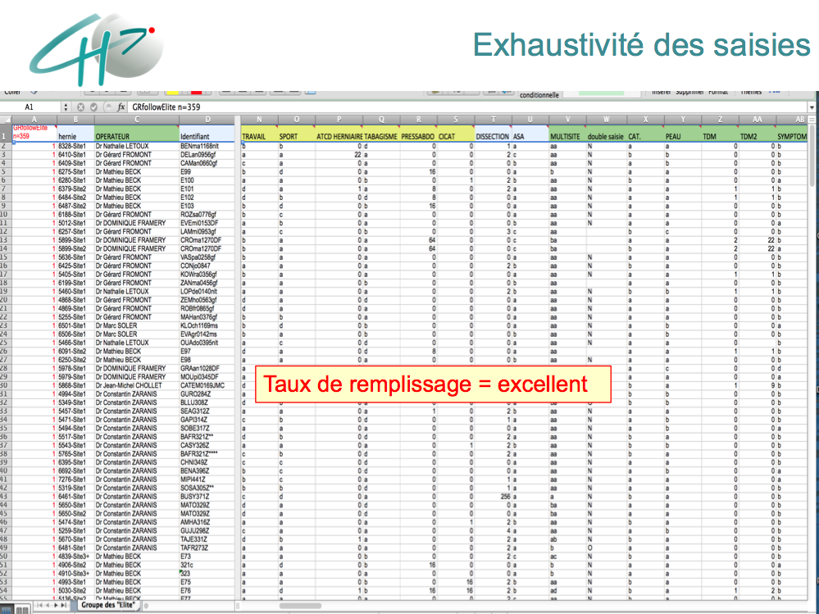
Objectifs
Patient caracteristics | Age, sex, BMI, weight, height, work occupation, sport activity, smoking, high abdominal pressure event, risk factors of a bad healing, ASA score.
Hernia caracteristics | side, clinical presentation (pain, time of presentation, frequency), quality of life alteration, localization in groin region, preoperative echography, recurrence and previous repair.
Intervention modality | Surgeon, type of anesthesia, EHS classification, operative technic, conversion, prosthesis, prosthesis weight, prosthesis dimensions, type of fixation, nervous structures identification, intra-operative complication, operative time
Others datas | Ambulatory recovery, postoperative complication, second look, readmission, hospitalization time, postoperative NRS, interruption of work and physical activity, clinical evaluation at 1 month, independent evaluation at 1 year, 2 years, 5 years control, quality of life questionary at 1, 2 and 5 years.
Which is incidence of severe preoperative pain?
Which is effect of GHR on preoperative pain?

Slide 7
Material and methods
17118 cures de hernies de l’aine chez 15330 patients
Population âge moyen 63,4 ans (2-102)
15173 chez l’homme / 1945 chez la femme (8/1)
Répartition anatomique
15526 Hernies Inguinales (90,7%)
332 Hernies Crurales (1,9%)
767 Hernies non palpables (4,5%)
491 Hernies non précisées (2,9%)
Total of GHR
(September 2011- January 2017)
17118
673 (3.9%)
complicated GHR
16445 (96.1%)
non complicated GHR
429 Hernies engouées (2,5%)
152 Hernies étranglées sans occlusion (0,9%)
87 Hernies étranglées avec occlusion (0,5%)
5 Hernies étranglées avec cellulite (0,03%)
12008 (73%)
painless GH
4437 (27%)
painful GH
Follow-up
1 week
1 month
2 years
3020 (18,6%)
moderate pain
1417 (8,9%)
severe pain
Verbal Rating Scale
questionnaire

Slide 8
Results
 | Severe pain group (N=1417) N of patients (%) | Moderate pain group (N=3020) N of patients (%) | OR (IC95%) | p-value
Age mean <60 >60 | 599 (42.3) 818 (57.7) | 1210 (40.1) 1810 (59.9) | 1.0954 (0.9615 - 1.2475) 0.9129 (0.8016 - 1.04) | NS NS
Sex female | 235 (17) | 392 (13) | 1.3328 (1.1128 - 1.594) | 0.002
BMI¹ >30 | 119 (8.4) | 206 (6.8) | 1.2523 (0.9811 - 1.5928) | 0.06
No sport activity | 806 (56.9) | 1513 (50.1) | 1.3138 (1.1548 - 1.4951) | NS
Unemployment | 534 (37.7) | 1298 (43) | 0.8023 (0.7033 - 0.9149) | <0.001
Smokers | 802 (56.6) | 1560 (51.7) | 1.2204 (1.0728 - 1.3888) | 0.002
T2DM² | 72 (5.1) | 131 (4.3) | 1.1805 (0.8664 - 1.5981) | NS
Corticosteroides | 48 (3.4) | 60 (2) | 1.7295 (1.1514 - 2.5857) | 0.006
Pelvic radiotherapy | 16 (1.1) | 26 (0.9) | 1.3151 (0.6568 - 2.5549) | NS
Chemotherapy | 34 (2.4) | 47 (1.6) | 1.5549 (0.9651 - 2.4821) | 0.06
Coagulation alterations | 230 (16.2) | 428 (14.2) | 1.1734 (0.081 - 1.4012) | NS
ASA³ > 3 | 279 (13.3) | 402 (19.7) | 1.5965 (1.3444 - 1.8943) | NS
Pevious abdominal surgery | 209 (14.8) | 314 (10.4) | 1.4909 (1.2293 - 1.8056) | NS
Résultats
25 rats
6 morts
24% mortalité (J1-J6)
1 peritonite stercorale
1 arret cardiaque en per-op
lors de sacrifices:
1 hernie interne
2 abcès peri-anastomoique
1 abcès sous cutanée

Slide 9
Results
 | Severe pain group (N=1417) N of patients (%) | Moderate pain group (N=3020) N of patients (%) | OR (IC95%) | p-value
Symptoms associated Chronic cough Dysuria Constipation Back pain Headache Depression | 98 (6.9) 97 (6.9) 65 (4.6) 19 (1.3) 2 (0.1) 11 (0.8) | 138 (4.6) 147 (4.9) 85 (2.8) 29 (1) 2 (0.1) 8 (0.3) | 1.5515 (1.1752 - 2.0423) 1.4361 (1.0903 - 1.8847) 1.6599 (1.175 - 2.3357) 1.4017 (0.7399 - 2.5966) 2.1325 (0.1544 - 29.437) 2.9448 (1.0762 - 8.4532) | 0.002 0.009 0.003 NS NS 0.02
Absence of other symptoms | 1223 (86.3) | 2474 (81.9) | 1.3912 (1.1618 - 1.6707) | < 0.000
Characteristics of hernia Crural Hernia Scrotal hernia Recurrent hernia Bilateral hernia Non palpable hernia | 69 (4.9) 174 (12.3) 145 (10.2) 330 (23.3) 74 (5.2) | 86 (2.8) 239 (7.9) 231 (7.7) 808 (26.8) 90 (3) | 1.746 (1.2446 - 2.4421) 1.6287 (1.3197 - 2.0167) 1.3763 (1.0985 - 1.7199) 0.8311 (0.7149 - 0.965) 1.7937 (1.2914 - 2.4848) | <0.001 NS 0.005 0.01 <0.001
Irradiation of pain Median pain Leg irradiation Scrotal Irradiation Pain referred in other regions | 22 (1.6) 34 (2.4) 47 (3.3) 26 (1.8) | 16 (0.5) 45 (1.5) 75 (2.5) 27 (0.9) | 2.9601 (1.4798 - 6.0509) 1.6251 (1.0046 - 2.6074) 1.3471 (0.9096 - 1.9775) 2.0717 (1.1568 - 3.7035) | 0.001 0.04 NS 0.01

Slide 10
Results
 | Severe pain group (N=1417) N of patients (%) | Moderate pain group (N=3020) N of patients (%) | OR (IC95%) | p-value
Frequency of symptoms Occasional symptoms Frequent symptoms Quotidian symptoms Full day symptoms | 114 (8.1) 1062 (75) 130 (9.2) 87 (6.1) | 268 (8.9) 2624 (86.9) 99 (3.3) 18 (0.6) | 0.8984 (0.7081 - 1.1344) 0.4516 (0.3835 - 0.5317) 2.9795 (2.2568 - 3.9434) 10.9024 (6.4798 - 19.3309) | NS NS NS NS
Interferences with quotidian activity Stop of some activity for pain Temporary stop of quotidian activity No interferences with quotidian activity | 375 (26.5) 632 (44.6) 81 (5.7) | 274 (9.1) 505 (16.7) 745 (24.7) | 3.6055 (3.0278 - 4.2975) 4.0081 (3.4703 - 4.6316) 0.1852 (0.144 - 0.2357) | NS NS NS
Ultrasound exams prescribed
 | Severe pain group (N=1417) N of patients (%) | Moderate pain group (N=3020) N of patients (%) | Odds ratio (IC95%) | p-value
Total of ultrasound performed | 463 (32.7) | 842 (27.9) | 1.2553 (1.0922 - 1.4421) | 0.001
Unltrasound order by General Practitioner | 439 (94.8) | 806 (95.7) | 0.8171 (0.4674 - 1.4516) | NS
Identification of non palpable hernia | 37 (8) | 50 (5.9) | 1.3912 (0.8684 - 2.2122) | NS

Slide 11
2-years follow-up
 | Severe pain group (N=1417) N of patients (%) | Moderate pain group (N=3020) N of patients (%) | Odds ratio (IC95%) | p-value
Preoperative status (Baseline) Pain score Severe (NRS >5) Moderate (NRS 3-4) | 1417 (100) 0 | 0 3020 (100)
8-days after surgery Missing data Data completed Pain score Severe (NRS>5) Moderate (NRS 3-4) Mild (NRS 1-2) Painless (NRS = 0) | 277 (19.5) 1140 (80.5) 93 (8.2) 148 (13) 382 (33.5) 517 (45.4) | 470 (15.6) 2550 (84.4) 149 (5.8) 310 (12.2) 907 (35.6) 1185 (46.5) | 1.3961 (1.0554 ; 1.839) 1.0679 (0.8612 ; 1.3199) 0.9421 (0.8178 ; 1.0841) 0.9759 (0.8595 ; 1.1074) | 0.0180NS NS NS
30-days after surgery Missing data Data completed Pain Score Severe (NRS>5) Moderate (NRS 3-4) Mild (NRS 1-2) Painless (NRS = 0) | 342 (24.1) 1075 (75.9) 20 (1.9) 30 (2.8) 161 (15) 864 (80.4) | 656 (21.7) 2364 (78.3) 29 (1.2) 55 (2.3) 301 (12.7) 1980 (83.8) | 1.5164 (0.8092 ; 2.7886) 1.1994 (0.7375 ; 1.9171) 1.1762 (0.9522 ; 1.4491) 0.9596 (0.8603 ; 1.0702) | NS NS NS NS
2- years after surgery Missing data Data completed Pain Score Severe (NRS>5) Moderate (NRS 3-4) Mild (NRS 1-2) Painless (NRS = 0) | 692 (48.8) 725 (51.2) 2 (0.3) 41 (5.7) 31 (4.3) 651 (89.8) | 1337 (44.3) 1683 (55.7) 6 (0.4) 53 (3.2) 46 (2.7) 1578 (93.8) | 0.7739 (0.0762 ; 4.3409) 1.7952 (1.153 ; 2.7786) 1.5641 (0.9504 ; 2.5435) 0.9577 (0.8424 ; 1.0886) | NS 0.008 0.06 NS

Slide 12
Satisfaction rate after 2 years
 | Severe pain group (N=1417) N of patients (%) | Moderate pain group (N=3020) N of patients (%) | Odds ratio (IC95%) | p-value
Preoperative status (Baseline) Pain score Severe (NRS >5) Moderate (NRS 3-4) | 1417 (100) 0 | 0 3020 (100)
Satisfaction degree after surgery Total of answer Excellent Good Medium Bad | 716 (50.5) 213 (29.7) 467 (65.2) 27 (3.7) 9 (1.3) | 1375 (45.5) 416 (30.3) 917 (66.7) 32 (2.3) 10 (0.7) | 0.9762 (0.7969 - 1.1942) 0.9368 (0.7712 - 1.1389) 1.6443 (0.9394 - 2.8586) 1.7372 (0.6214 - 4.7808) | NS NS NS NS

Slide 13
Conclusions
Pain incidence before GHR is around 27% with 9% of severe pain;
We obtained a complete description of preoperative pain (baseline)
Anterograde comparaison from baseline between preoperative and postoperative pain show the real interest of groin hernia repair;
In most of case, groin pain seems to be linked to hernia pathology because it disappear or decrease after GHR;
In our series, we confirm obesity, sex female, depression, hight intra-abdominal pressure causes and smoking as risk factors of pre and postoperative groin pain.
Preoperative pain stratification is mandatory for better understand postoperative pain

Slide 14
Next steps:
What about follow-up of asymptomatic patients in preoperative period?
Which could be be the interest of a Preoperative Pain score?

