Slide 1
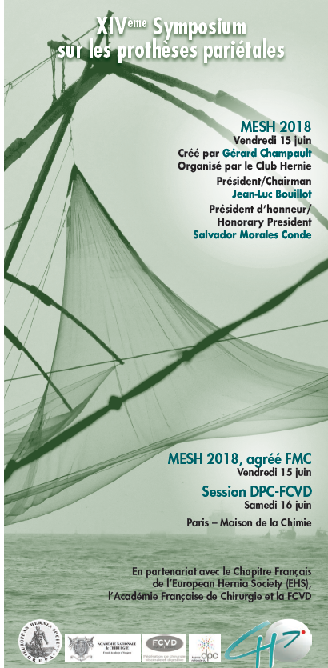

Evidence –base use of prophylactic meshes in stoma creation and take-down
Dra. Hernández Granados

Slide 2
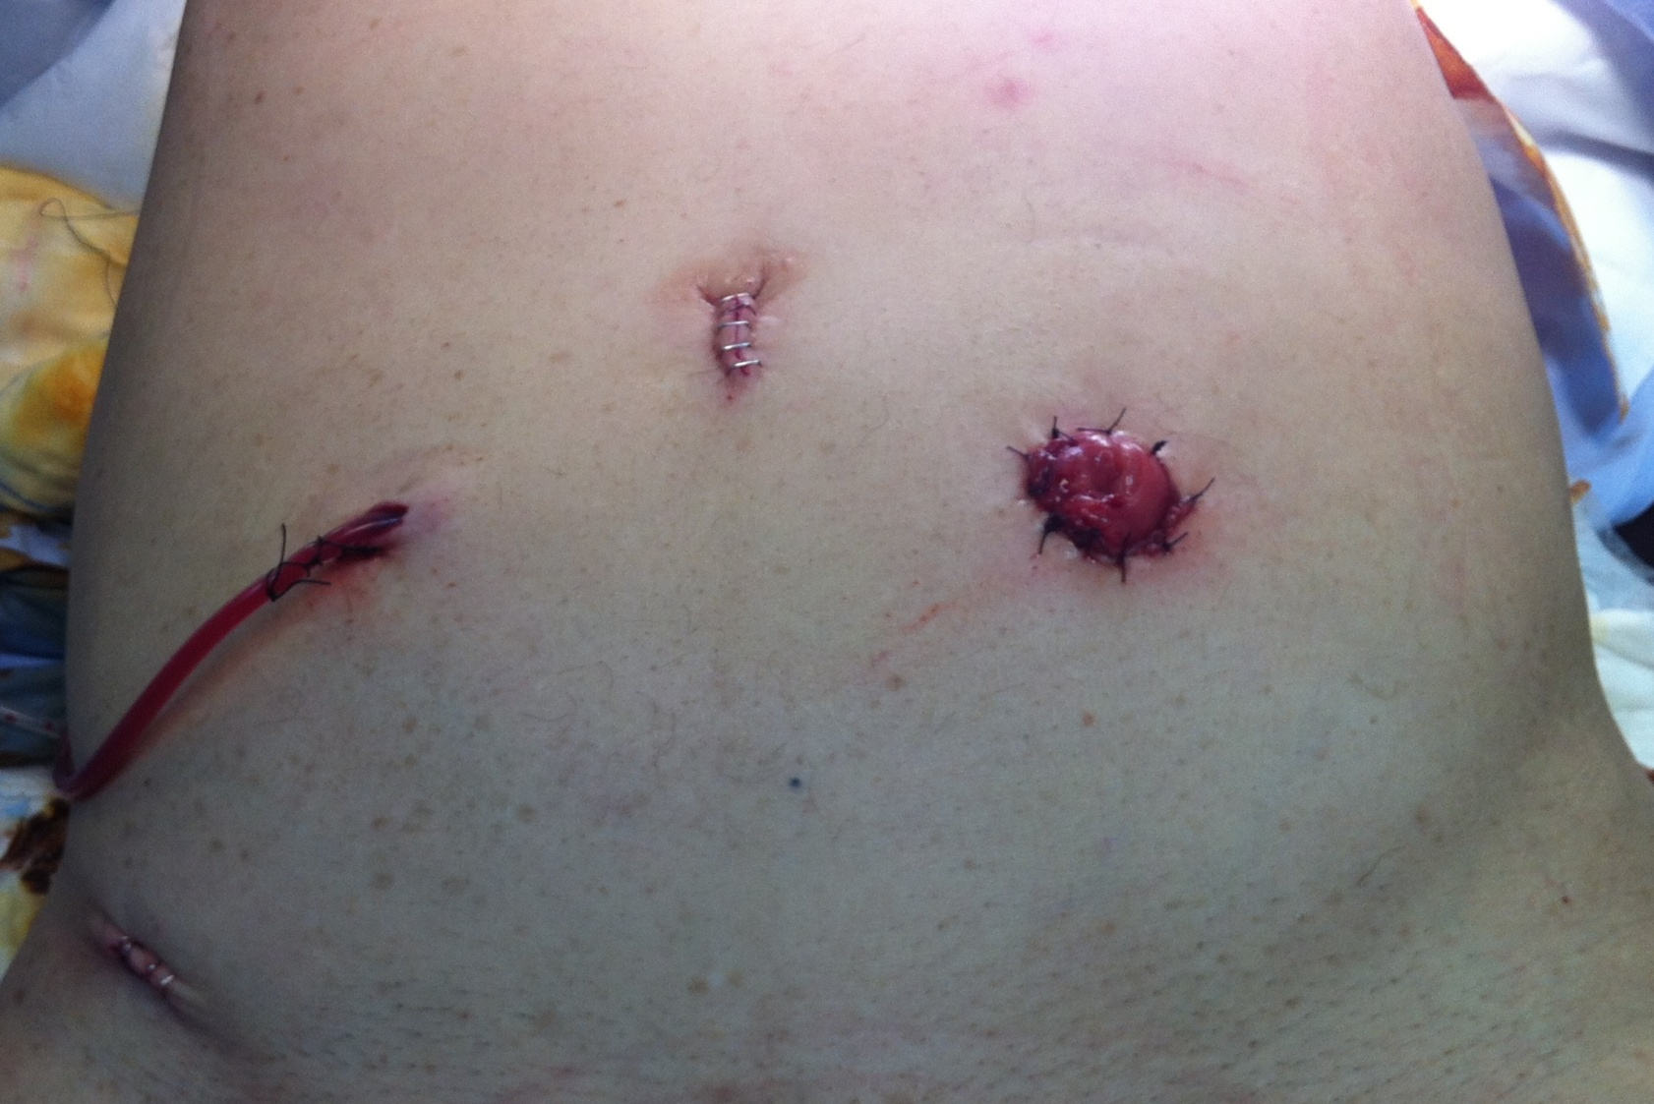
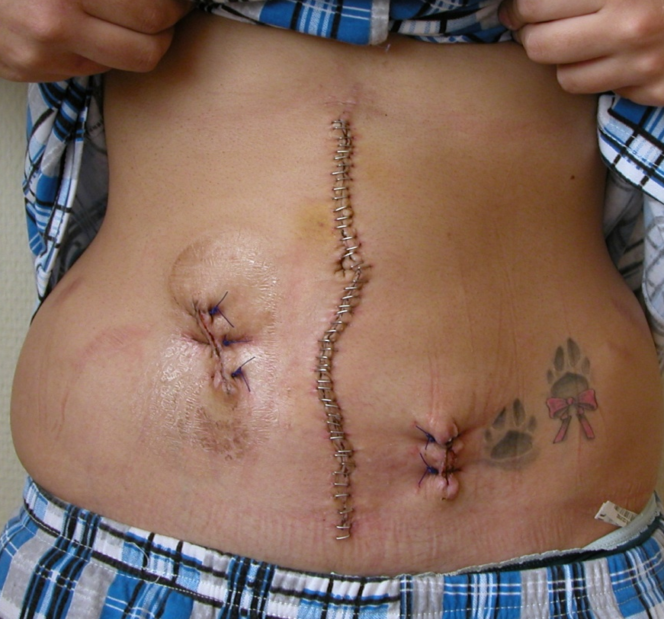
Introduction
Stomas:
  Colostomy
  Ileostomy
  Urinary derivation (Bricker)
Temporary stoma closure
  Colostomy
  Ileostomy

Slide 3
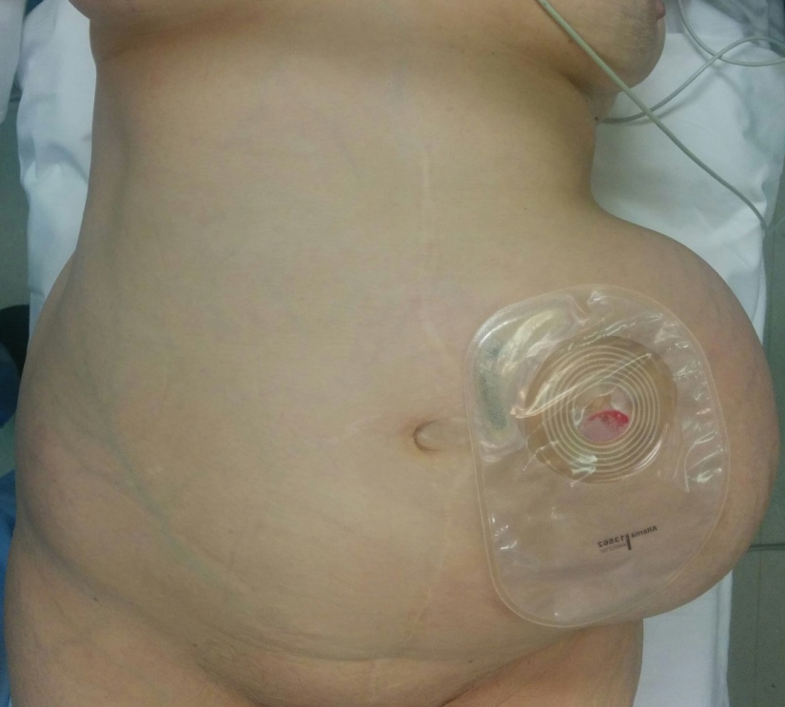
Parastomal hernias
High incidence
  End colostomy
    30-50 %
  End ileostomy
    2-28%

Slide 4
Parastomal hernias
Decrease patient´s quality of life
  Bad disposal appliance
  Leakage
  Pain
Emergency surgery
  Intestinal obstruction
  Strangulation

Slide 5
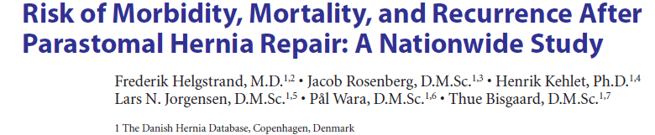

13% reintervention for complications
11% reintervention for recurrence

Slide 6
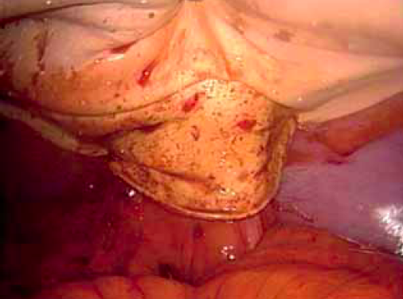
Prevention
Prophylactic meshes
  Different meshes
  Many positions
  Different techniques

Slide 7
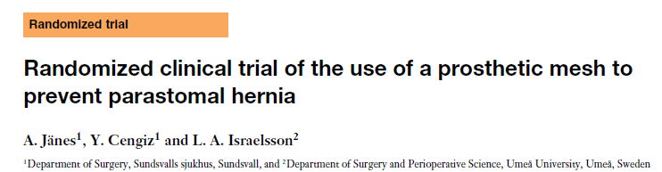
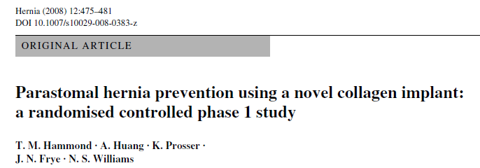
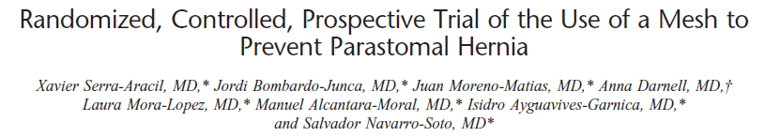
Open surgery
Synthetic retromuscular mesh
Biological preperitoneal mesh
Synthetic preperitoneal mesh

Slide 8
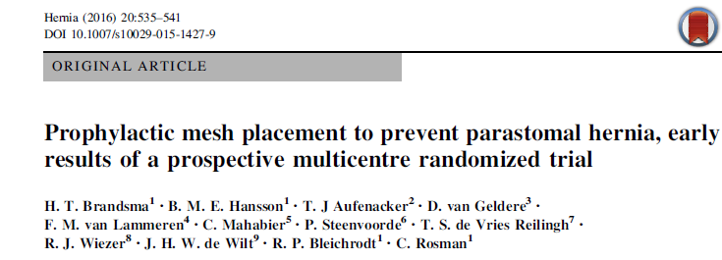
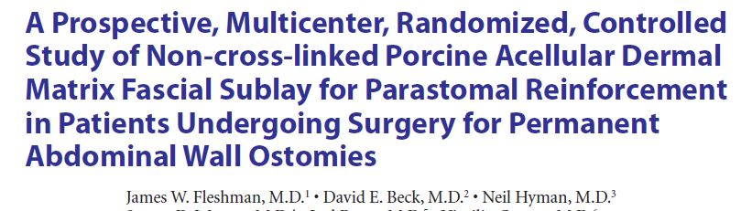
Open surgery, retromuscular mesh
Open surgery, retromuscular mesh

Slide 9
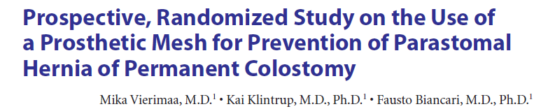
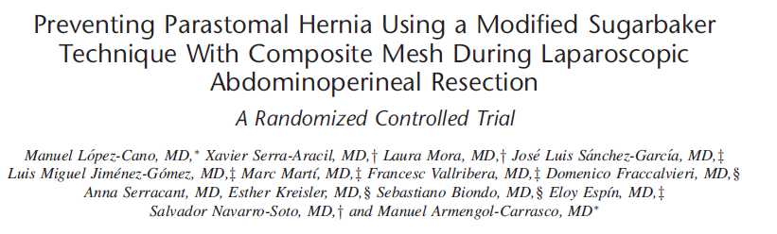
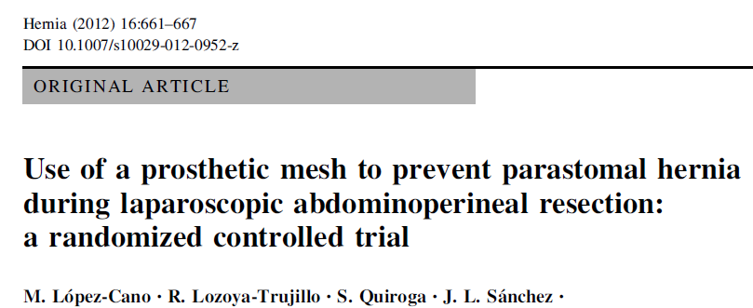
Keyhole
Laparoscopic surgery
Keyhole

Slide 10
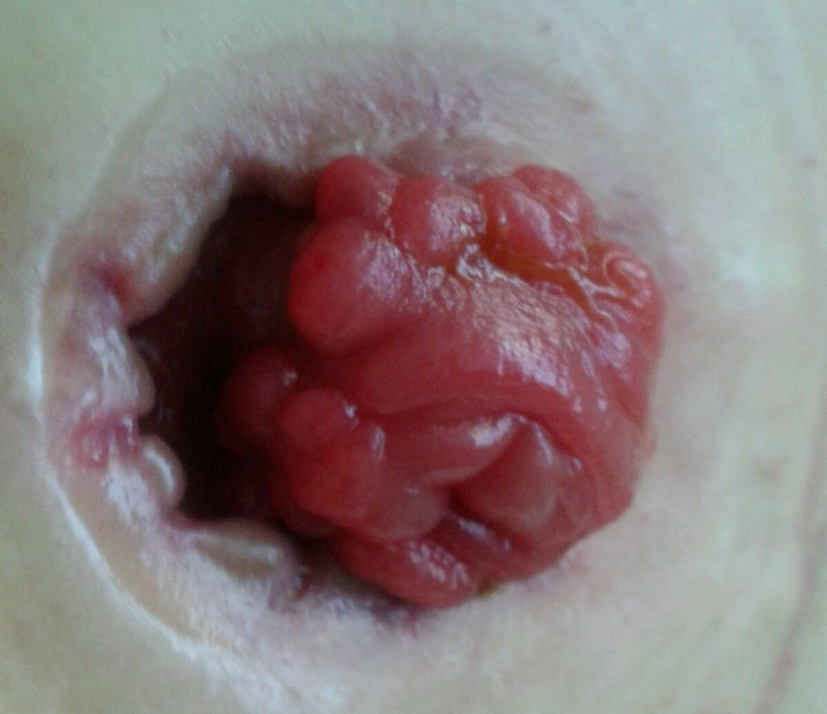
RCT prevention
Conclusions
  Prophylactic meshes reduce parastomal hernia incidence
  No increase stoma-related complications

Slide 11
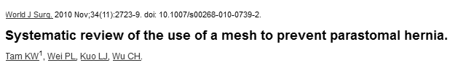
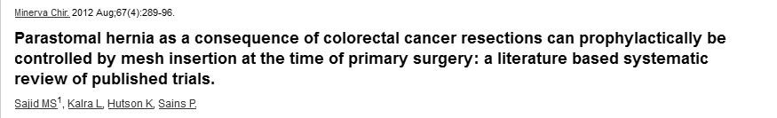

Slide 12
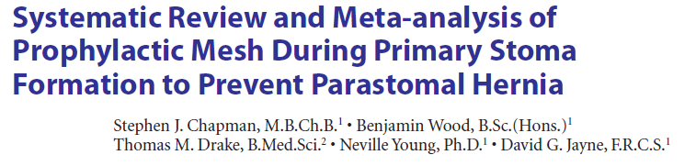
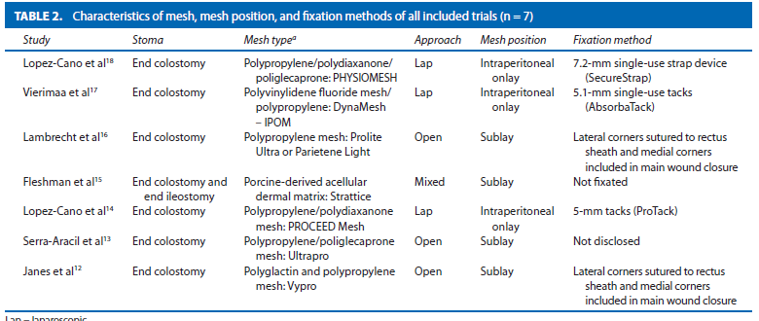

Slide 13
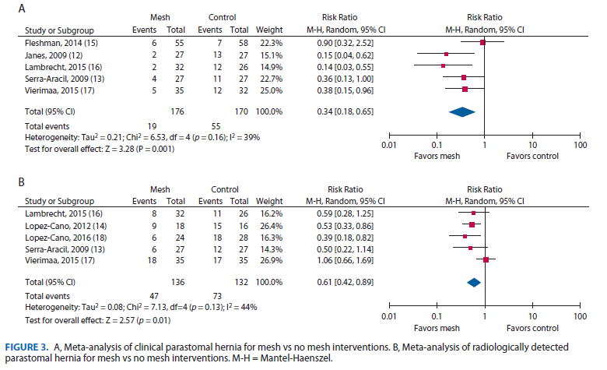

Clinical PH
Radiological PH

Slide 14
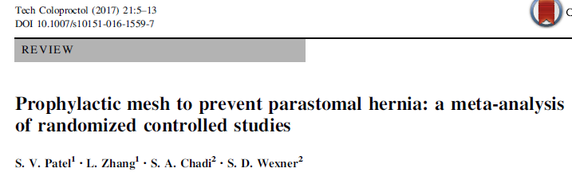
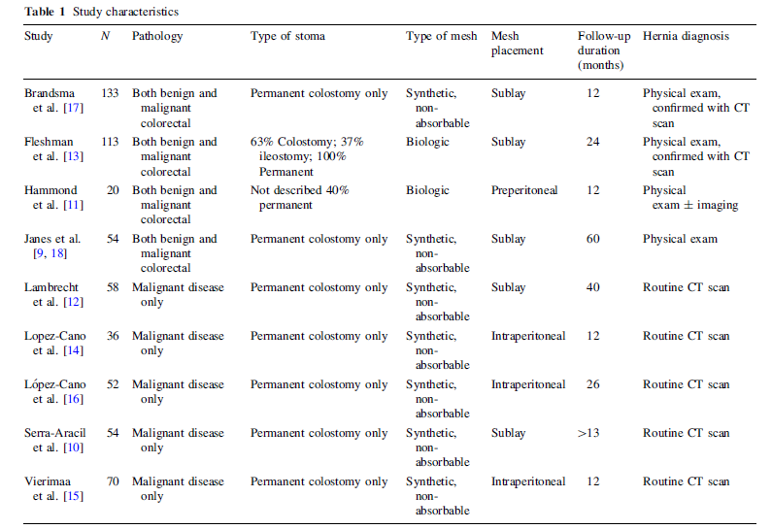

Slide 15
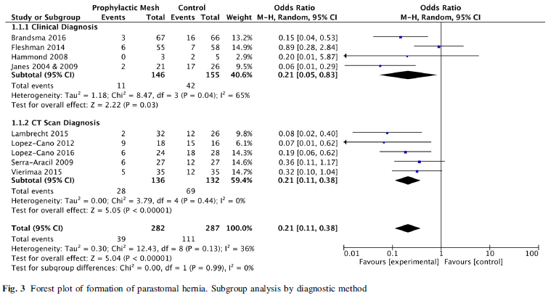

Slide 16
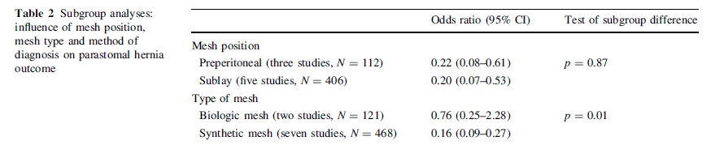
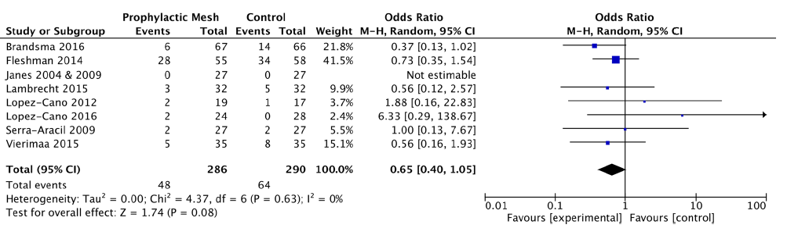
Stoma-related complications

Slide 17
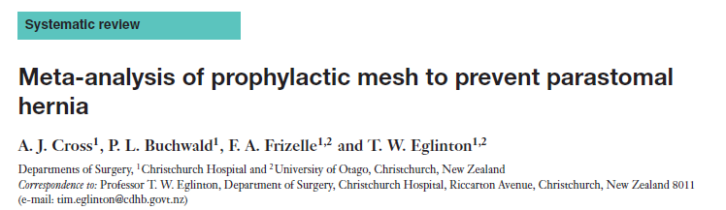

Slide 18
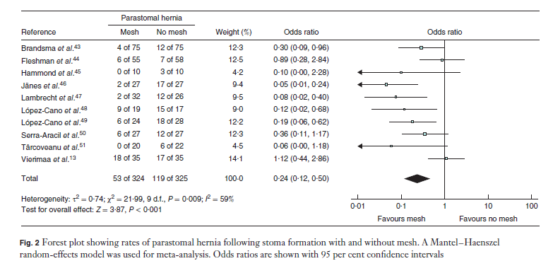

Slide 19
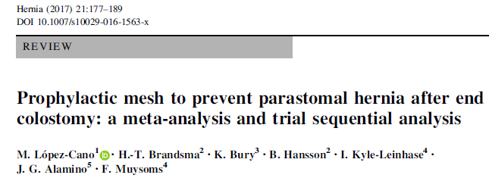
Author /year | Localization | Type of mesh | Type of surgery | Result
Jänes 2009 | Retromuscular | Polypropylene | Open | Clinic PH
Serra-Aracil 2009 | Retromuscular | Polypropylene | Open | Clinic H/CT
López-Cano 2012 | Intraperitoneal | Proceed (keyhole) | Laparoscopic | PH CT
Lambrecht 2015 | Retromuscular | Polypropylene | Open | Clinic PH/CT
Vierimaa 2015 | Intraperitoneal | PVDF | Laparoscopic | Clinic PH/CT
Brandsma 2016 | Retromuscular | Polipropileno | Open | Wound infection/PH
López- Cano 2016 | Intraperitoneal | Physiomesh (Sugarbaker) | Laparoscopic | PH CT

Slide 20
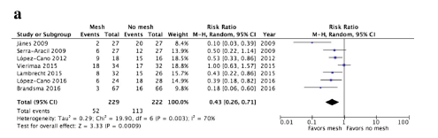
Clinical diagnosis of PH and/or CT
57% reduction of PH incidence

Slide 21
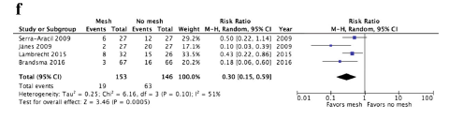
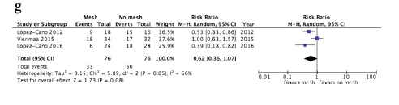
Retromuscular position
Intraperitoneal position

Slide 22
Trial sequential analysis (TSA)
RIS (required information size)
  estimation: type I and II error, nº events in controls, size effect (Relative risk reduction) and heterogeneity
  AIS (accrued information size)= 451, 187% RIS estimation (RRR 57%)=241

Slide 23
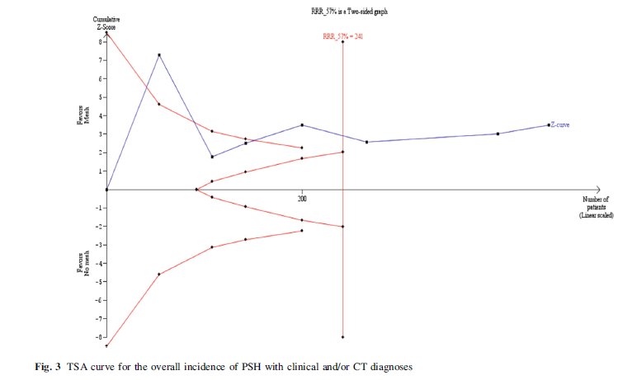
Trial sequential analysis
  AIS= 451 (187%)
  RIS (RRR 57%)=241

Slide 25
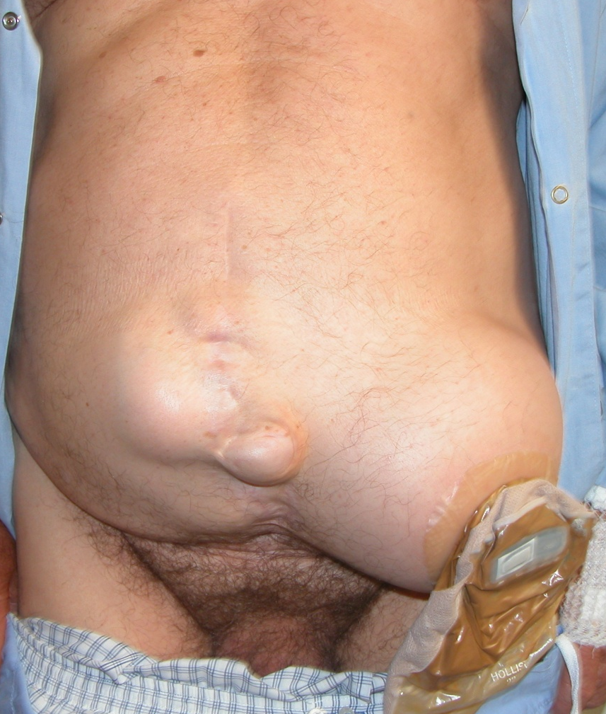
Conclusions
Prophylactic mesh prevents parastomal hernia
  End colostomy
  Open surgery
  Retromuscular mesh
No conclusions in:
  Laparoscopic surgery with intraperitoneal mesh
  Other stomas

Slide 26


Slide 27
Hernias after temporary stoma closure
Underdiagnosed problem
1 /3 patients clinical diagnosis
50% radiological diagnosis
No consensus about closure method
  Only evidence in skin closure

Slide 29

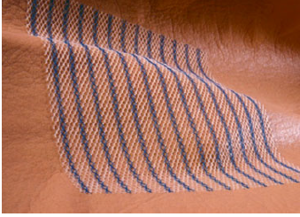
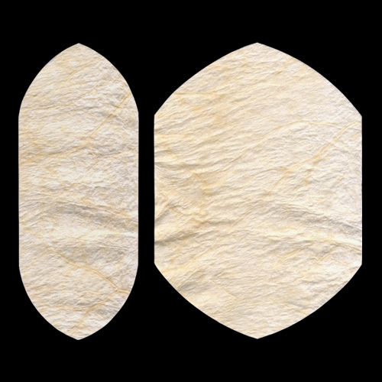

Prophylactic meshes
¿What mesh?
  Biological
  Synthetic
  Absorbable
  Permanent
¿What position?
  Intraperitoneal
  Retromuscular
  Supraaponeurotic

Slide 30
Systematic review (IHP 2015)
194 patients (4 studies)
  94 prophylactic mesh 4% incisional hernia
  100 without mesh 18%
  No differences in wound infection
  No mesh-related complications
Reduce risk of incisional hernia

Slide 31
Retrospective
83 patients (47 with mesh)
Supraaponeurotic polypropylene mesh as reinforcement
Median follow-up 18 months
IH with mesh 6.4% /without mesh 36.1%

Slide 32
Intervention:
  Biological mesh not cross-linking
  Intraperitoneal
  Aponeurosis closure
Control:
  Traditional closure, except use of absorbable suture (Vicryl)

Slide 33
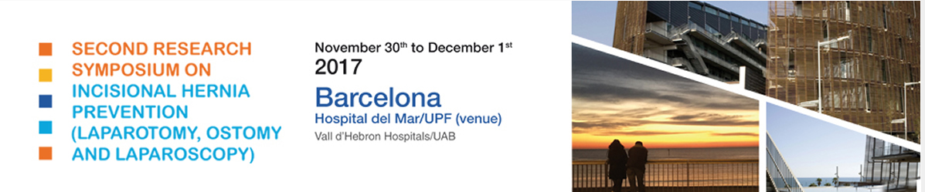
Feasibility study (90 patients)
  No problems
Final sample: 790 pacientes
Finished 2017

Slide 34
30 cases/64 controls
  Retromuscular biological mesh
Follow-up at one year:
  IH with mesh 3%
  In without mesh 16%

Slide 35
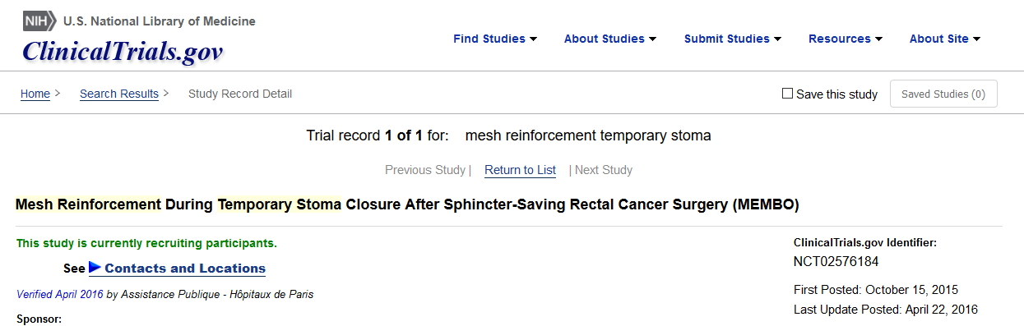
Randomization 3 groups
Without mesh/biological mesh/ synthetic mesh
Results in 2018

Slide 36
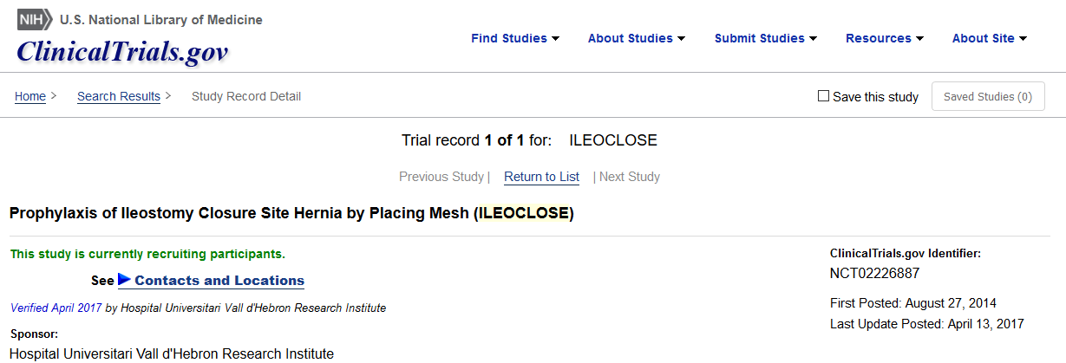
2 groups:
PDS 4:1 closure
PDS 4:1 closure + sandwich mesh

Slide 37
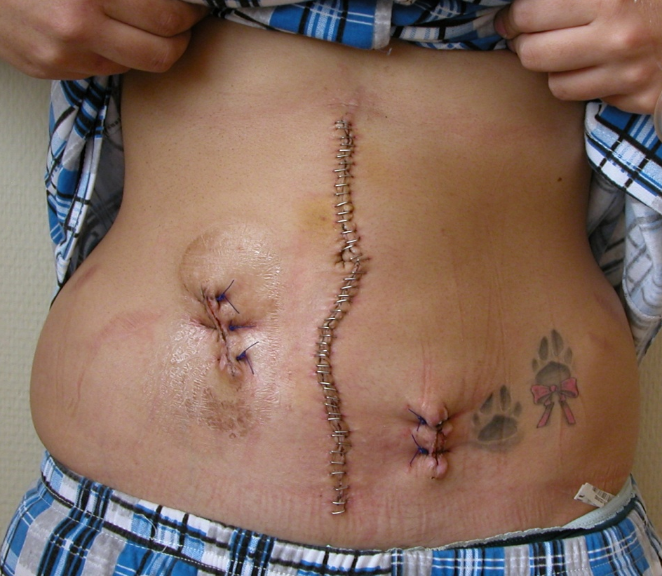
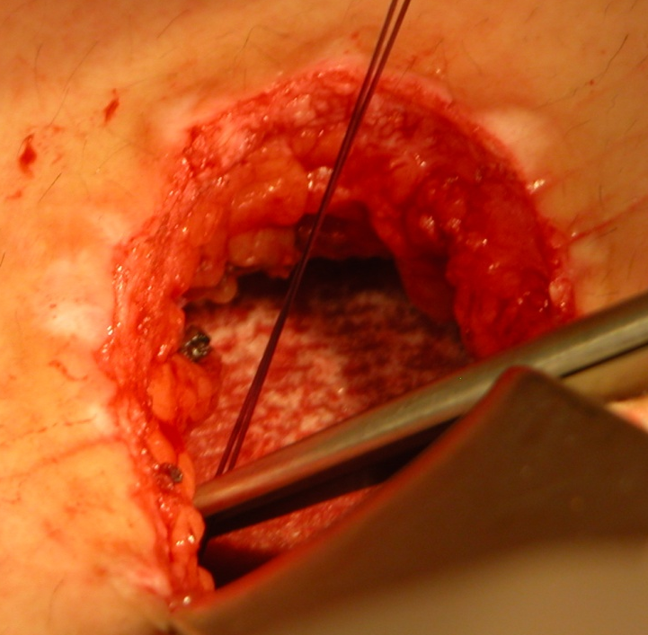
Conclusions
Prophylactic mesh probably reduces incisional hernia
Ongoing studies, waiting for results

Slide 38


